Slide 1
No outsiders
Week 7
The Equality Act

Slide 2
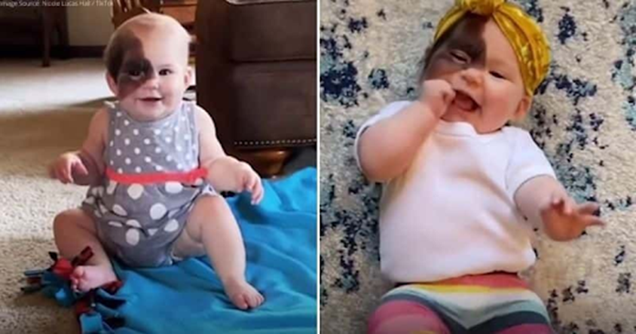
Winry Hall is a happy, healthy, confident 13 month old baby who is a bundle of joy, always laughing.
Winry was born with a birthmark on her face so she looks different to other babies.
Winry's mother is using social media to reimagine beauty standards and show her baby that she is beautiful.

Slide 3
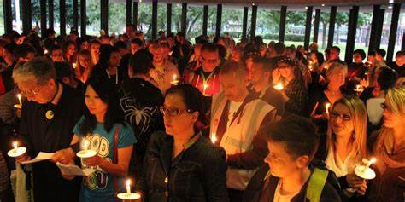
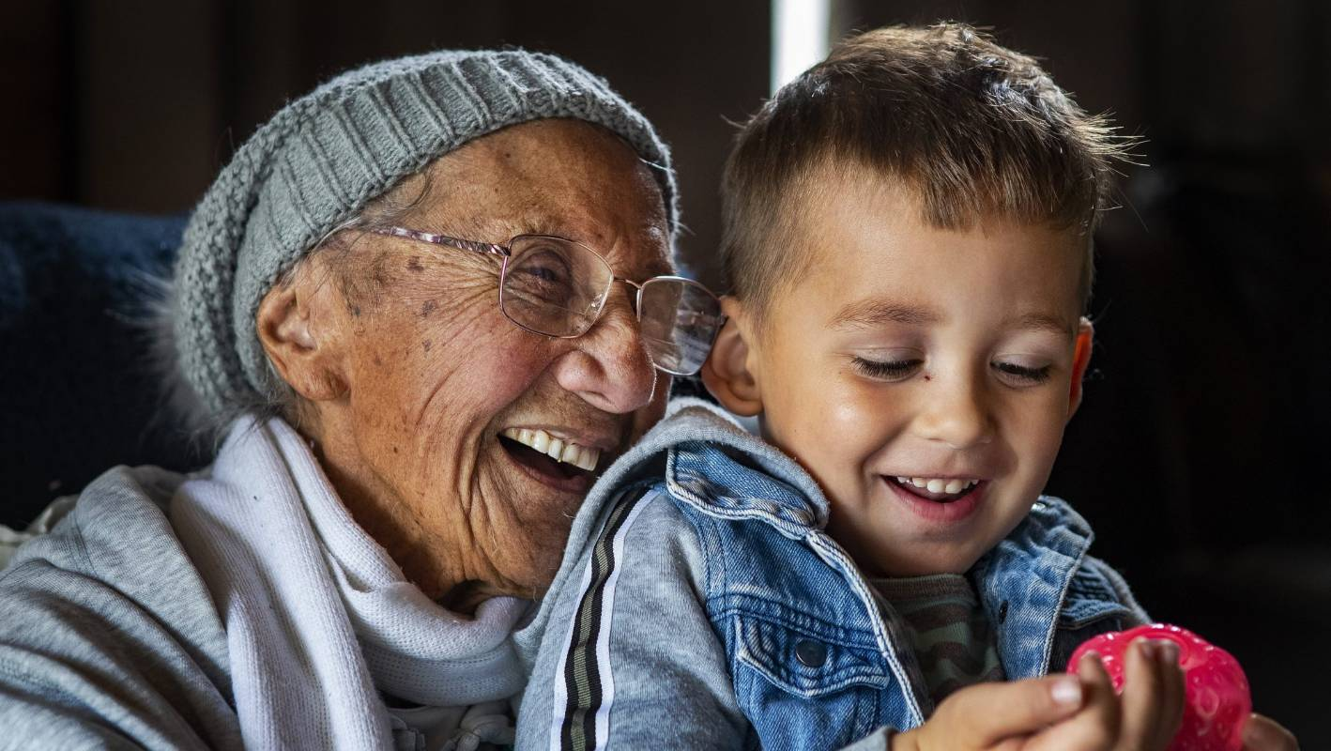
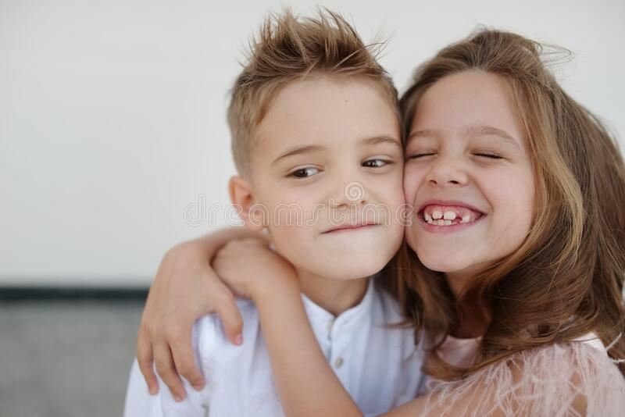
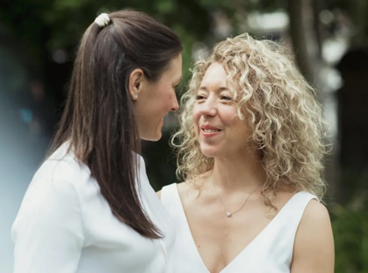
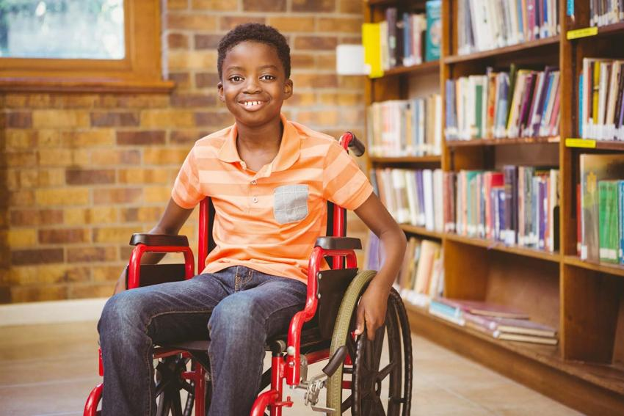
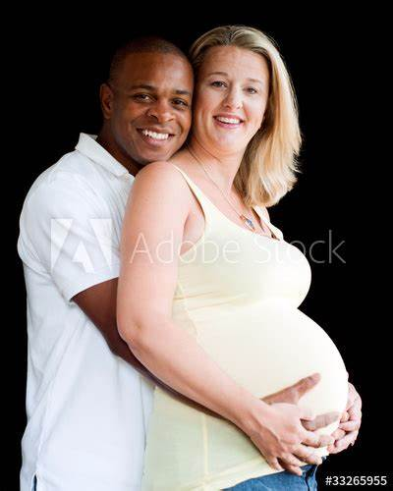
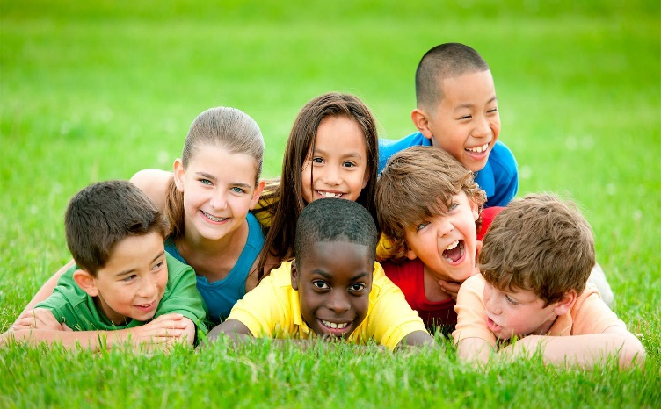
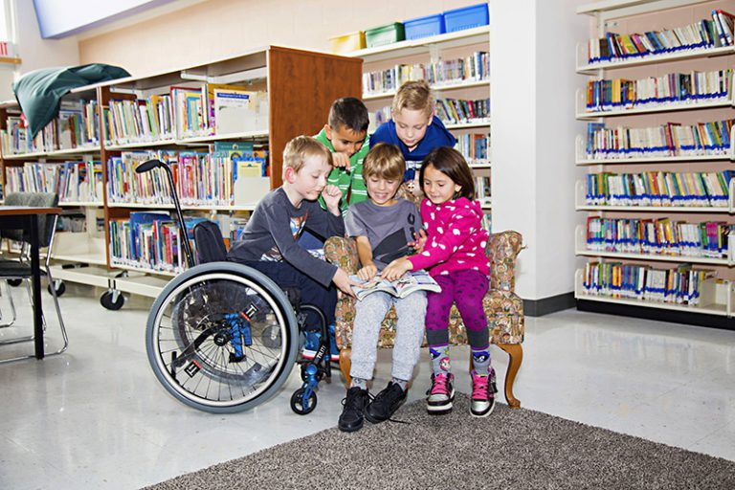
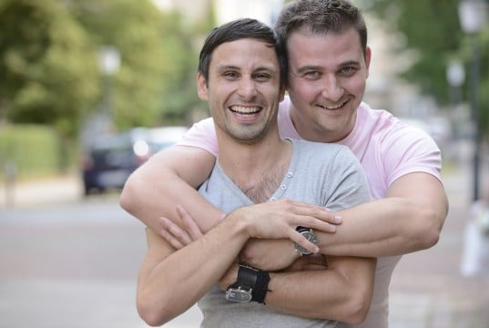
Light your candle
Over the last 7 weeks we have looked at “No outsiders”. In our school we will not discriminate against others. Think how you can make this happen as you look at the pictures.

Slide 4
Mum says, "For a lot of people, this is the first time seeing a birth mark like hers and that's part of why I enjoy sharing.
This is a good conversation: to see children who have differences, or for those parents who do have a kid that looks like Winry or has any kind of birthmark, to see their child represented.“
Mum says being different can be a child's superpower.
As Winry grows older, she will have to be careful to use sunscreen and wear hats to protect her skin, but Mum says her biggest worry is bullying at school, and experiences she might have in her childhood.

Slide 5

what do you see in the picture, what do you think this story is about?
- what is a birth mark?
- who decides what is beautiful and not beautiful in society? How do we get these messages?
- Mum's bigger worry is bullying by other children - why?
- where does bullying come from? should Mum be worried about bullying? If Winry came to our school, would that be a problem?
- There is a video in the link were we can see Winry has a doll that looks like her - why do you think that is important for Winry?

Slide 6
Winry’s mum goes on to say…….
"A lot of the problem can arise from ignorance and not having seen this before. Before I had her in my arms, I had not seen a birthmark like this either. It doesn't upset me that others haven't seen it but I just wish that was different. I really feel like the more you see differences the more normalised they will be." That is why sharing photos and videos on social media is a positive thing.
Since sharing photos of Winry, Mum has met many other people with birthmarks who she says radiate positivity which is heart warming and has given her support. Mum says 20 years from now she just wants Winry to be doing whatever makes her happy as she can do whatever she sets her heart on.

Slide 7
When we relate this back to the Bible we are going to use a passage written in John Chapter 3 verse 16
All people are morally equal before the throne of God facing the law and His mercy. We all have equal responsibility to use what we have to the glory of God.
Every human being is the object of the love of God (John 3:16)

Slide 8
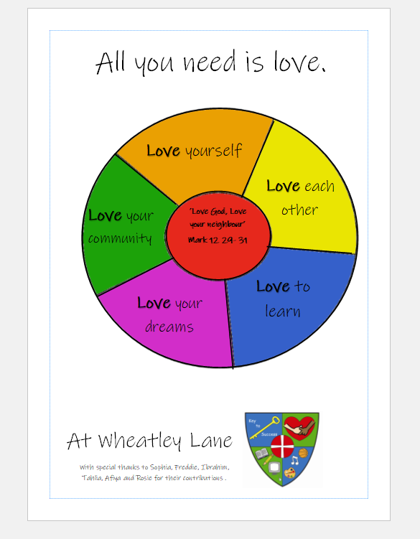
We think in particular this week about our love charter and how all the themes learnt about over the last 7 weeks are part of our love charter.
In particular - love yourself, love each other, love your neighbour, love your community.
By doing this you are respecting the PROTECTED CHARACTERISTICS and making sure there are NO OUTSIDERS.

Slide 9
In our school
https://www.bbc.co.uk/teach/school-radio/primary-school-songs-our-school/z3f84xs

