Slide 1
No Outsiders
Week 6
Being proud to be me – equality and inclusion for all

Slide 2
Watch the video - these are children of different ages trying to explain ‘difference’ and ‘the same’
https://www.youtube.com/watch?v=tPNfHSfQgxU

Slide 3
Have a think about the differences between yourself and others in class.
Can you list them?

Slide 4

Does being different have to be a negative thing?
What do you think?

Slide 5
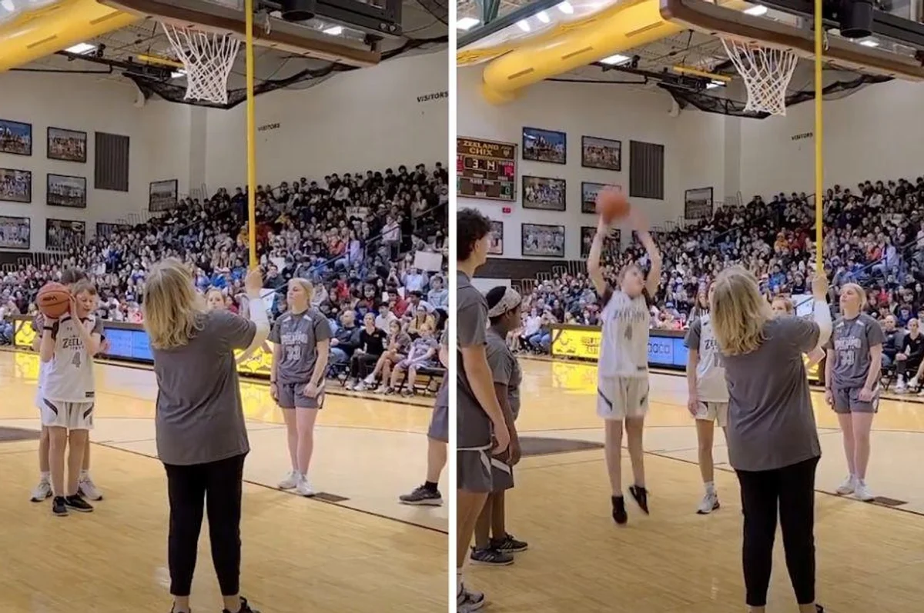
Have a look at this photo – what do you think is happening?
This is Jules Hogland who is taking a basketball shot at a High School game.
But something is different to a usual game….. Have a think what this could be.

Slide 6
Jules is blind. His differences have been celebrated and he has been included just the same as his teammates.
Watch the video to see how his teammates enabled Jules to play with them.
https://www.upworthy.com/blind-basketball-player-crowd-hush?rebelltitem=1#rebelltitem1

Slide 7
To make sure the game was accessible for Jules, a fellow player tapped the hoop with a long stick. Another player positioned James and then the crowd remained silent for the shot. The crowd are absolutely silent as the shot is taken and then they erupt when it goes in.
Not only was it a great shot, it was an example of what support and inclusion can look like from a school and a community.
The goal is not for those without disabilities to "help" those with, rather, it's a way to empower everyone to have fun together. Teammates work together to play their personal and collective best for the good of the team."

Slide 8

What do you think?
- what are the challenges for a player who is blind?
- Why do the crowd go silent in the video?
- what does 'collective best' mean?
- What can we learn from Jules?
- What can we learn from the crowd?
- Why is this about No Outsiders

Slide 9

This is just one example where difference isn’t a negative thing.
It is something to be celebrated.
Can you think of any other examples where difference has been a positive or where it has meant including others because of their difference?

Slide 10
Let us think about our uniqueness and our relationship with God.
This one is easy.
God made us – Genesis 3.
God made us special.
God made us unique.
https://www.youtube.com/watch?v=Zc63hfrrea4

