Slide 1
No outsiders
Week 5
Gender

Slide 2

Light your candle
May God’s blessing be upon you now.
https://youtu.be/awNZXC7N9WM

Slide 3
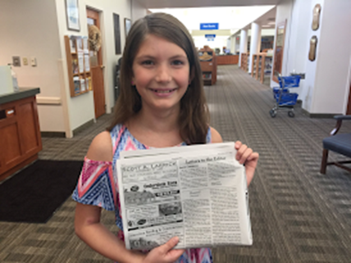
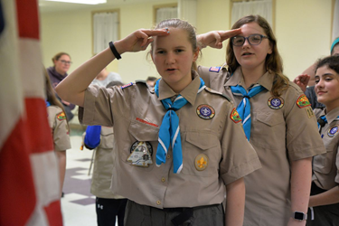
A 12 year old girl wrote a letter to the editor of her local newspaper about a remark make by an announcer at a scout parade.
Julianne Speyer was marching with the Chesterland, Ohio Girl Scouts as part of a 4th July parade. Julianne's troop were marching behind the Chesterland Boy Scouts and as they passed the announcer, he remarked over the loud speakers that the boys were, "future leaders of America" while the girls were, "Just having fun."

Slide 4

What do you think about what was said?

Slide 5
Julianne was offended by these remarks and decided to remind people that girls can be whatever they wanted to be. She wrote an open letter to the editor of her local newspaper, which quickly went viral:
"My name is Julianne Speyer. I am 12 years old and I would like to inform you of how offended and disappointed I am by the announcer of the Chesterland's 4th July parade's comment about the Girl Scouts and Boy Scouts. The announcer labelled the Boy Scouts as 'future leaders of America' and he said the Girl Scouts were "just having fun." I found this comment very sexist and patronising. I would appreciate it if you would help me to let other people know how much this kind of thing happens and how bad it is. I feel it is an insult to both girls and women of all ages. This kind of thing happens way too much and it's not OK at all.
I have always been taught that if you think something is unjust, change it. So this is how I am making a change. Thank you for listening to me and I hope you can help me."

Slide 6
Julianne's letter went viral across America yet there was no response from the announcer or parade organisers.
Eventually the parade organisers issue a statement in response to the letter:
"There was an unfortunate misunderstanding of two unrelated comments. The announcer is a volunteer and made an observation that participants were enjoying the parade, with no disrespect intended."
Julianne later commented, "You don't want to judge people based on their gender. Maybe, in the future if no-one beats me to the job, I'll be the first girl president. I could scream the message that girls can be anything they want to be. They can be in charge someday. We can be the leaders of America,"
Julianne received a letter from former Secretary of State, Hilary Clinton, praising Julianne for using her voice and speaking up; "Never forget that you are valuable, powerful and worthy of every opportunity to fulfil your potential."

Slide 7
-why do you think the letter went viral?
- why do you think the announcer never responded?
- Look at the response from the organisers; were the two comments unrelated? Is this a misunderstanding? Do you think there is anything missing from that response? (an apology?)
- what would a better response look like?
- "You don't want to judge people based on their sex" what does this mean?
- "Never forget that you are valuable, powerful and worthy of every opportunity to fulfil your potential." what does this mean?
- what can we learn from Julianne?
- Why is this about No Outsiders?

Slide 8
Let us think about one story in the Bible that tells us about gender.
The very first book of the Bible – tells us how men and women are equal – this is the first word of God – that is how important it is to say that there is equality between all.
The verse tells us that
‘man and woman are created equally in the image of God and together have control over the earth’ Genesis 1:26-27

Slide 9
God’s word is that each gender is equal. We should celebrate our differences but also our equality - in being able to do anything we want to do and be anything we want to be.
There are no outsiders.

Slide 10
Hymn – My Lighthouse https://youtu.be/OaW_4MWSE6I
God will be with you in all you do and wants you to be the best you can be.

