Slide 1
No Outsiders
Week 4
Religion and belief

Slide 2
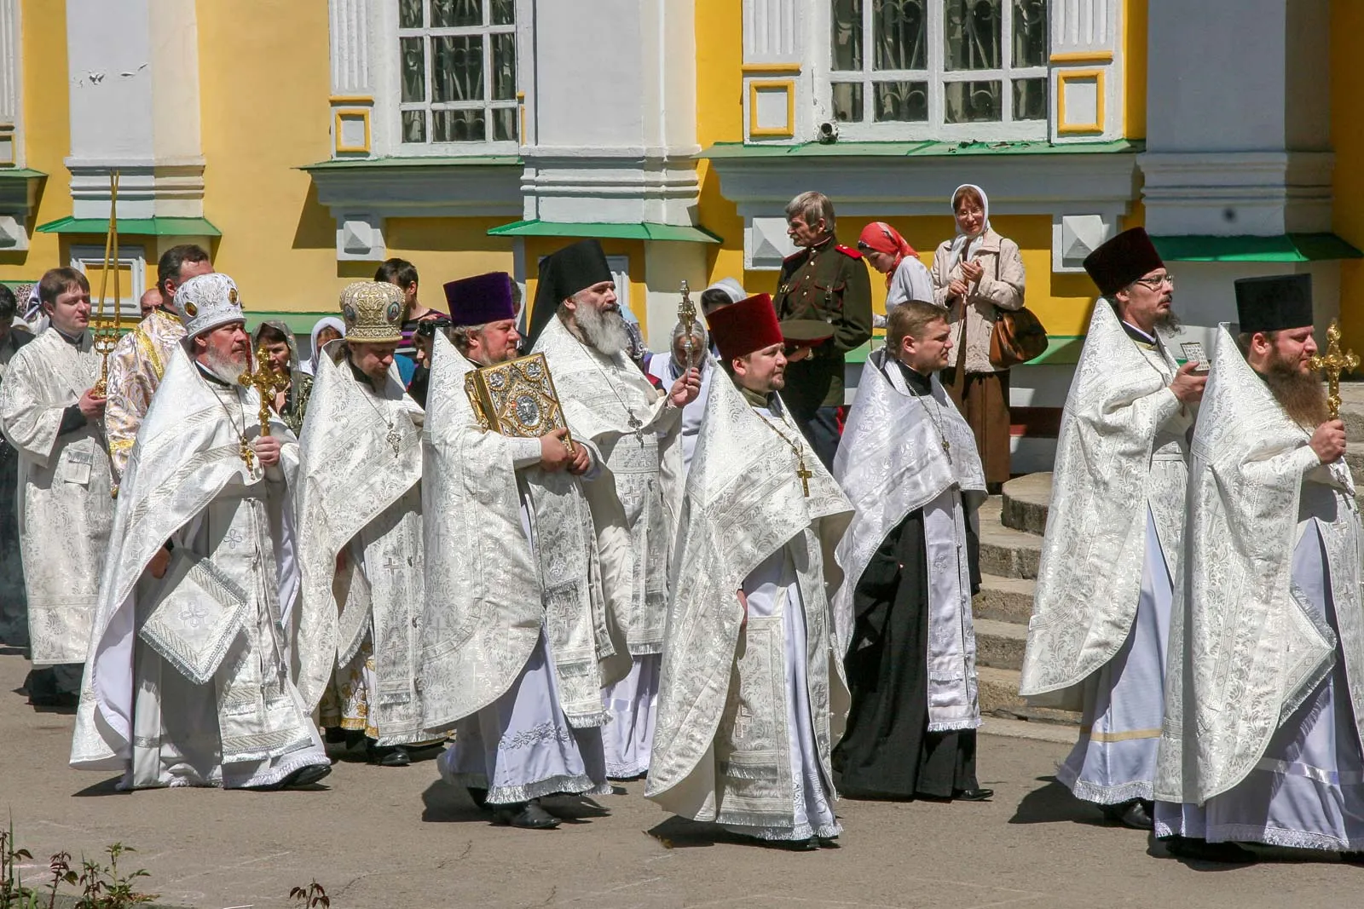
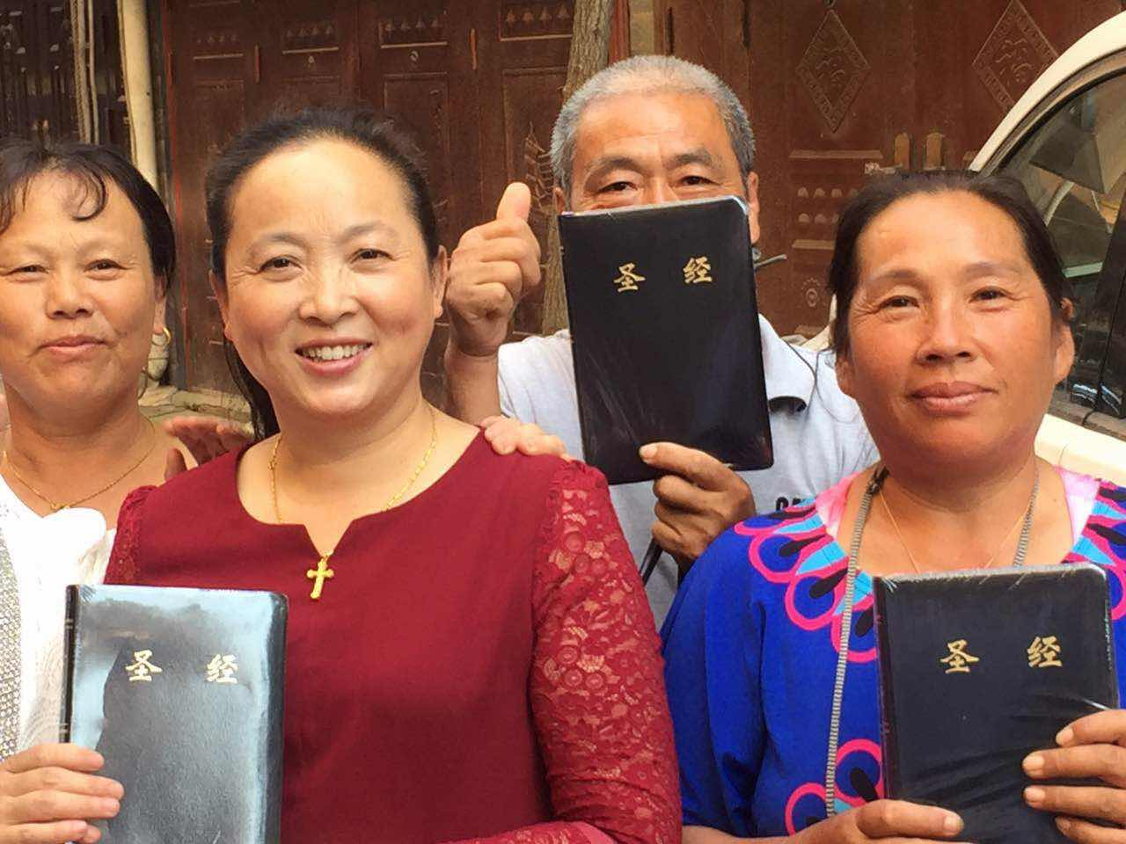
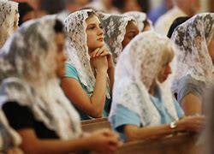
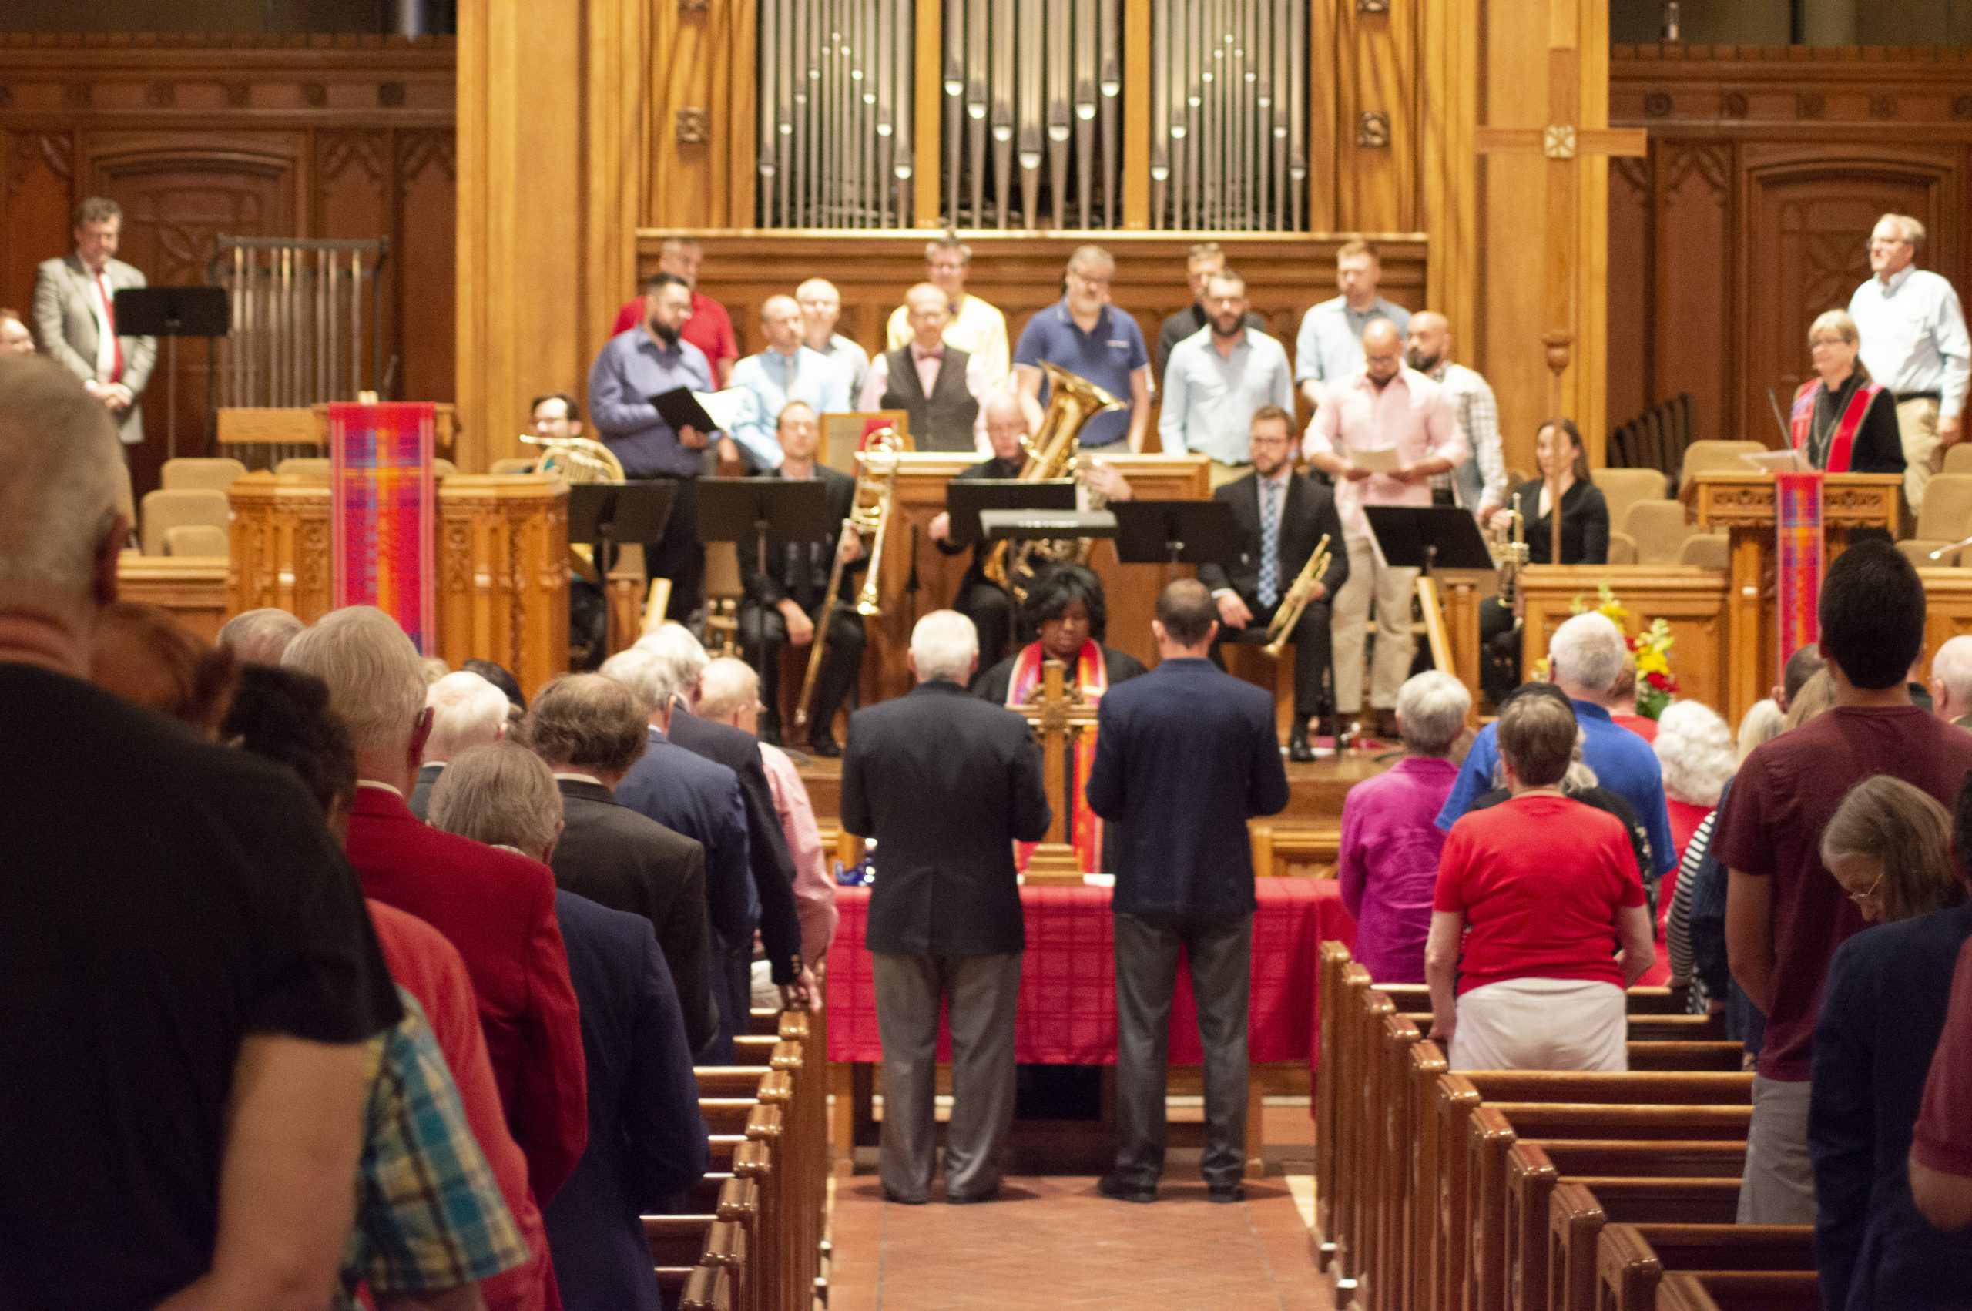
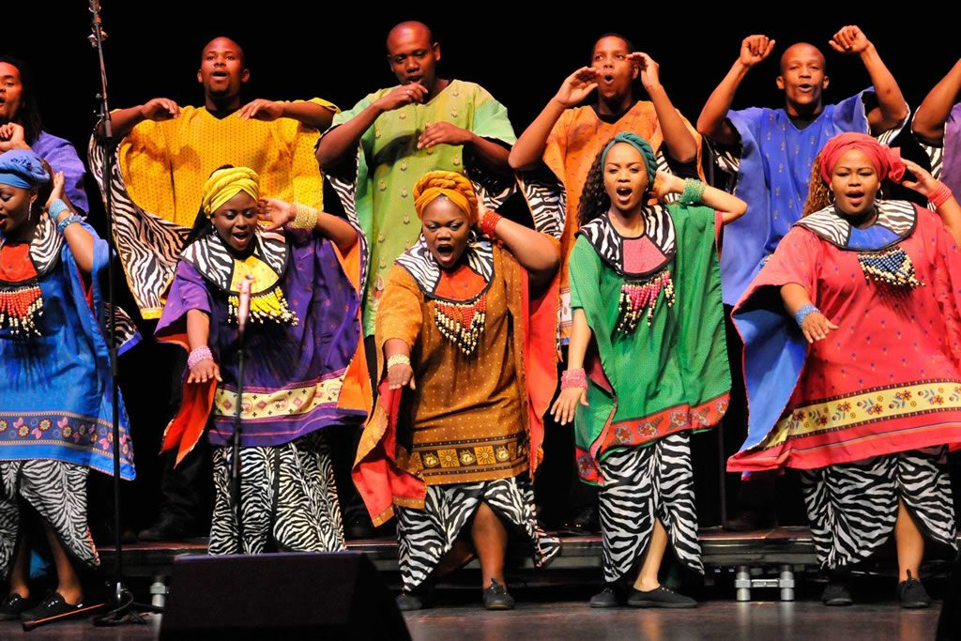
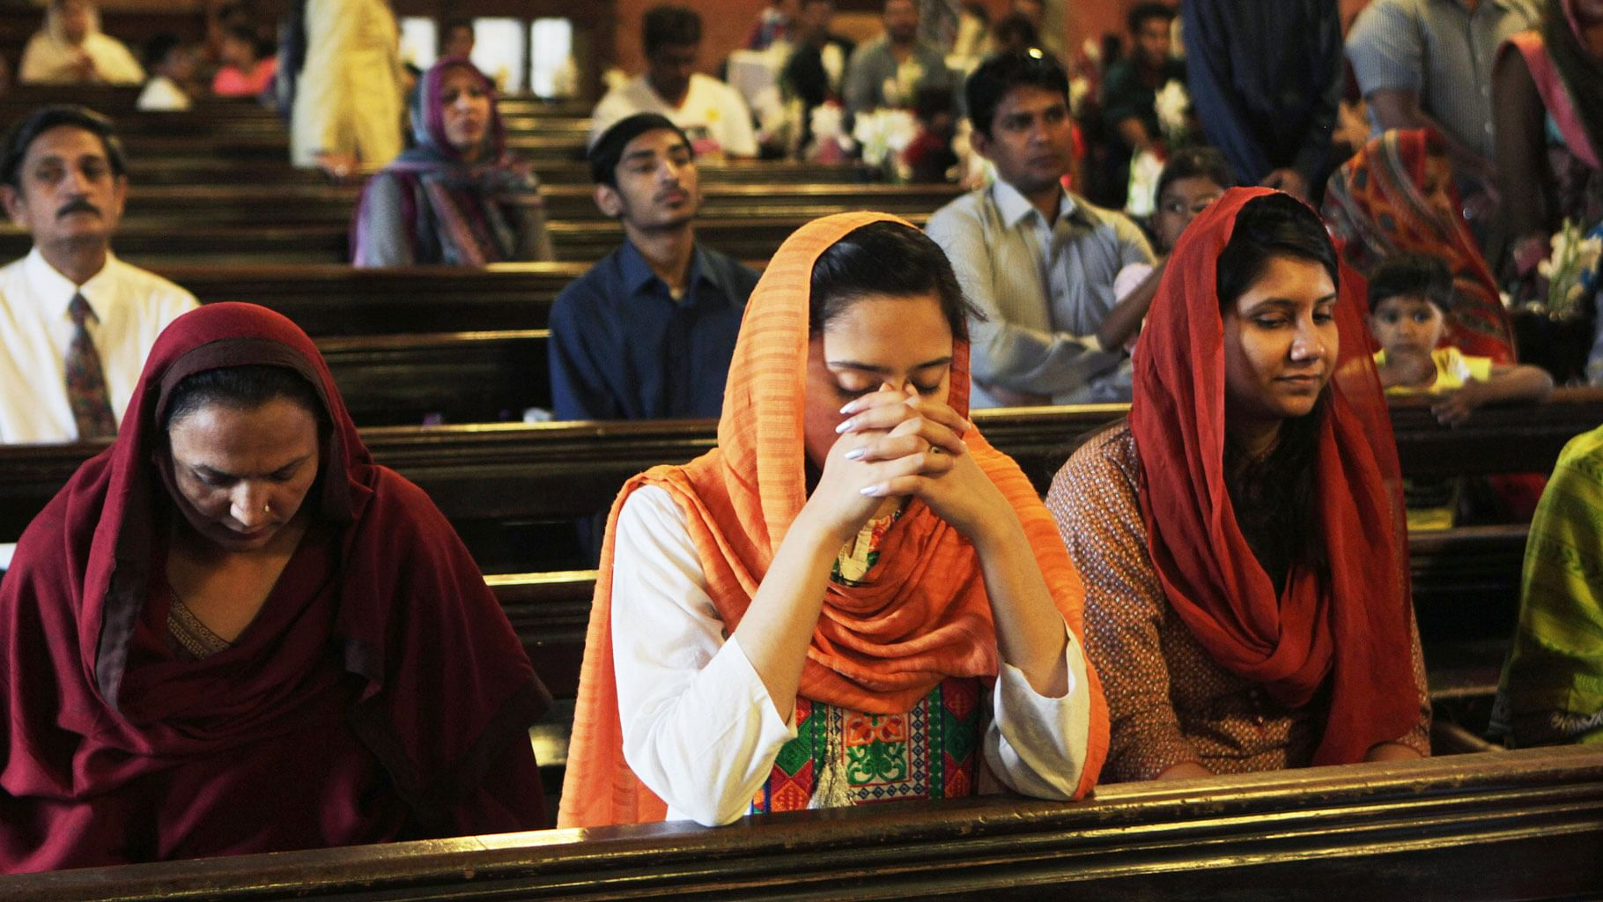
Light your candle as you light your candle look at these pictures. What do you think they have in common?

Slide 3
They are all Christian. Their cultures may be different but they all believe in Jesus,

Slide 4
Please share the book
‘Hats of Faith’
https://www.youtube.com/watch?v=WuGuZ-ASo_Q

Slide 5
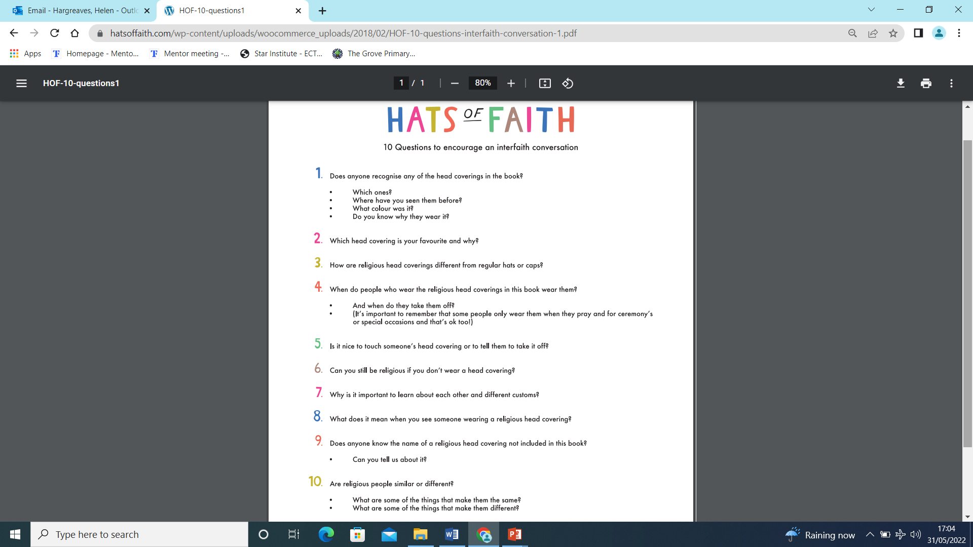

Slide 6

What do you think about Hats of Faith?

Slide 7
Hymn – today we listen to a Christian hymn in Urdu.
https://youtu.be/q9hr0QZjK-w

Slide 8
The book helps us to know about different faiths and cultures.
It celebrates head coverings from faiths including Christian, Jewish, Muslim, Rastafarian and Sikh.
It helps us to see how we can love and respect other people’s faiths because we know more about different customs.
This is part of No outsiders because we are learning about things that are beyond our own experiences.
We learn TOLERANCE AND CELEBRATE CULTURAL DIVERSITY.

Slide 9
Let us pray
God of all creation,
Help us to tolerant and understanding of people who do not share our beliefs.
Teach us to work alongside each other with patience to make our world a better place for all.
Amen

