Slide 1
No outsiders
Week 3
All are equal

Slide 2
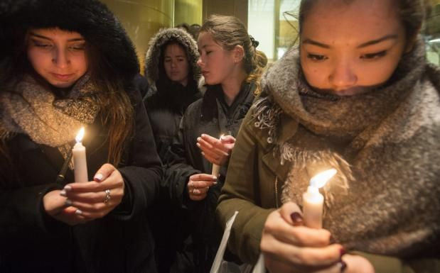
Light your candle

Slide 3
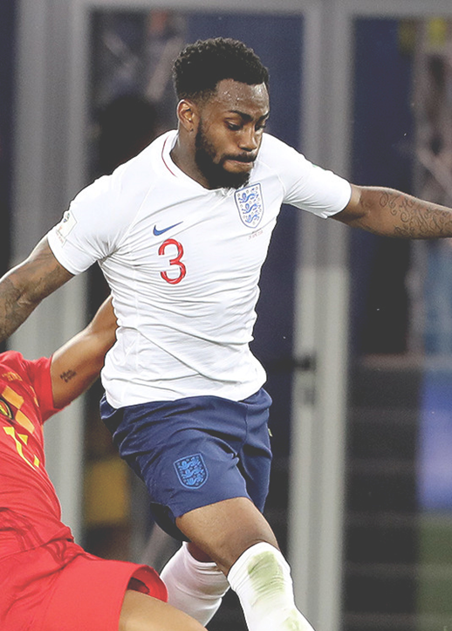
Racism in football has hit headlines time and time again. Several high-profile names have spoken out regarding racist abuse received by supporters and fans. England player Danny Rose was subjected to racist abuse during a game against Montenegro in March, 2019.
As a result of the racist abuse, Rose said he ‘can’t wait to see the back’ of football and many players, managers and fans have supported him and are arguing that racist, abusive behaviour should be severely punished.
Raheem Sterling, another England player, said that ‘if you walk off, they win’ but wasn't sure he alone could challenge racism in society by simply speaking out, adding that “It's something that happened before I was born and before my parents were born.”

Slide 4
What is your understanding of the word Racism?
What is race and racism?
Race can mean a person’s colour, nationality, ethnicity or citizenship.
It’s a protected characteristic in law under the Equality Act 2010¹ in England, Scotland and Wales, and the Race Relations Order 1997² in Northern Ireland. This means it’s illegal to discriminate against someone, or treat them differently, because of their race. It’s important to remember that someone’s ethnicity or national origin may not be the same as their current nationality.

Slide 5
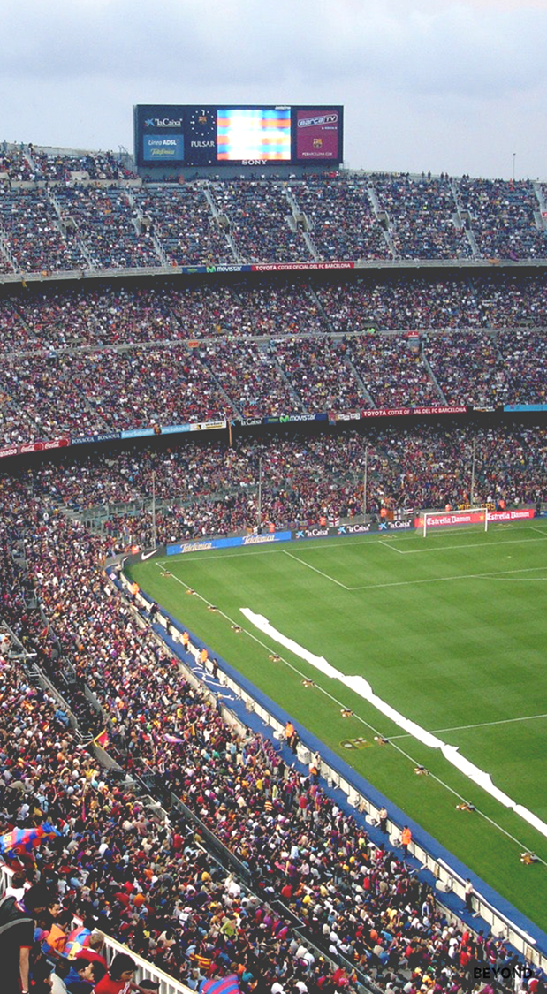
So football players – playing for their Club or National team – how do you think they feel when they receive abuse because of the colour of the skin?
What do you think should be done about it?
Some teams want a strict rules to stop racist abuse.

Slide 6
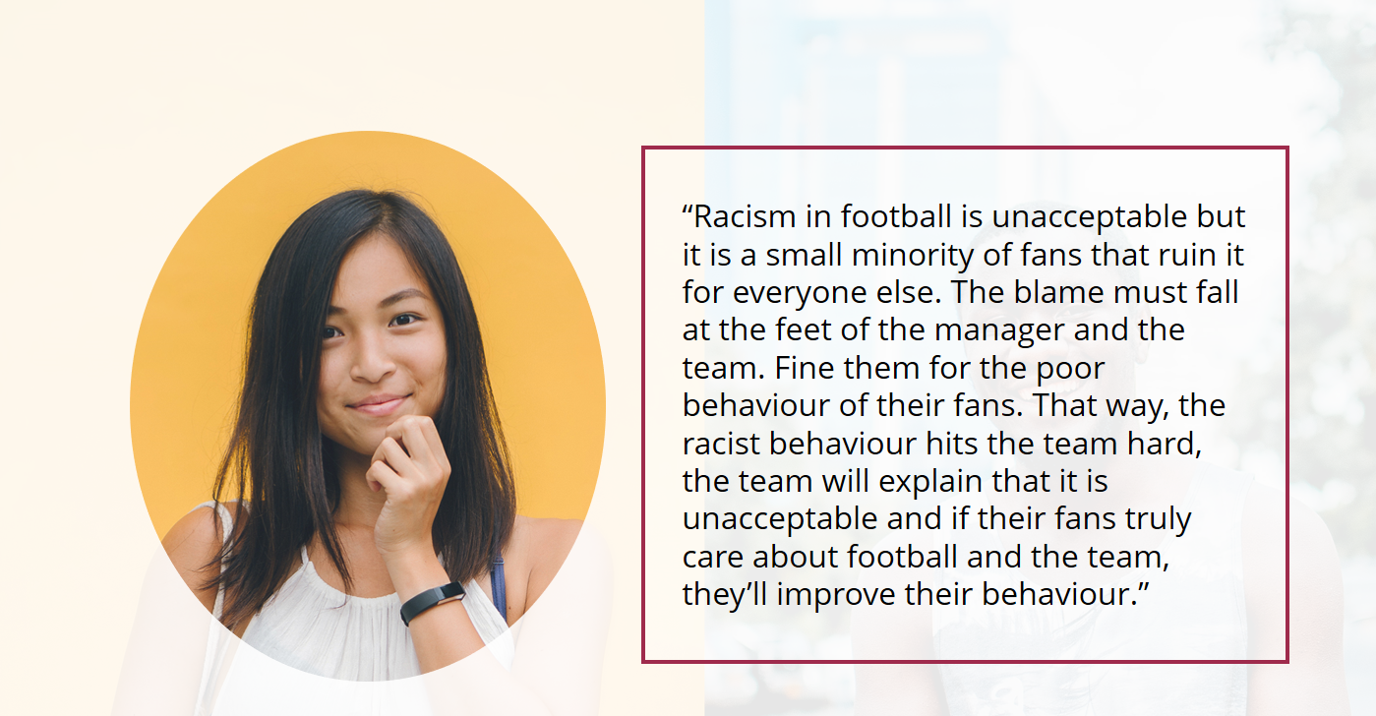

Slide 7
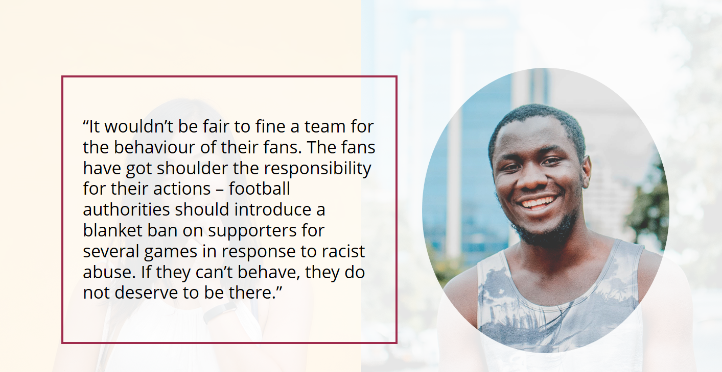

Slide 8

What do you think?

Slide 9
Song – I’d like to teach the world to sing
https://youtu.be/sbWRpNX75fc

Slide 10
Racism, isn’t just on the football field though, others can experience it.
What we can learn from these discussions…..
It helps us to see that footballers who get racist abuse and anyone who experiences racism is wrong and it is hurtful.
It can help explain that we aren’t all the same, that our school, community and the world is diverse and that is a good thing.
The world would be a very boring place if everyone was the same!
We can notice race and appreciate it.
We can encourage conversation, and it helps us to understand with people who are different and why we should celebrate our differences.
It helps us to see that footballers who get racist abuse is wrong.

Slide 11
Let us think about one story in the Bible that tells us about Race.
Watch the story and think – what is the important message about Race that Jesus wants us to learn from the story?
https://www.youtube.com/watch?v=osfQg4yKtq8
What can you learn about Race in this story?

Slide 12
Again, there are so many things to learn from this story, but here we can learn that Race was of no importance to the Good Samaritan.
The Good Samaritan knew the man who had been attacked and needed help – it was just about being a good neighbour, a good friend and showing compassion.
The Good Samaritan was showing the man he was no outsider.

Slide 13
Let us pray
Heavenly Father,
We are sorry for the times we have not treated others fairly.
Help us to understand that racism of any kind is unacceptable.
Teach us how to break down barriers and celebrate difference.
Amen

