Slide 1
No Outsiders
Week 1
Family

Slide 2
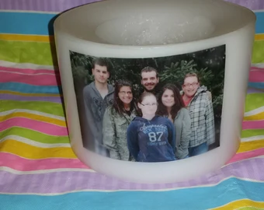
Light your candle
Let there be love shared among us.
https://youtu.be/vZYQZPHABY8

Slide 3
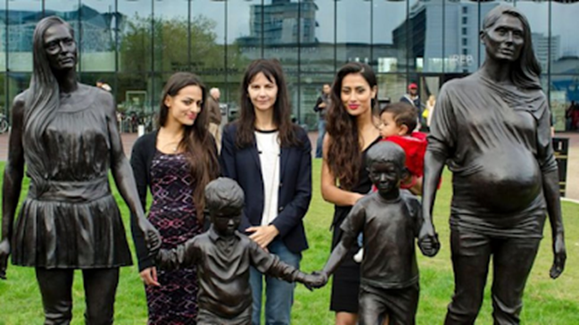
The photo shows a statue in Birmingham City Centre called, "A real Birmingham family.“
Can you describe your family?
Can you describe what family is?
Wo do you think the people are in the

Slide 4

The people standing in photo are the family used for the statue and the sculptor, Gillian Wearing, who stands in the middle.
The two woman depicted in the photo are sisters, Roma and Emma Jones and their children, Kyan and Shaye.
Gillian said she wanted to show that the idea of what makes a family isn't fixed. She liked how the sisters spoke of their closeness and how they supported each other.

Slide 5

But not everyone agreed that this showed a real family.
Some argued that the statue did not represent a typical family and there should be a dad; "It doesn't portray a family as it should be," said Angela.
On social media many people praised the statue but some argued it was not representative of Birmingham:
"Why is there 2 women? There should be a mum and a dad and two kids. It's a confusing sculpture in my opinion."
"Would be nice to see other representations, maybe with a father? Bit demoralising for dads this one."

Slide 6
What do you think?

Slide 7
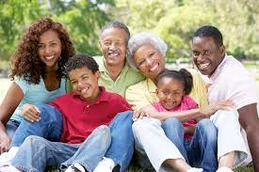
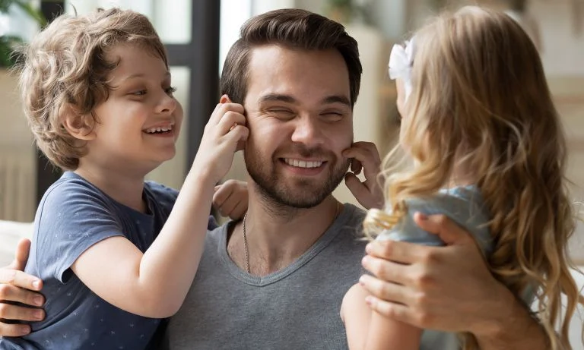
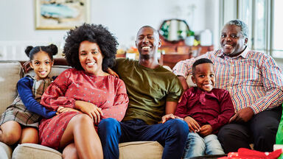
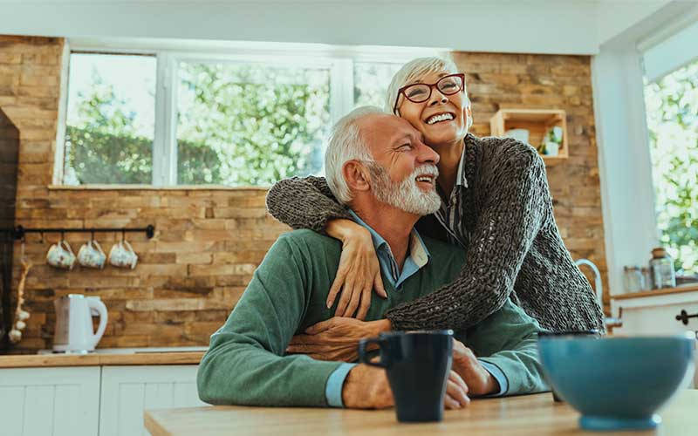
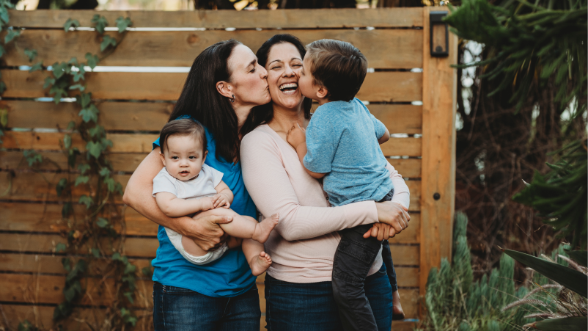
Have your opinions of what a family is changed from the discussion at the start of the worship?
Some people said this on social media
A family can be a anyone, it's who you love and look after and cherish that matters, whether that be Mum and Dad and children or 2 dads and children or just a loving couple with no children. Families come in all shapes and sizes, it's not one size fits all."

Slide 8

If you had to write something about ‘family’ in this speech bubble now what would you write?

Slide 9
Additional Questions:
Why do you think Birmingham City Centre wanted a statue that showed family?
The idea of ‘what makes a family’ isn’t fixed. What does that mean?
How might dad’s feel about the sculpture? Are dad’s represented elsewhere?
How would you feel if you weren’t represented in art of media?
What can we learn about this story?
Why is this part of the No outsiders programme?

Slide 10
Let us think about one story in the Bible that tells us about family.
Watch the story and think – what is the important message about family that Jesus wants us to learn from the story?
https://www.youtube.com/watch?v=DJgROx4wFKM
Why does Jesus tell this story?

Slide 11
There are lots of things Jesus is telling us through this parable – but in this context the focus should be love.
Even though the older son did wrong, his family is where he is safe and where he is loved. Where he is welcomed back and despite his choices, he was no outsider.

Slide 12

Let us pray

