Slide 1

Phonics at Wheatley Lane Primary School.
An informative presentation for parents to support phonics at home.

Slide 2
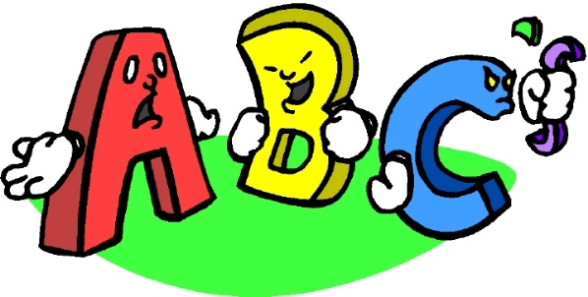
What is phonics?
Phonics is a way of teaching children how to read and write. It helps children hear, identify and use different sounds that distinguish one word from another in the English language
Written language can be compared to a code, so knowing the sounds of individual letters and how those letters sound when they’re combined will help children decode words as they read.
Understanding phonics will also help children know which letters to use when they are writing words.
Phonics involves matching the sounds of spoken English with individual letters or groups of letters. For example, the sound ’c’ can be spelled as c, k, ck or ch.

Slide 3
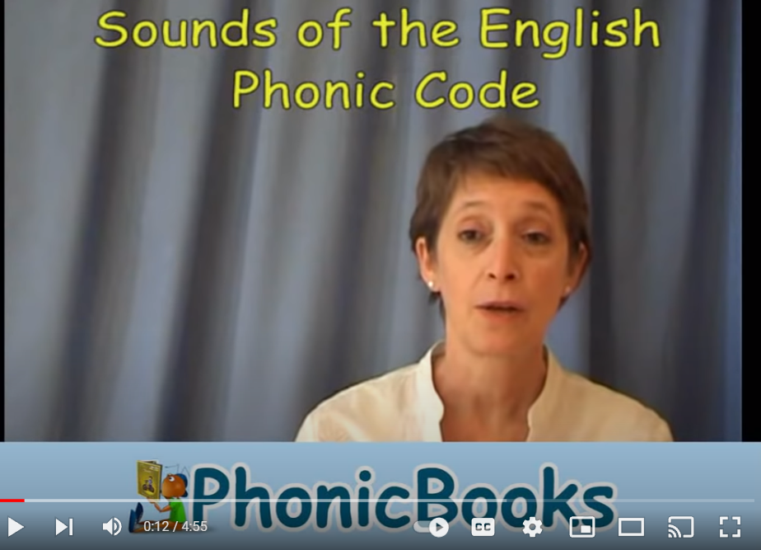
Pure speech sounds
Sounds of the English Phonic Code -Synthetic Phonics.wmv - YouTube
This video shows you how to pronounce the sounds. Notice how the lady in the video doesn’t add an ‘uh’ sound at the end, so she says: ‘t’ not ‘tuh’.

Slide 4
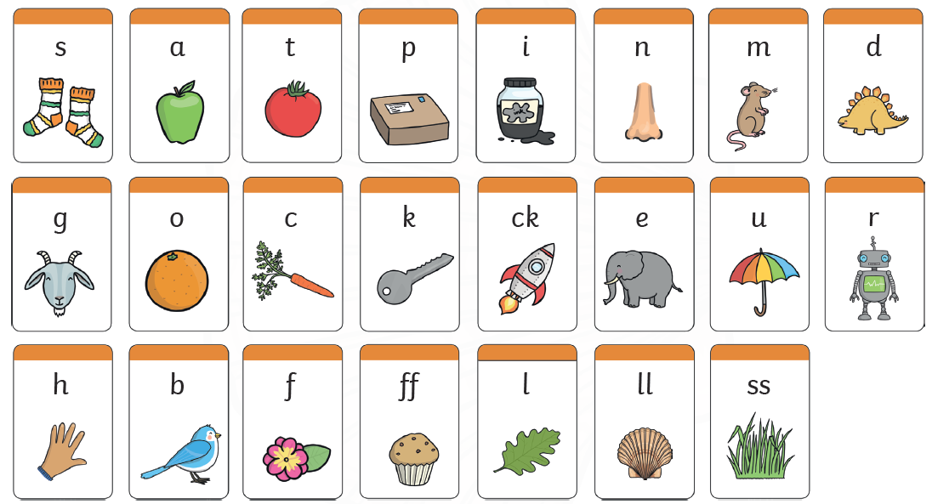
My turn, your turn.
Lets practice!

Slide 5
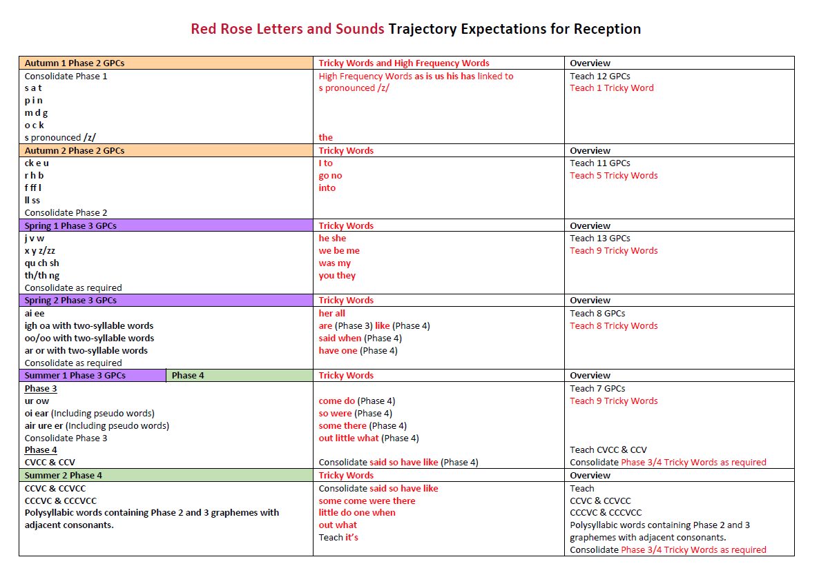
Red Rose Letters and sounds
We follow the scheme Red Rose Letters and Sounds.

Slide 6


Phoneme: The smallest unit of sound in a word.
a
Grapheme: The letter or letters that represent the phoneme.
or
Digraph: two letters that make the same sound.
igh
Trigraph: three letters that make the same sound.

Slide 7
Lets practice!
sh
or
igh
ee
oo
ai

Slide 8
Segmenting
Robot talking
Splitting the word up into individual sounds
p | a | t

Slide 9
Blending
Blending – putting sounds together to read words
Teaching children to blend the sounds of letters together helps them decode unfamiliar or unknown words by sounding them out. For example, when a child is taught the sounds for the letters t, p, a and s, they can start to build up the words: “tap”, “taps”, “pat”, “pats” and “sat”.
pat

Slide 10
Tricky words
Words that cannot be sounded out.
the
I
go
no

Slide 11
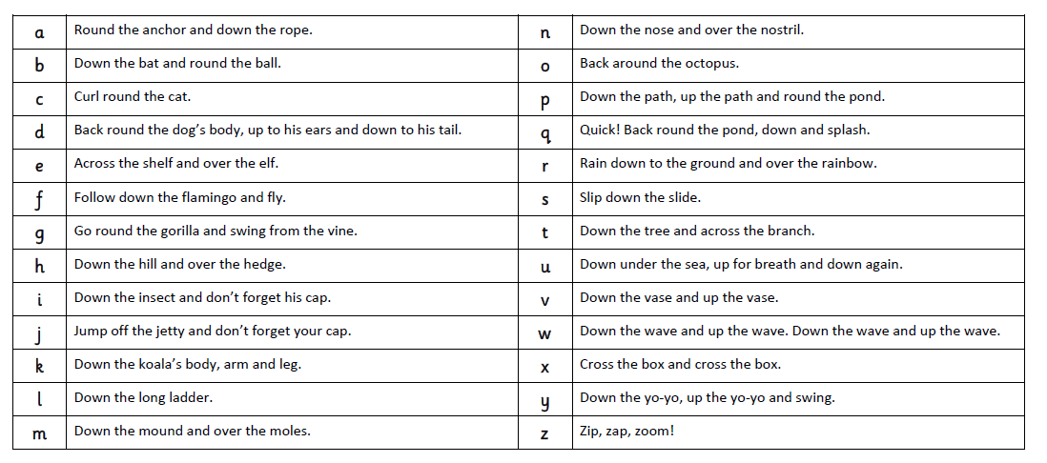
Every letter has a name
Every letter has a phoneme – sound
Every letter has a formation phrase

Slide 12
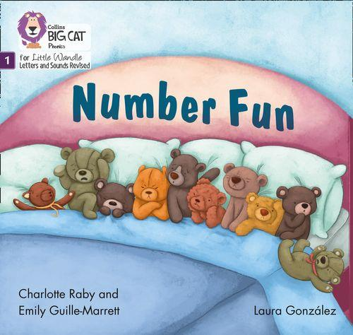
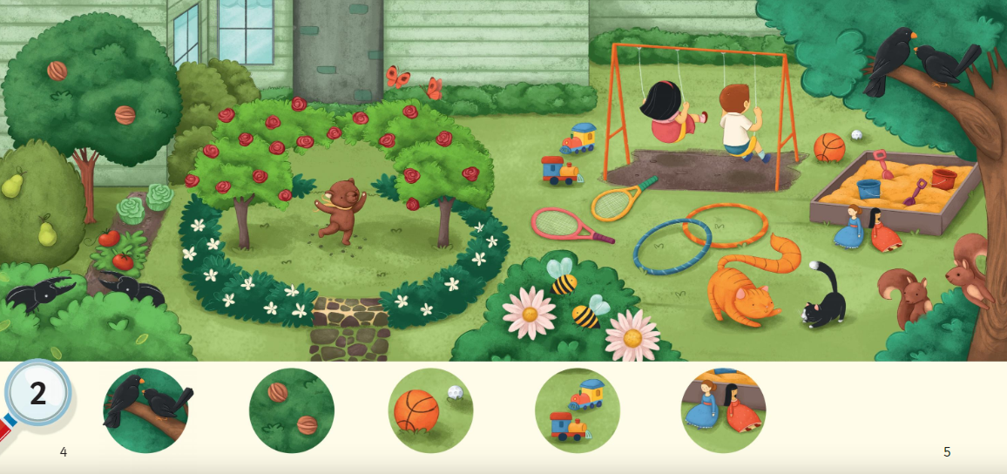
Books without words

Slide 13
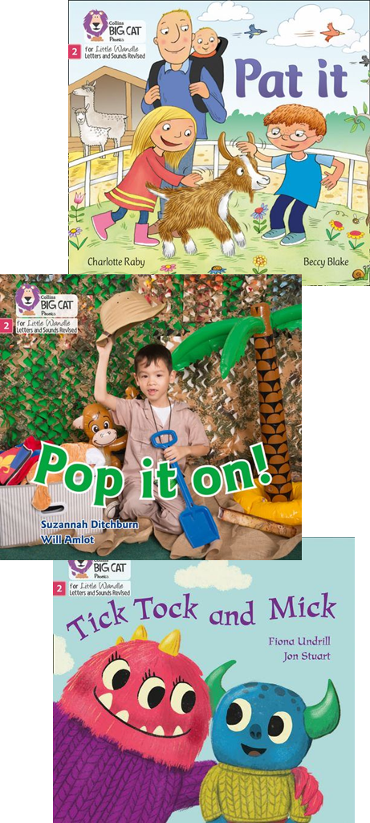
Phonics books
It is the school’s role to teach reading.
Parents/carers play a vital role. It is important that children have plenty of practice reading at home in order to become fluent, confident readers.
Parents’ or carers’ support is needed to help their child practise reading and develop fluency with a book they have already read at school.
This book needs to be matched to their phonic stage and be fully decodable. If books are sent home that the child cannot decode, it will lead to frustration for the child and the parent/carer.
To ensure that reading at home is an enjoyable experience and does not feel like a chore, schools will send books in which the child can read 95% of the words.
It does not have to be a different book every time; it may need to be the same book if the child still needs to develop fluency.
Reading records & reading bee bags-Please make a comment each time your child reads at home. On changing book days, we will tick off a reading bee at the back of your child’s reading record. Once all of the reading bees have been signed off by school staff your child will win a ‘reading bee bag’

Slide 14
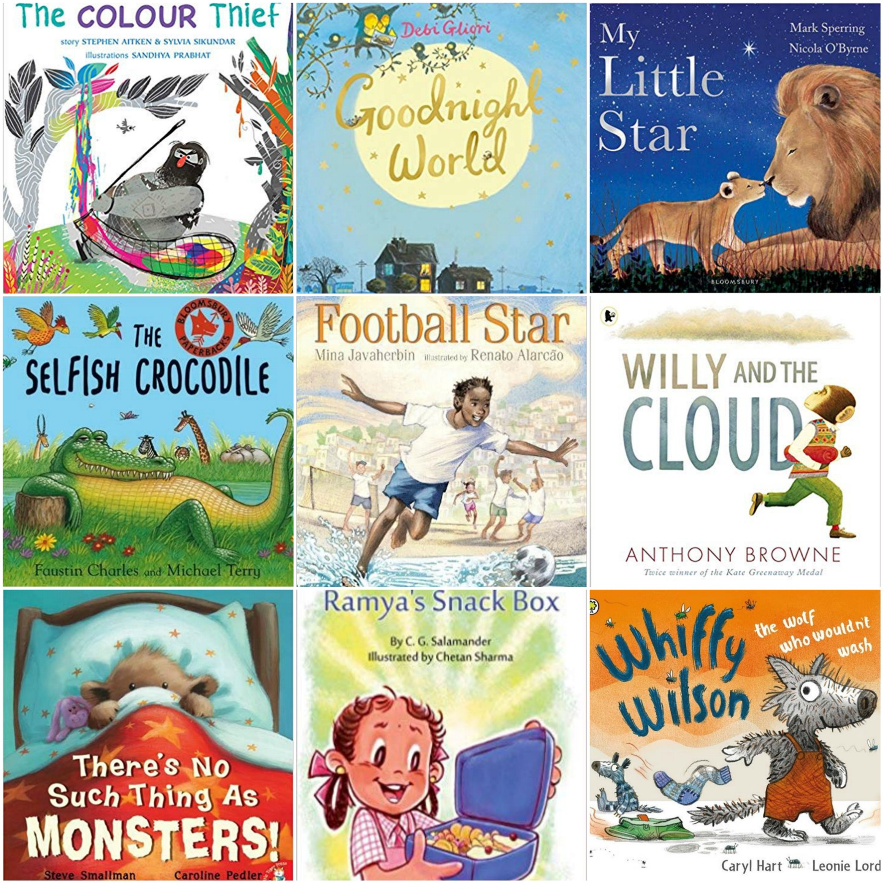
Sharing books
If children are to become lifelong readers, it is essential that they are encouraged to read for pleasure. The desire of wanting to read will help with the skill of reading.
Parents/carers should not expect their child to read this book independently and certainly should not try to get their child to do so.
The book is for the parent/carer to read to or with the child.
The goal is enjoyment.

Slide 15
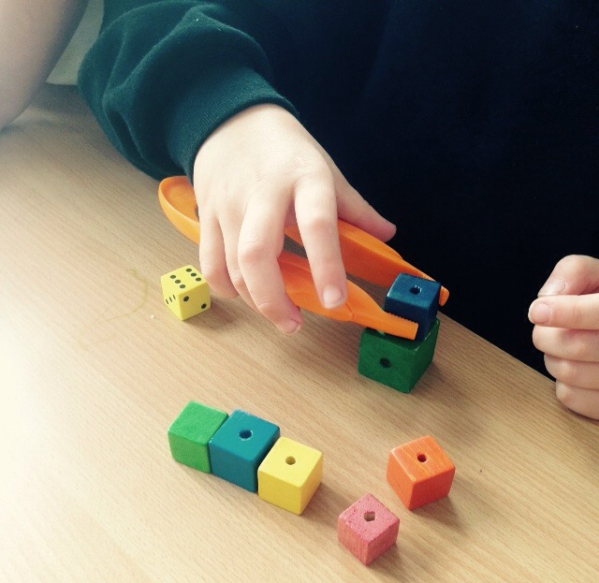
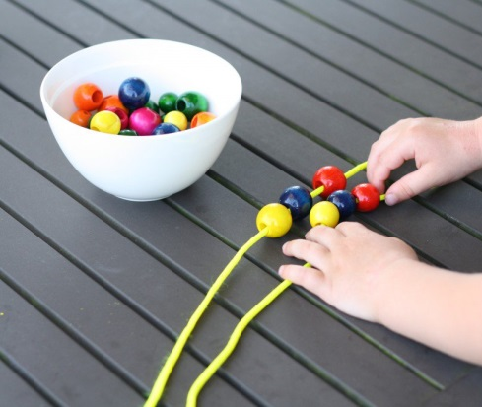
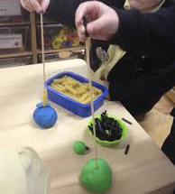
How can you support writing for your child at home-
Support and encourage Fine Motor Skills
Young children need to develop the muscles in their fingers before they can hold a pencil properly.

Slide 16


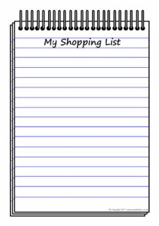
How can you support writing for your child at home
Writing with purpose
Praise your child for ‘play writing’.
Write with your child- ‘think out loud’
Spellings- phonetically spelt.
Encourage correct formation of letters and lowercase
Treasure maps
Write a birthday card
Write a shopping list

Slide 17
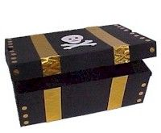
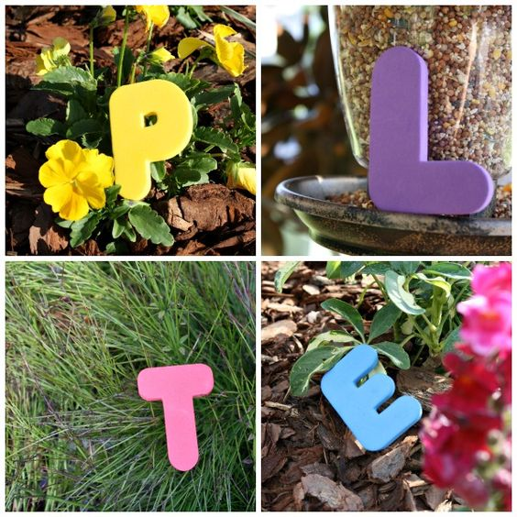

Making it fun!
Write phonics in sand
Magnetic letters play
Play schools
Go on a treasure hunt, reading clues along the way.
Go on a sound hunt in the garden or around the house.
Target practise: Hit the grapheme or word with the football!

Slide 18

Please join us for a cup of tea and a phonics chat. We have some phonics games set up for you to try out too.
Thankyou for listening!

