Slide 1
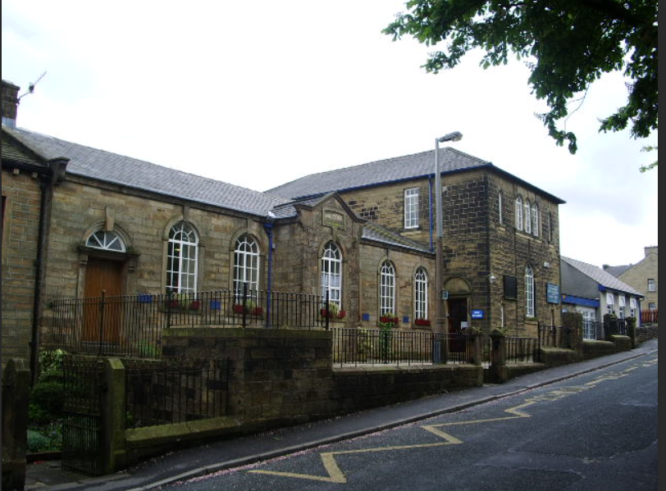

EYFS Long
Term Plan 24-25
Our school is an amazing place, with Gods help, we do all we can to be the best we can be.
Children feel valued and loved in school and staff pride themselves on building strong relationships with children, parents/carers and the community. We treat every child as an individual and are committed to the development of the ‘whole child’. We want children to be happy, self-assured, independent learners with a thirst to learn and the confidence to know that they can do anything they want to do and that we will support them on their journey.

Slide 2


EYFS Long Term Plan 24-25
 | Autumn 1 | Autumn 2 | Spring 1 | Spring 2 | Summer 1 | Summer 2
General Themes | All about me! | Sparkle and Shine! | Terrific tales! | Come outside! | Ticket to ride! | Fun at the seaside!
Over Arching Principles | Characteristics of Effective Learning Playing and exploring: - Children investigate and experience things, and ‘have a go’. Children who actively participate in their own play develop a larger store of information and experiences to draw on which positively supports their learning Active learning: - Children concentrate and keep on trying if they encounter difficulties. They are proud of their own achievements. For children to develop into self-regulating, lifelong learners they are required to take ownership, accept challenges and learn persistence. Creating and thinking critically: - Children develop their own ideas and make links between these ideas. They think flexibly and rationally, drawing on previous experiences which help them to solve problems and reach conclusions.
Over Arching Principles | Unique Child: Every child is unique and has the potential to be resilient, capable, confident and self-assured. Positive Relationships: Children flourish with warm, strong & positive partnerships between all staff and parents/carers. This promotes independence across the EYFS curriculum. Children and practitioners are NOT alone – embrace each community. Enabling environments: Children learn and develop well in safe and secure environments where routines are established and where adults respond to their individual needs and passions and help them to build upon their learning over time. Learning and Development: Children develop and learn at different rates (not in different ways as it stated 2017). We must be aware of children who need greater support than others. PLAY: We understand that children learn best when they are absorbed, interested and active. We understand that active learning involves other children, adults, objects, ideas, stimuli and events that aim to engage and involve children for sustained periods. We believe that Early Years education should be as practical as possible and therefore , we are proud that our EYFS curriculum has an underlying ethos of ‘Learning through play. PLAY is essential for children’s development across all areas. Play builds on children’s confidence as they learn to explore, to relate to others around them and develop relationships , set their own goals and solve problems. Children learn by leading their own play and by taking part in play which is guided by adults.’. We will ensure that all children learn and develop well and are kept healthy and safe at ALL times.
COEL

Slide 3
EYFS Long Term Plan 24-25
 | Autumn 1 | Autumn 2 | Spring 1 | Spring 2 | Summer 1 | Summer 2
General Themes NB: These themes may be adapted at various points to allow for children’s interests | Ourselves! | Sparkle and shine! | Terrific tales! | Come outside! | Ticket to ride! | Fun at the seaside!
 | Starting school / getting to know my new class Being me in my world Superheroes linked to People who help us My family and PSED focus on what am I good at? Being kind and making friends | Bonfire night Birthdays Little Red Hen linked to Harvest festival The Nativity Christmas Lists Letters to Father Christmas and walking to post them in groups | Once upon a time World book day Heroes and villans Baking gingerbread Role play characters What is my favourite story? | Plants & Flowers Weather / seasons The great outdoors Planting seeds Make a sculpture/ transient nature art linked to Andy Goldsworthy Life cycles Happy habitats Around the world | Where in the world have you been? Where do we live in the UK / world? Fly me to the moon! Finding out about vehicles past and Present Designing our own vehicles. Who was Neil Armstrong? | Who lives under the sea? Holiday clothes and packing. Where in the world shall we go? Send me a postcard! Marine life Fossils – Mary Anning Dinosaurs – how do we know about them?
Possible texts and ‘old favourites’ | Elmer Owl Babies Ruby’s Worry Meesha Makes Friends Ravi’s Roar Tilda Tries Again The See Saw Perfectly Norman Pumpkin soup | Christmas Story / Nativity The Gingerbread Man The Enormous Turnip Little Red Hen Tiger who came to tea | The gingerbread man Goldilocks Red riding hood Hansel and Gretel The three little pigs Billy goats gruff | Oliver’s Vegetables Jack and the Beanstalk Jasper’s Beanstalk Tidy Someone Swallowed Stanley The bad tempered ladybird Arghh spider Walking through the jungle | The Way Back Home Mr. Gumpy’s Outing Bob, The Man on the Moon Whatever Next! How to Catch a star Planet zum zee Alien teaparty Ten aliens Encylopedia-Planets | Tiddler The Tickly Octopus What the Ladybird heard at the Seaside The Storm Whale Dinosaur non-fiction books Tyrannosaurus Drip Dinosaurs vs Humans
Enrichment and Special Events | World mental health day- 10th October Black History Month – 17th October National Poetry Day-Poetry recital Harvest | Welly walk and transient art show Remembrance Day 11th November Anti-Bullying Week 14th-18th November Christmas Time / Nativity Church visit-communion | Safer internet day-8th February Children’s mental health awareness week activities 7th-13th February | Grow a beanstalk Mother’s Day Walk to school week Bikeability | School trip | World Ocean Day Father’s Day

Slide 4
EYFS Long Term Plan 24-25
 | Autumn 1 | Autumn 2 | Spring 1 | Spring 2 | Summer 1 | Summer 2
General Themes | All about me! | Sparkle and shine! | Terrific tales! | Come outside! | Ticket to ride! | Fun at the seaside!
Our Christian Vision, Values, Ethos & Moto | Value: Love Romans 5:5 and hope does not disappoint us, because God’s love has been poured into our hearts through the Holy Spirit that has been given to us.. John 13:34 I give you a new commandment, that you love one another. Just as I have loved you, you also should love one another.. Colossians 3:14 Above all, clothe yourselves with love, which binds everything together in perfect harmony | Value: Joy 1 Thessalonians 1:6 And you became imitators of us and of the Lord, for in spite of persecution you received the word with joy inspired by the Holy Spirit, so that you became an example to all the believers Value: Patience Romans 8:25 But if we hope for what we do not see, we wait for it with patience.1 Corinthians 13:4 Love is patient; love is kind; love is not envious or boastful or arrogant or rude. | Value: Peace Matthew 5:9 “Blessed are the peacemakers, for they will be called the children of God. Hebrews 12:14 Pursue peace with everyone, as well as holiness, without which no one will see the Lord | Kindness Colossians 3:12 As God’s chosen ones, holy and beloved, clothe yourselves with compassion, kindness, humility, meekness, and patience. Ephesians 4:32 Be kind to one another, tenderhearted, forgiving one another, as God in Christ has forgiven you. | Value: Goodness Galatians 6:10 So then, whenever we have an opportunity, let us work for the good of all, and especially for those of the family of faith. Faithfulness Psalm 25:10 All the paths of the Lord are steadfast love and faithfulness, for those who keep his covenant and his decrees. 3 John 1-3 .I was overjoyed when some of the friends arrived and testified to your faithfulness to the truth, namely how you walk in the truth. | Value: Gentleness Titus 3:2 To speak evil of no one, to avoid quarrelling, to be gentle, and to show every courtesy to everyone. Ephesians 4:2-3 With all humility and gentleness, with patience, bearing with one another in love, making every effort to maintain the unity of the Spirit in the bond of peace. Self-control 4 Maccabees 1:18 Now the kinds of wisdom are rational judgment, justice, courage, and self-control. 2 Peter 1 5-7 For this very reason, you must make every effort to support your faith with goodness, and goodness with knowledge, and knowledge with self-control, and self-control with endurance, and endurance with godliness, and godliness with mutual affection, and mutual affection with love
Core Principles | God is good all the time, all the time God is good. We are a unique village school, in the heart of the Fence village. Inspired by our Christian love, we open our hearts to God’s wonderful, diverse creation, cherishing everyone as a child of God. Through Jesus’ example, we instil resilience and confidence for tomorrow. We aim high, achieve much, befriend all and believe in ourselves and each other. We care and cherish our school family and create confident Christians following in Jesus’ footsteps. Our school prioritises relationships. We really care for each other as a staff team, for our children and our families. Our Christian vision, values and ethos permeate through everything we do and you feel it the second you walk through the door.

Slide 5
EYFS Long Term Plan 24-25
 | Autumn 1 | Autumn 2 | Spring 1 | Spring 2 | Summer 1 | Summer 2
General Themes | All about me! | Sparkle and shine! | Terrific tales! | Come outside! | Ticket to ride! | Fun at the seaside!
British values Assemblies PSHE CIRCLE TIMES | Mutual respect We are all unique. We respect differences between different people and their beliefs in our community, in this country and all around the world. All cultures are learned , respected, and celebrated. | Mutual Tolerance Everyone is valued, all cultures are celebrated and we all share and respect the opinions of others. Mutual tolerance of those with different faiths and beliefs and for those without faith. | Rule of law We all know that we have rules at school that we must follow. We know who to talk to if we do not feel safe. We know right from wrong. We recognise that we are accountable for our actions. We must work together as a team when it is necessary. | Individual liberty We all have the right to have our own views. We are all respected as individuals. We feel safe to have a go at new activities. We understand and celebrate the fact that everyone is different. | Democracy We all have the right to be listened to. We respect everyone and we value their different ideas and opinions. We have the opportunity to play with who we want to play with. We listen with intrigue and value and respect the opinions of others. | Recap all British Values Fundamental British Values underpin what it is to be a citizen in a modern and diverse Great Britain valuing our community and celebrating diversity of the UK. Fundamental British Values are not exclusive to being British and are shared by other democratic countries.
Assessment opportunities | In-house - Baseline data on entry National Baseline data by end of term | Pupil progress meetings Parents evening info End of term Assessments | GLD Projections pupil progress meeting. Cluster moderation | Pupil progress meetings Parents evening info End of term Assessments | Cluster moderation | Pupil progress meetings Reports End of term Assessments EOY data
Parental Involvement | Meet the teacher Home visits Poetry recital | Nativity Parents evening | Class worship | World book day-Grandparents come and read Parents Evening | School trip Class worship | School trip. Reports Sports day

Slide 6
EYFS Long Term Plan 24-25
 | Autumn 1 | Autumn 2 | Spring 1 | Spring 2 | Summer 1 | Summer 2
General Themes | All about me! | Sparkle and shine! | Terrific tales! | Come outside! | Ticket to ride! | Fun at the seaside!
Communication and Language Talk to parents about what language they speak at home, try and learn a few key words and celebrate multilingualism in school. | The development of children’s spoken language underpins all seven areas of learning and development. Children’s back-and-forth interactions from an early age form the foundations for language and cognitive development. The number and quality of the conversations they have with adults and peers throughout the day in a language-rich environment is crucial. By commenting on what children are interested in or doing, and echoing back what they say with new vocabulary added, practitioners will build children's language effectively. Reading frequently to children, and engaging them actively in stories, non-fiction, rhymes and poems, and then providing them with extensive opportunities to use and embed new words in a range of contexts, will give children the opportunity to thrive. Through conversation, story-telling and role play, where children share their ideas with support and modelling from their teacher, and sensitive questioning that invites them to elaborate, children become comfortable using a rich range of vocabulary and language structures.
Focus – C&L is developed throughout the year through high quality interactions, daily group discussions, sharing circles, PSHE times, stories, singing, speech and language interventions, EYFS productions, assemblies and weekly interventions. | Welcome to EYFS Settling in activities Making friends Children talking about experiences that are familiar to them through the use of news from home books. Rhyming and alliteration Shared stories Model talk routines through the day. For example, arriving in school: “Good morning, how are you?” | Tell me a story! Settling in activities Develop vocabulary Discovering Passions Tell me a story - retelling stories Story language Word hunts Listening and responding to stories Following instructions Takes part in discussion Understands how to listen carefully and why listening is important – introducing talking partners. Use new vocabulary through the day. Carefully chosen stories to develop the children’s vocabulary. | Tell me why! Using language well. Encourage and model the use of how and why questions during new time. Discovering Passions Retelling a story with story language – provide puppets and props in CP. Encourage and model describing events in some detail during new time and in the puppet area. Listen to and talk about stories to build familiarity and understanding. Learn rhymes, poems and songs. | Talk it through! Encourage and model the use of time connectives when children are telling their news from home or retelling stories. Understand how to listen carefully and why listening is important – children to listen carefully and ask good Questions. Sustained focus when listening to a story. | What happened? Re-read some favourite stories/ stories we have uses in our learning to revisit and consolidate vocabulary and events – making our learning sticky! | Time to share! Show and tell during celebration worship. Read aloud books to children that will extend their knowledge of the world and illustrate a current topic. Select books containing photographs and pictures, for example, places with different weather types, dinosaurs and seaside destinations. Model using the features of non-fiction books.
Core Principles | Curriculum goal: To become a Confident Communicator who can listen carefully in different situations, hold a conversation with friends and adults, ask relevant questions and use new vocabulary to explain ideas and feelings

Slide 7
EYFS Long Term Plan 24-25
 | Autumn 1 | Autumn 2 | Spring 1 | Spring 2 | Summer 1 | Summer 2
General Themes | All about me! | Sparkle and shine! | Terrific tales! | Come outside! | Ticket to ride! | Fun at the seaside!
Personal social and emotional development. | Children’s personal, social and emotional development (PSED) is crucial for children to lead healthy and happy lives, and is fundamental to their cognitive development. Underpinning their personal development are the important attachments that shape their social world. Strong, warm and supportive relationships with adults enable children to learn how to understand their own feelings and those of others. Children should be supported to manage emotions, develop a positive sense of self, set themselves simple goals, have confidence in their own abilities, to persist and wait for what they want and direct attention as necessary. Through adult modelling and guidance, they will learn how to look after their bodies, including healthy eating, and manage personal needs independently. Through supported interaction with other children, they learn how to make good friendships, co-operate and resolve conflicts peaceably. These attributes will provide a secure platform from which children can achieve at school and in later life.
Managing self Building relationships Self regulation Controlling own feelings and behaviours -Applying personalised strategies to return to a state of calm -Being able to curb impulsive behaviours -Being able to concentrate on a task -Being able to ignore distractions -Behaving in ways that are pro-social -Planning -Thinking before acting -Delaying gratification -Persisting in the face of difficulty. | Being Me In My World • I can help others to feel welcome. • I can begin to recognise and manage my own feelings • I understand why it is good to have kind and gentle hands • I am beginning to Understand what responsible means. Linked stories: Dogger hands are not for hitting. | Celebrating Difference • I can talk about what I am good at. • I understanding that being different makes us all special • I know ways that we are different and the same • I can tell you how to be a kind friend • I can tell you why my home is special to me • I know ways to stand up for myself. Linked stories: Elmer Barry the Fish with Fingers The Family Book The Dog and the Dolphin | Dreams and Goals • I understand that if I persevere I can tackle challenges • I can tell you a time that I didn’t give up • I can set a goal and work towards it • I can use kind words to encourage people • I know what it means to feel proud of myself. Linked stories: Love Monster Don’t Worry Hugless Douglas. | Healthy Me • I understand that I need to exercise to keep my body healthy • I understand that moving and resting are good for my body • I know which foods are healthy and not healthy • I know how to help myself go to sleep and why it is good for me • I can wash my hands thoroughly and I know why it is important to stay healthy • I know what a stranger is and how to keep safe if a stranger approaches me. Linked stories: Never talk to strangers not everyone is nice. | Relationships • I can identify some of the jobs I do in my family and how I feel like I belong • I know how to make friends to stop myself from feeling lonely • I can think of ways to solve problems and stay friends • I am starting to understand the impact of unkind words • I can use Calm Me time to manage my feelings • I know how to be a good friend. Linked stories: Mable and Me George and Martha | Changing Me • I can name parts of the body • I can tell you some things I can do and foods I can eat to be healthy • I understand that we all grow from babies to adults • I can express how I feel about moving to Year 1 • I can talk about my worries and/or the things I am looking forward to about being in Year 1 • I can share my memories of the best bits Linked stories I wonder why kangaroos have pouches Huge Bag of Worries Look inside your body
Core Principles | Curriculum Goal: To become an Independent Individual who can follow the Golden Rules, set simple goals and persevere to achieve them, select resources, manage their own personal needs and know how to stay fit and healthy. To become a Fantastic Friend who can be kind, caring and helpful, show empathy and respect to others, work and play co-operatively whilst considering others’ ideas and feelings

Slide 8
EYFS Long Term Plan 24-25
 | Autumn 1 | Autumn 2 | Spring 1 | Spring 2 | Summer 1 | Summer 2
General Themes | All about me! | Sparkle and shine! | Terrific tales! | Come outside! | Ticket to ride! | Fun at the seaside!
Physical development | Physical activity is vital in children’s all-round development, enabling them to pursue happy, healthy and active lives. Gross and fine motor experiences develop incrementally throughout early childhood, starting with sensory explorations and the development of a child’s strength, co-ordination and positional awareness through tummy time, crawling and play movement with both objects and adults. By creating games and providing opportunities for play both indoors and outdoors, adults can support children to develop their core strength, stability, balance, spatial awareness, co-ordination and agility. Gross motor skills provide the foundation for developing healthy bodies and social and emotional well-being. Fine motor control and precision helps with hand-eye co-ordination, which is later linked to early literacy. Repeated and varied opportunities to explore and play with small world activities, puzzles, arts and crafts and the practice of using small tools, with feedback and support from adults, allow children to develop proficiency, control and confidence.
Fine Motor: Daily opportunities for Fine Motor Activities Continuously check the process of children’s handwriting (pencil grip and letter formation, including directionality). Provide extra help and guidance when needed. ‘Funky fingers’ as children arrive. | Threading, cutting, weaving, playdough, Fine Motor activities. Manipulate objects with good fine motor skills Draw lines and circles using gross motor movements Hold pencil/paint brush beyond whole | Threading, cutting, weaving, playdough, Fine Motor activities. Develop muscle tone to put pencil pressure on paper Use tools to effect changes to materials Show preference for dominant hand. Engage children in structured activities: guide them in what to draw, write or copy. Teach and model correct letter formation using letter join. | Threading, cutting, weaving, playdough, Fine Motor activities. Begin to form letters correctly. Handle tools, objects, construction and malleable materials with increasing Control. Encourage children to draw freely. Holding Small Items /Button Clothing / Cutting with Scissors. | Threading, cutting, weaving, playdough, Fine Motor activities. Hold pencil effectively with comfortable grip Forms recognisable letters most correctly formed. | Threading, cutting, weaving, playdough, Fine Motor activities. Develop pencil grip and letter formation continually. Use one hand consistently for fine motor tasks.Cut along a straight line with scissors / Start to cut along a curved line, like a circle / Draw a cross. | Threading, cutting, weaving, playdough, Fine Motor activities. Form letters correctly Copy a square. Begin to draw diagonal lines, like in a triangle / Start to colour inside the lines of a picture. Start to draw pictures that are Recognisable/Build things with smaller linking blocks,
Gross motor Daily opportunities for Gross Motor Development | Cooperation games including parachute games. Climbing using the outdoor equipment Different ways of moving to be explored with children. Help individual children to develop good personal hygiene. Acknowledge and praise their efforts. Provide regular reminders about thorough | Ball skills- throwing and catching. Crates play- balancing and climbing. Hula hoops for skipping in outside area Provide a range of wheeled resources for children to balance, sit or ride on, or pull and push. Two-wheeled balance bikes and pedal bikes without stabilisers | Ball skills- aiming, dribbling, pushing, throwing & catching, patting, or kicking Ensure that spaces are accessible to children with varying confidence levels, skills and needs. Provide a wide range of activities to support a broad range of abilities. | Balance- children moving with confidence Dance related activities in the new stage area. Provide opportunities for children to, spin, rock, tilt, fall, slide and bounce. Use picture books and other resources to explain the importance of the different aspects of a healthy lifestyle. | Obstacle activities children moving over, under, Through and around Equipment. Encourage children to be highly active and get out of breath several times every day. Provide opportunities for children to, spin, rock, tilt, fall, slide and bounce. Dance / moving to music. | Races / team games involving gross motor movements dance related activities. Allow less competent and confident children to spend time initially observing and listening, without feeling pressured to join in. Gymnastics/Balance.
PE | FMS Elmer | Dance seasons | Fantasy fairy tales | FMS Minibeasts | An adventure with emergency services | An encounter with pirates
Curriculum goals: To become an Amazing Athlete who can show strength, balance and co-ordination when playing, move confidently and safely in a variety of different ways, use a range of equipment To become a Talented Tool User who can hold a pencil effectively, use a range of tools (for example scissors, cutlery, paintbrushes, tweezers, hammer, screwdrivers) safely and with confidence

Slide 9
EYFS Long Term Plan 24-25
 | Autumn 1 | Autumn 2 | Spring 1 | Spring 2 | Summer 1 | Summer 2
General Themes | All about me! | Sparkle and shine! | Terrific tales! | Come outside! | Ticket to ride! | Fun at the seaside!
Literacy | It is crucial for children to develop a life-long love of reading. Reading consists of two dimensions: language comprehension and word reading. Language comprehension (necessary for both reading and writing) starts from birth. It only develops when adults talk with children about the world around them and the books (stories and non-fiction) they read with them, and enjoy rhymes, poems and songs together. Skilled word reading, taught later, involves both the speedy working out of the pronunciation of unfamiliar printed words (decoding) and the speedy recognition of familiar printed words. Writing involves transcription (spelling and handwriting) and composition (articulating ideas and structuring them in speech, before writing)
Writing | Texts as a Stimulus: leaf man, shark in the park. Children will be experimenting with mark -making and writing patterns in a range of mediums. They will begin to develop a dominant hand and work towards a tripod grip. Children will start to give meaning to marks and labels. Writing initial sounds and simple captions. Use initial sounds to label characters / images. Children will begin to write letters from their names. Name writing practice. | Texts as a Stimulus: The best birthday present, chapatti moon, the best Christmas present. Children will be labelling using initial sounds. Orally telling stories sometimes with adults acting as scribes. Writing CVC words to label characters. | Texts as a Stimulus: You choose fairy tales, the gingerbread man, Goldilocks and the three bears. Writing simple captions about pictures from traditional tales e.g. man on the mat. Help children identify the sound that is tricky to spell. Sequence stories such as Goldilocks and the gingerbread man. | Texts as a Stimulus: Jack and the beanstalk. You choose. Drawing and labelling our own story maps, writing captions and labels, writing simple sentences. Writing short sentences to accompany story maps. Order the story. Labels and captions. Character descriptions. Write 1 sentence. | Texts as a Stimulus: The train ride, the way back home, Writing some of the tricky words such as I, me, my, like, to, the. Writing CVC words, Labels using CVC, CVCC, CCVC words. Guided writing based around developing short sentences. Write 2 sentences | Texts as a Stimulus: The night pirates, writing sentences using a range of tricky words that are spelt correctly. Use of full stops, capital letters and finger spaces. Innovation of familiar texts Using familiar texts as a model for writing own stories.
Drawing club Drawing club (the brainchild of author and childhood advocate Greg Bottrill). Key message; we need to engage children in the love of bringing stories to life. It is essential that we invite children to get swept up in a world of imagination and possibility. Drawing club is accessible to ALL children and has the potential to unfold the wonder of story. Drawing Club brings children’s attention to detail, it is not about being ‘GOOD’ at drawing! It’s about the development of fine motor skills to add detail, the extension of vocabulary while doing it and the joy in the success of messaging, all the time experiencing life at the cusp of confidence. Each week the children will focus on a key text/animation/traditional tale. They will learn new vocabulary, write and draw about the story, use a special button to make the work come alive and add some maths.
Curriculum goals: To become an Awesome Author who can write letters that are formed correctly, write words and simple sentences (using single sounds and digraphs they have learnt) that can be read by others.

Slide 10
EYFS Long Term Plan 24-25
 | Autumn 1 | Autumn 2 | Spring 1 | Spring 2 | Summer 1 | Summer 2
General Themes | All about me! | Sparkle and shine! | Terrific tales! | Come outside! | Ticket to ride! | Fun at the seaside!
Literacy | It is crucial for children to develop a life-long love of reading. Reading consists of two dimensions: language comprehension and word reading. Language comprehension (necessary for both reading and writing) starts from birth. It only develops when adults talk with children about the world around them and the books (stories and non-fiction) they read with them, and enjoy rhymes, poems and songs together. Skilled word reading, taught later, involves both the speedy working out of the pronunciation of unfamiliar printed words (decoding) and the speedy recognition of familiar printed words. Writing involves transcription (spelling and handwriting) and composition (articulating ideas and structuring them in speech, before writing)
Word reading Children will practice word reading during phonics lessons, in independent learning in the continuous provision, while reading their reading books and practicing their set HFW | Consolidate Phase 1 Phase 2 GPCs s a t p i n m d g o c k s pronounced /z/ Tricky word: The Reading: Initial sounds, oral blending, CVC sounds, reciting known stories, listening to stories with attention and recall. Help children to read the sounds speedily. This will make sound-blending easier Listen to children read aloud, ensuring books are consistent with their developing | Phase 2 GPCs ck e u r h b f ff l ll ss Consolidate Phase 2 Tricky words: I, to, go, no, into Reading: Blending CVC sounds, rhyming, alliteration, knows that print is read from left to right. Spotting diagraphs in words. Show children how to touch each finger as they say each sound. For exception words such as ‘the’ and ‘said’, help children identify the sound | Phase 3 GPCs j v w x y z/zz qu ch sh th/th ng Consolidate as required Tricky words: he, she, we, be, me, was, my, you, they Reading: Rhyming strings, common theme in traditional tales, identifying characters and settings. Provide opportunities for children to read words containing familiar letter groups: ‘that’, ‘shop’, ‘chin | Phase 3 GPCs ai ee igh oa with two-syllable words oo/oo with two-syllable words ar or with two-syllable words Consolidate as required Tricky words her all are (Phase 3) like (Phase 4) said when (Phase 4) have one (Phase 4) Reading: Story structure. beginning, middle, end. Innovating and retelling stories to an audience, non fiction books. Listen to children read some longer words made up of letter-sound correspondences they know: ‘rabbit’, | Phase 3 ur ow oi ear (Including pseudo words) air ure er (Including pseudo words) Consolidate Phase 3 Phase 4CVCC & CCV Tricky words: come do (Phase 4) so were (Phase 4) some there (Phase 4) out little what (Phase 4) Consolidate said so have like (Phase 4) Reading: Non-fiction texts, Internal blending, Naming letters of the alphabet. Distinguishing capital letters and lower case letters. | Phase 4 CCVC & CCVCC CCCVC & CCCVCC Polysyllabic words containing Phase 2 and 3 graphemes with adjacent consonants. Consolidate said so have like some come were there little do one when out what Teach it’s Reading: Reading simple sentences with fluency. Reading CVCC and CCVC words confidently. End of term assessments
Comprehension Developing a passion for reading Children will have continuous access to the classroom reading area. They will have 3 opportunities to change their reading books per week and read to their reading buddies every Friday afternoon. | Joining in with rhymes and showing an interest in stories with repeated refrains. Environment print. Having a favourite story/rhyme. Understand the five key concepts about print: - print has meaning - print can have different purposes - we read English text from left to right and from top to bottom - the names of the different parts of a book. Sequencing familiar stories through the use of pictures to tell the story. Recognising initial sounds. Name writing activities. Engage in extended conversations about stories, learning new vocabulary. | Retell stories related to events through acting/role play. Christmas letters/lists. Retelling stories using images and– Story Maps. Editing of story maps and orally retelling new stories. Non-Fiction Focus Retelling of stories. Sequence story – use vocabulary of beginning, middle and end. Blend sounds into words, so that they can read short words made up of known letter– sound correspondences. Enjoys an increasing range of books. | Making up stories with themselves as the main character. Encourage children to record stories through picture drawing/mark making for LAs. Read simple phrases and sentences made up of words with known letter–sound correspondences and, where necessary, a few exception words. | Information leaflets about animals in the garden/plants and growing. Re-read books to build up their confidence in word reading, their fluency and their understanding and enjoyment. World Book Day Uses vocabulary and forms of speech that are increasingly influenced by their experiences of books. They develop their own narratives and explanations by | Stories from other cultures and traditions. Retell a story with actions and / or picture prompts as part of a group - Use story language when acting out a narrative. Rhyming words. Parents reading stories. Can explain the main events of a story - Can draw pictures of characters/ event / setting in a story. May include labels, sentences or captions. Can draw pictures of characters/ event / setting in a story. Listen to stories, accurately anticipating key events & respond to what they hear with relevant comments, questions and reactions. Make predictions | Beginning to understand that a non-fiction is a non-story- it gives information instead. Fiction means story. - Can point to front cover, back cover, spine, blurb, illustration, illustrator, author and title. Sort books into categories.
Curriculum goals: To become a Brilliant Bookworm who can show a love for reading, use new vocabulary to talk about what they have read or has been read to them, read words and simple sentences (using single sounds and digraphs they have learnt).

Slide 11
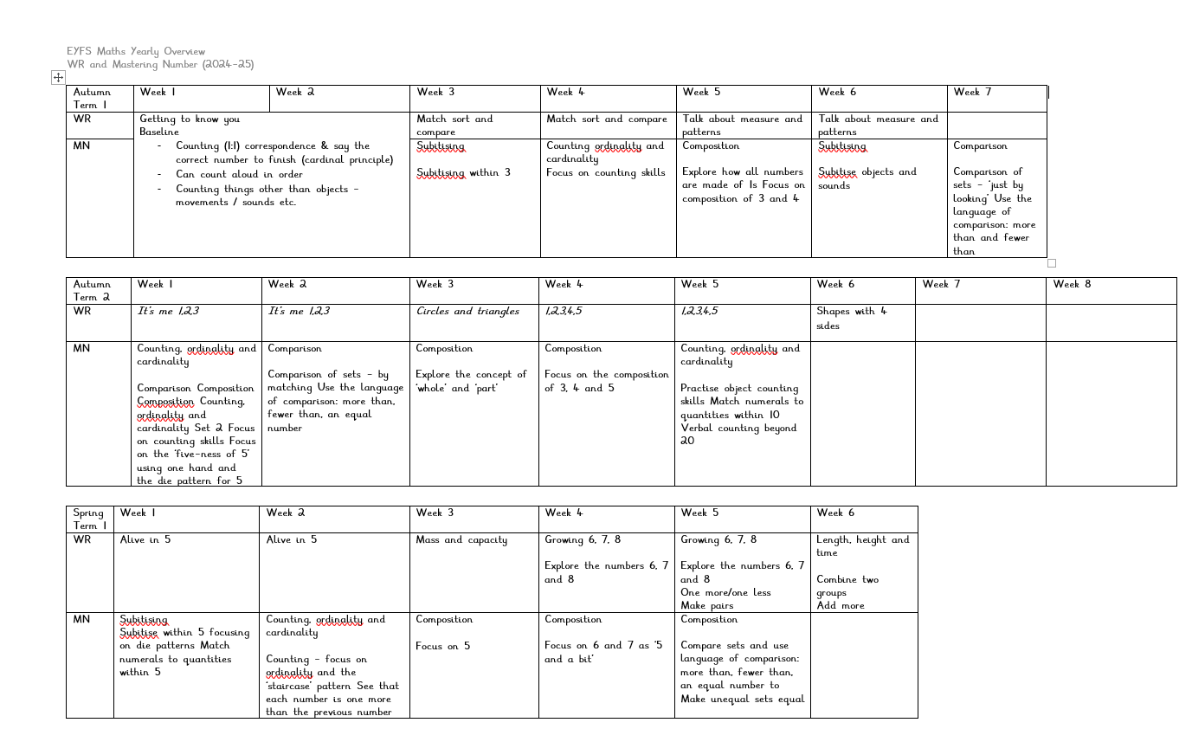
EYFS Long Term Plan 24-25
Maths
We build in time for short adult led focus inputs which include number songs, rhymes, games and suggested prompts for learning (from White Rose guidance). The concepts are taken further with short teacher led activities. We give daily opportunities to practise new skills through play in the different areas of provision, either independently or with adult support. The children have daily opportunities to practise their counting and subitising skills. Regular opportunities are provided for children to apply their understanding to reason and problem solve. Key skills of counting, subitising, composition, ordering and comparing are threaded throughout the guidance and get progressively more challenging.

Slide 12
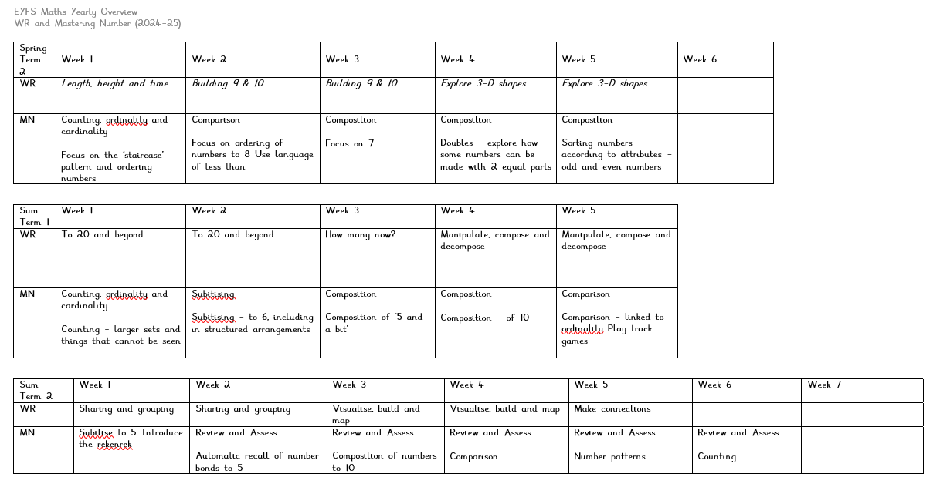
EYFS Long Term Plan 24-25
Maths
Curriculum goals: To become a Master of Maths who can show a deep understanding of numbers to 10, recognise patterns within the number system, subitise, compare quantities and recall number bonds. Developing a strong grounding in number is essential so that all children develop the necessary building blocks to excel mathematically. Children should be able to count confidently, develop a deep understanding of the numbers to 10, the relationships between them and the patterns within those numbers. By providing frequent and varied opportunities to build and apply this understanding - such as using manipulatives, including small pebbles and tens frames for organising counting - children will develop a secure base of knowledge and vocabulary from which mastery of mathematics is built. In addition, it is important that the curriculum includes rich opportunities for children to develop their spatial reasoning skills across all areas of mathematics including shape, space and measures. It is important that children develop positive attitudes and interests in mathematics, look for patterns and relationships, spot connections, ‘have a go’, talk to adults and peers about what they notice and not be afraid to make mistakes

Slide 13
EYFS Long Term Plan 24-25
 | Autumn 1 | Autumn 2 | Spring 1 | Spring 2 | Summer 1 | Summer 2
General Themes | All about me! | Sparkle and shine! | Terrific tales! | Come outside! | Ticket to ride! | Fun at the seaside!
Understanding the world. Science History Geography RE/ Festivals Our RE Curriculum enables children to develop a positive sense of themselves and others and learn how to form positive and respectful relationships. They will begin to understand and value the differences of individuals and groups within their own community. Children will have opportunity to develop their emerging moral and cultural awareness. | Understanding the world involves guiding children to make sense of their physical world and their community. The frequency and range of children’s personal experiences increases their knowledge and sense of the world around them – from visiting parks, libraries and museums to meeting important members of society such as police officers, nurses and firefighters. In addition, listening to a broad selection of stories, non-fiction, rhymes and poems will foster their understanding of our culturally, socially, technologically and ecologically diverse world. As well as building important knowledge, this extends their familiarity with words that support understanding across domains. Enriching and widening children’s vocabulary will support later reading comprehension.
 | Peek into the past -Family tree -Can you guess who? -My lifetime -Spot the difference -Identifying their family. Commenting on photos of their family; naming who they can see and of what relation they are to them. -Can talk about what they do with their family and places they have been with their family. Can draw similarities and make comparisons between other families. Name and describe people who are familiar to them. -Read fictional stories about families and start to tell the difference between real and fiction. Talk about members of their immediate family and community. | Our school -Welly walk- explore school grounds-explore the seasons and weather -Looking after our school grounds and creatures outdoors. Make bug hotels & nature catchers. -Observational painting and transient art of our school | Our school -Create pen pals with another school to compare and contrast. Discuss similarities and differences between schools. -Take a tour inside school and talk about what we see using a wide range of vocabulary -Create a journey stick -Our school from above -Build a map -Draw a map -Investigate a map | Hot, cold and wet places -Desert explorers -Polar explorers -Exploring world landscapes -Observational painting -Senses in nature -Explore the seasons and weather -Freezing and melting story characters in ice -Growing a beanstalk | Adventures through time -Transport through time -Past and present -The first moon landing -Sinking and floating ships |  | Where should we go on holiday? -Explain some similarities and differences between life in this country and life in other countries, drawing on knowledge from stories, non-fiction texts and – when appropriate – maps. -City or countryside -Home or away -Bears travels
 | I am special, Harvest. God and Creation. Harvest festival | Christmas. Diwali, | Special places (Church Mosque) Chinese New Year, Shrove Tuesday/ash Wednesday. | Easter Palm Sunday, Vaisakhi, Start of Ramadan | Stories Jesus heard Eid |  | Stories Jesus told Summer solstice, Eid
Curriculum goals:To become an Exceptional Explorer who can show curiosity about the world around them, understand how to read and draw a simple map, understand some differences between times and places. To become a Compassionate Citizen who can help to look after their community and care for the environment, know some reasons why Wheatley Lane and Fence is special, have an awareness of other people’s cultures, Religions and beliefs.

Slide 14
EYFS Long Term Plan 24-25
 | Autumn 1 | Autumn 2 | Spring 1 | Spring 2 | Summer 1 | Summer 2
General Themes | All about me! | Sparkle and shine! | Terrific tales! | Come outside! | Ticket to ride! | Fun at the seaside!
Expressive arts and design | The development of children’s artistic and cultural awareness supports their imagination and creativity. It is important that children have regular opportunities to engage with the arts, enabling them to explore and play with a wide range of media and materials. The quality and variety of what children see, hear and participate in is crucial for developing their understanding, self-expression, vocabulary and ability to communicate through the arts. The frequency, repetition and depth of their experiences are fundamental to their progress in interpreting and appreciating what they hear, respond to and observe. Give children an insight into new musical worlds. Invite musicians in to play music to children and talk about it. Encourage children to listen attentively to music. Discuss changes and patterns as a piece of music develops.
Creating with materials. Being imaginative and expressive. | Join in with familiar songs. Beginning to mix primary colours to make secondary colours. Joins in with role play games and uses resources available for props; build models using construction equipment. Sings call-and-response songs, echoing phases adults sing. Self-portraits, junk modelling, take picture of children’s creations and record them explaining what they did. Exploring sounds (body percussion and instruments) and how they can be changed, tapping out of simple rhythms. Provide opportunities to work together to develop | Listen to music and make their own dances in response. Clay diva lamps/salt dough Christmas baubles. Firework pictures, Christmas decorations, Christmas cards, Christmas songs/poems The use of story maps, props, puppets & story bags will encourage children to retell, invent and adapt stories. Role Play Party’s and Celebrations Role Play of The Nativity. | Use different textures and materials to make houses for the three little pigs and bridges for the Three Billy Goats Shadow Puppets Teach children different techniques for joining materials, such as how to use adhesive tape, treasury tags, paper clips and different sorts of glue. | Make different textures; make patterns using different colours Children will explore ways to protect the growing of plants by designing scarecrows and light catchers using old CDs. Collage animals / Making houses. Pastel drawings, printing, patterns on Easter eggs, Life cycles, Flowers-Sun flowers Mother’s Day crafts Easter crafts Home Corner role play Artwork themed around minibeasts / The Seasons Provide a wide range of props for play which encourage imagination dressing up, instruments, puppets, etc. | Design and make rockets. Design and make objects they may need in space, thinking about form and function. Learn a traditional African song and dance and perform it. Encourage children to create their own music. Junk modelling, houses, bridges boats and transport. Exploration of other countries – dressing up in different costumes. Retelling familiar stories. Creating outer of space pictures Provide children with a range of materials for children to construct with. | Sand pictures / Rainbow fish collages Lighthouse designs Paper plate jellyfish Puppet shows: Provide a wide range of props for play which encourage imagination. Salt dough fossils Water pictures, collage, shading by adding black or white, colour mixing for beach huts, making passports. Colour mixing,wax resistant painting, masking tape batik – underwater pictures. Father’s Day Crafts
Artist of the month. | Artist: Bridget Riley Lines/spirals Malleable Materials – Imprints Kapow art: Drawing marvellous marks | Artist: Kadinsky Circles Malleable materials – Clay Shape art Tree art project Christmas crafts | Artist:: Jayne Huskisson Paper ripping Malleable materials - Making models from recycled materials: link to props for stories and rhyme | Artist: Andy Goldsworthy Nature art Malleable Materials –Pebbles/natural items/loose parts. Mothers day crafts. Making easter garden | Artist: Van Gough Observational art Malleable materials-Oil pastels, chalk, shading DT: Structures-boats | Artist: Henri Edmond Cross Cotton bud painting Collage. Father’s Day Crafts
Music | Nursery Rhymes Charanga unit - ME | Christmas Nativity Songs and Rehearsals Charanga unit-our stories | Nursery rhyme and action songs Charanga unit-Everyone | Nursery rhymes and action songs Charanga unit- our world | Interrelated with instruments Charanga unit-Big bear funk | Listening, history and language of music Charanga unit- Reflect, replay, rewind
Curriculum goals: To become a Proud Performer who can perform a song, poem or dance to an audience, retell stories with expression and confidence, play a range of percussion instruments correctly and with good rhythm. To become a Dynamic Designer who can choose and safely use the resources they need to make their creations, talk about what they have made and how they have made it.

Slide 15
EYFS Long Term Plan 24-25
Early Learning Goals – for the end of the year - Holistic / best fit Judgement! | Early Learning Goals | Autumn 2 | Spring 1 | Spring 2 | Summer 1 | Summer 2
Communication and Language | Personal, social, emotional development | Physical Development | Literacy | Maths | Understanding the World | Expressive arts and design
ELG: Listening, Attention and Understanding Listen attentively and respond to what they hear with relevant questions, comments and actions when being read to and during whole class discussions and small group interactions Make comments about what they have heard and ask questions to clarify their understanding Hold conversation when engaged in back-and-forth exchanges with their teacher and peers ELG: Speaking Participate in small group, class and one-to-one discussions, offering their own ideas, using recently introduced vocabulary. Offer explanations for why things might happen, making use of recently introduced vocabulary from stories, non-fiction, rhymes and poems when appropriate. Express their ideas and feelings about their experiences using full sentences, including use of past, present and future tenses and making use of conjunctions, with modelling and support from their teacher. | ELG: Self-Regulation Show an understanding of their own feelings and those of others, and begin to regulate their behaviour accordingly. Set and work towards simple goals, being able to wait for what they want and control their immediate impulses when appropriate. Give focused attention to what the teacher says, responding appropriately even when engaged in activity, and show an ability to follow instructions involving several ideas or actions. ELG: Managing Self Be confident to try new activities and show independence, resilience and perseverance in the face of challenge. Explain the reasons for rules, know right from wrong and try to behave accordingly. Manage their own basic hygiene and personal needs, including dressing, going to the toilet and understanding the importance of healthy food choices. ELG: Building Relationships Work and play cooperatively and take turns with others. Form positive attachments to adults and friendships with peers;. Show sensitivity to their own and to others’ needs. | ELG: Gross Motor Skills Negotiate space and obstacles safely, with consideration for themselves and others. Demonstrate strength, balance and coordination when playing. Move energetically, such as running, jumping, dancing, hopping, skipping and climbing. ELG: Fine Motor Skills Hold a pencil effectively in preparation for fluent writing – using the tripod grip in almost all cases. Use a range of small tools, including scissors, paint brushes and cutlery. Begin to show accuracy and care when drawing. | ELG: Comprehension Demonstrate understanding of what has been read to them by retelling stories and narratives using their own words and recently introduced vocabulary. Anticipate – where appropriate – key events in stories. Use and understand recently introduced vocabulary during discussions about stories, non-fiction, rhymes and poems and during role-play. ELG: Word Reading Say a sound for each letter in the alphabet and at least 10 digraphs. Read words consistent with their phonic knowledge by sound-blending. Read aloud simple sentences and books that are consistent with their phonic knowledge, including some common exception words. ELG: Writing Write recognisable letters, most of which are correctly formed. Spell words by identifying sounds in them and representing the sounds with a letter or letters. Write simple phrases and sentences that can be read by others. | ELG: Number Have a deep understanding of number to 10, including the composition of each number; Subitise (recognise quantities without counting) up to 5; - Automatically recall (without reference to rhymes, counting or other aids) number bonds up to 5 (including subtraction facts) and some number bonds to 10, including double facts. ELG: Numerical Patterns Verbally count beyond 20, recognising the pattern of the counting system; - Compare quantities up to 10 in different contexts, recognising when one quantity is greater than, less than or the same as the other quantity. Explore and represent patterns within numbers up to 10, including evens and odds, double facts and how quantities can be distributed equally. | ELG: Past and Present Talk about the lives of the people around them and their roles in society. Know some similarities and differences between things in the past and now, drawing on their experiences and what has been read in class. Understand the past through settings, characters and events encountered in books read in class and storytelling. ELG: People, Culture and Communities Describe their immediate environment using knowledge from observation, discussion, stories, non-fiction texts and maps. Know some similarities and differences between different religious and cultural communities in this country, drawing on their experiences and what has been read in class. Explain some similarities and differences between life in this country and life in other countries, drawing on knowledge from stories, non-fiction texts and – when appropriate – maps. ELG: The Natural World Explore the natural world around them, making observations and drawing pictures of animals and plants. Know some similarities and differences between the natural world around them and contrasting environments, drawing on their experiences and what has been read in class. Understand some important processes and changes in the natural world around them, including the seasons and changing states of matter. | ELG: Creating with Materials Safely use and explore a variety of materials, tools and techniques, experimenting with colour, design, texture, form and function. Share their creations, explaining the process they have used; - Make use of props and materials when role playing characters in narratives and stories. ELG: Being Imaginative and Expressive Invent, adapt and recount narratives and stories with peers and their teacher. Sing a range of well-known nursery rhymes and songs; Perform songs, rhymes, poems and stories with others, and – when appropriate – try to move in time with music.

