Slide 1

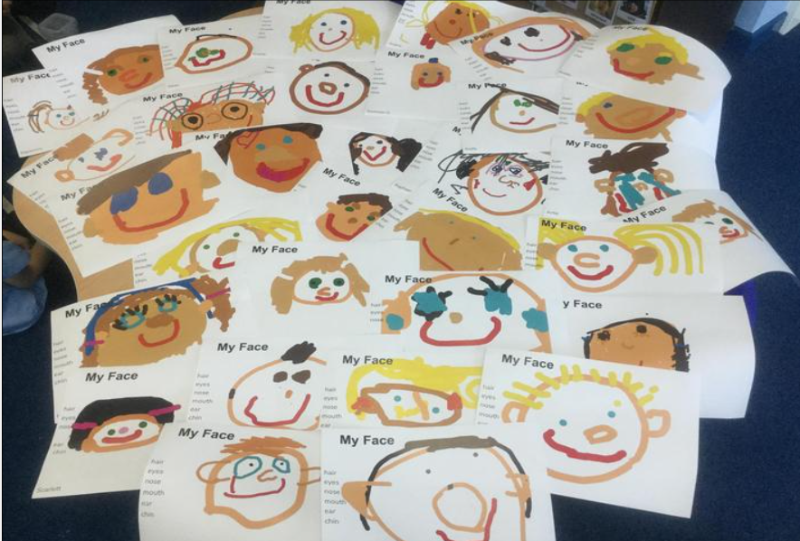
Welcome to Wheatley Lane!
Notes:
Introductions
Welcome

Slide 2
Meet the teachers
Miss Jennings – Class Teacher
Mrs Pollard– Teaching assistant
Mrs Stronach-Teaching assistant
Mrs Salmon-Teaching assistant

Slide 3
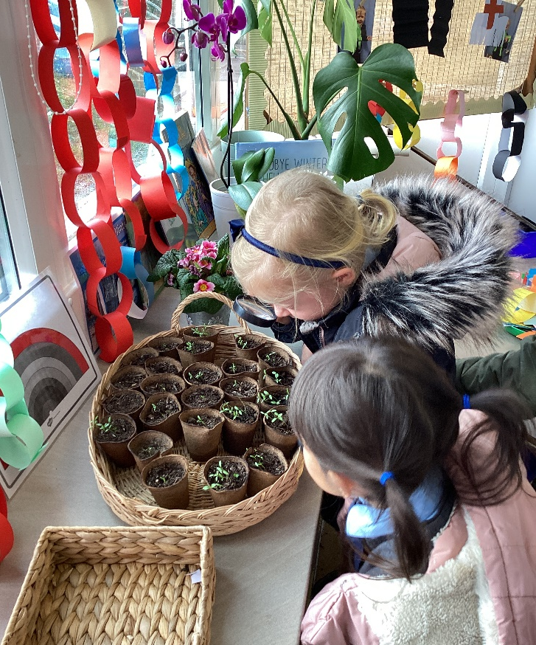
Settling into school
Stay and play –
Group A Wed 26th June and Wed 3rd July 2.00-3.00
Group B Wed 10th and 17th July 2.00-3.00
Staggered start during the first week. Whole class on Friday.
Home visits

Slide 4
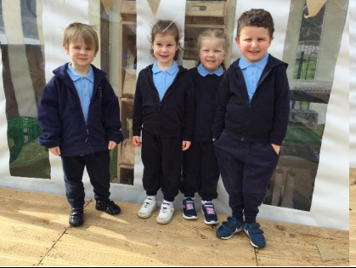
Uniform
Pale blue polo shirt
Navy joggers/leggings or Navy shorts
Navy hoodie or sweatshirt (school logo optional)
1 pair of named wellies to stay in school
Trainers suitable for PE that can be fastened by your child.

Slide 5
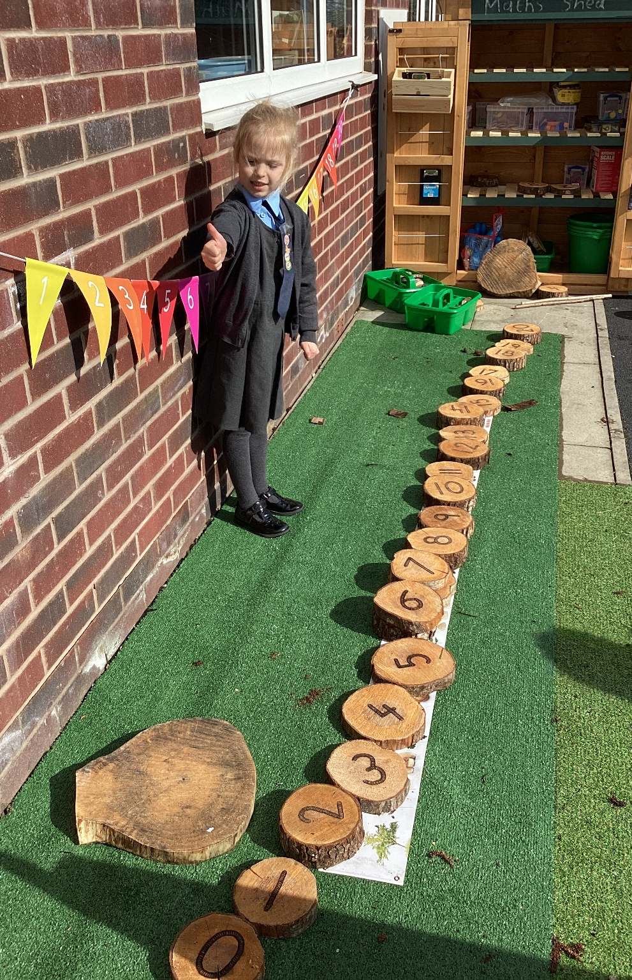
Useful information
Label everything!
Please provide a pair of named wellies to keep in school,
Children will need a named water bottle brought in each day and sent home to be washed.
Children will need to bring their book bag in each day. Please don’t add keyrings or additional items to book bags or they won’t fit in your child’s tray.
Children will be offered fruit each afternoon, provided by school.
Children will need to bring one piece of fresh fruit for our morning snack.
Milk is free for your child until he/she is 5.

Slide 6
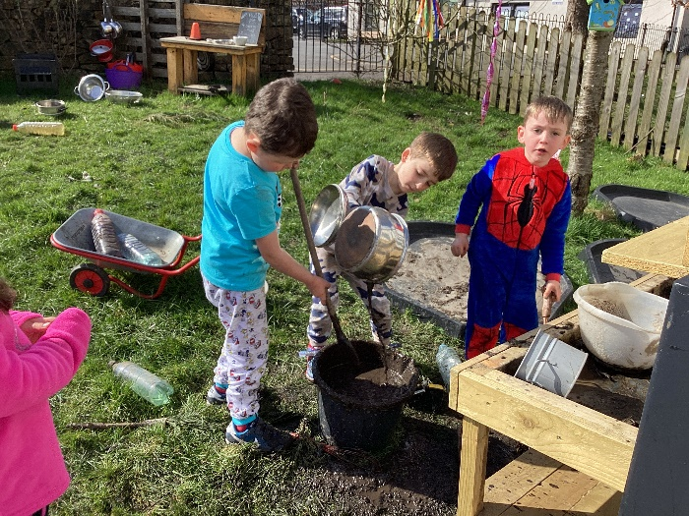
EYFS
4 Specific Areas–
Literacy
Mathematics
Understanding the World
Expressive Arts
and Design
3 Prime Areas –
Communication and Language
Personal Social and Emotional Development
Physical Development
17 Early Learning Goals
Most children will reach
these by the
end of the reception year but some will not.
Notes:
The Early Years Foundation Stage (EYFS) is the stage of education for children from birth to the end of the Reception year.
It is based on the recognition that children learn best through play and active learning.

Slide 7
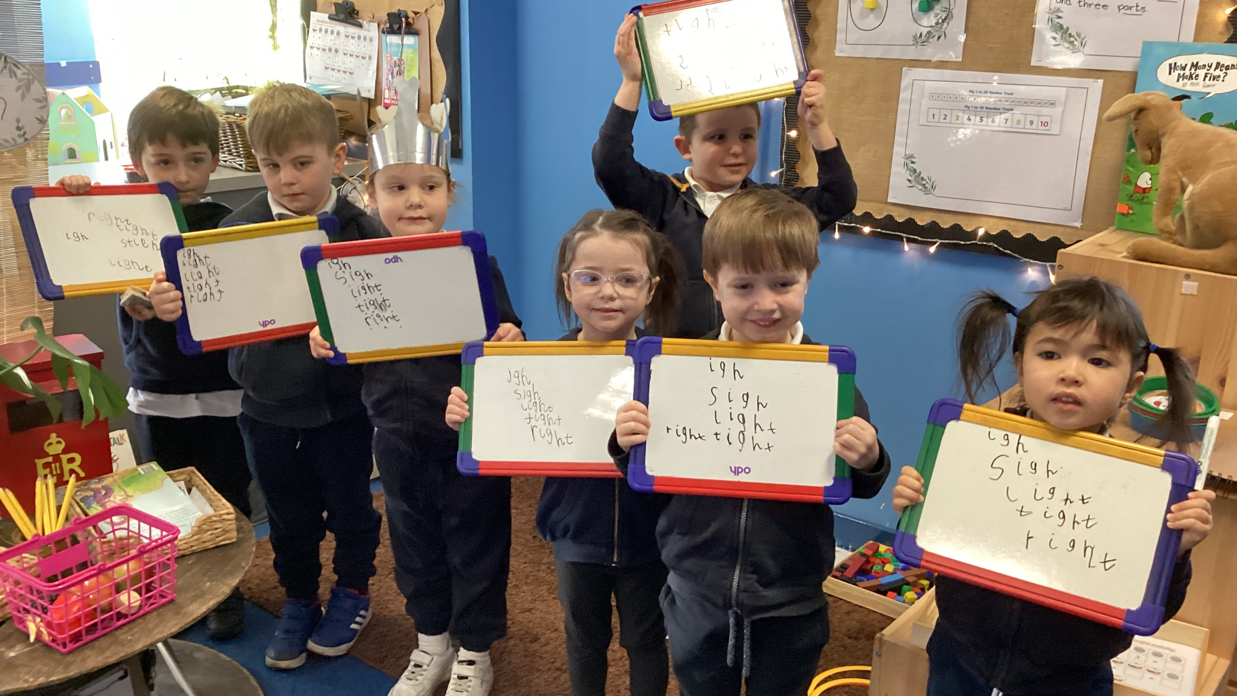
Phonics
We follow a scheme of work called ‘Red Rose Phonics’
Continues into KS1.
Workshop for parents end of September.

Slide 8
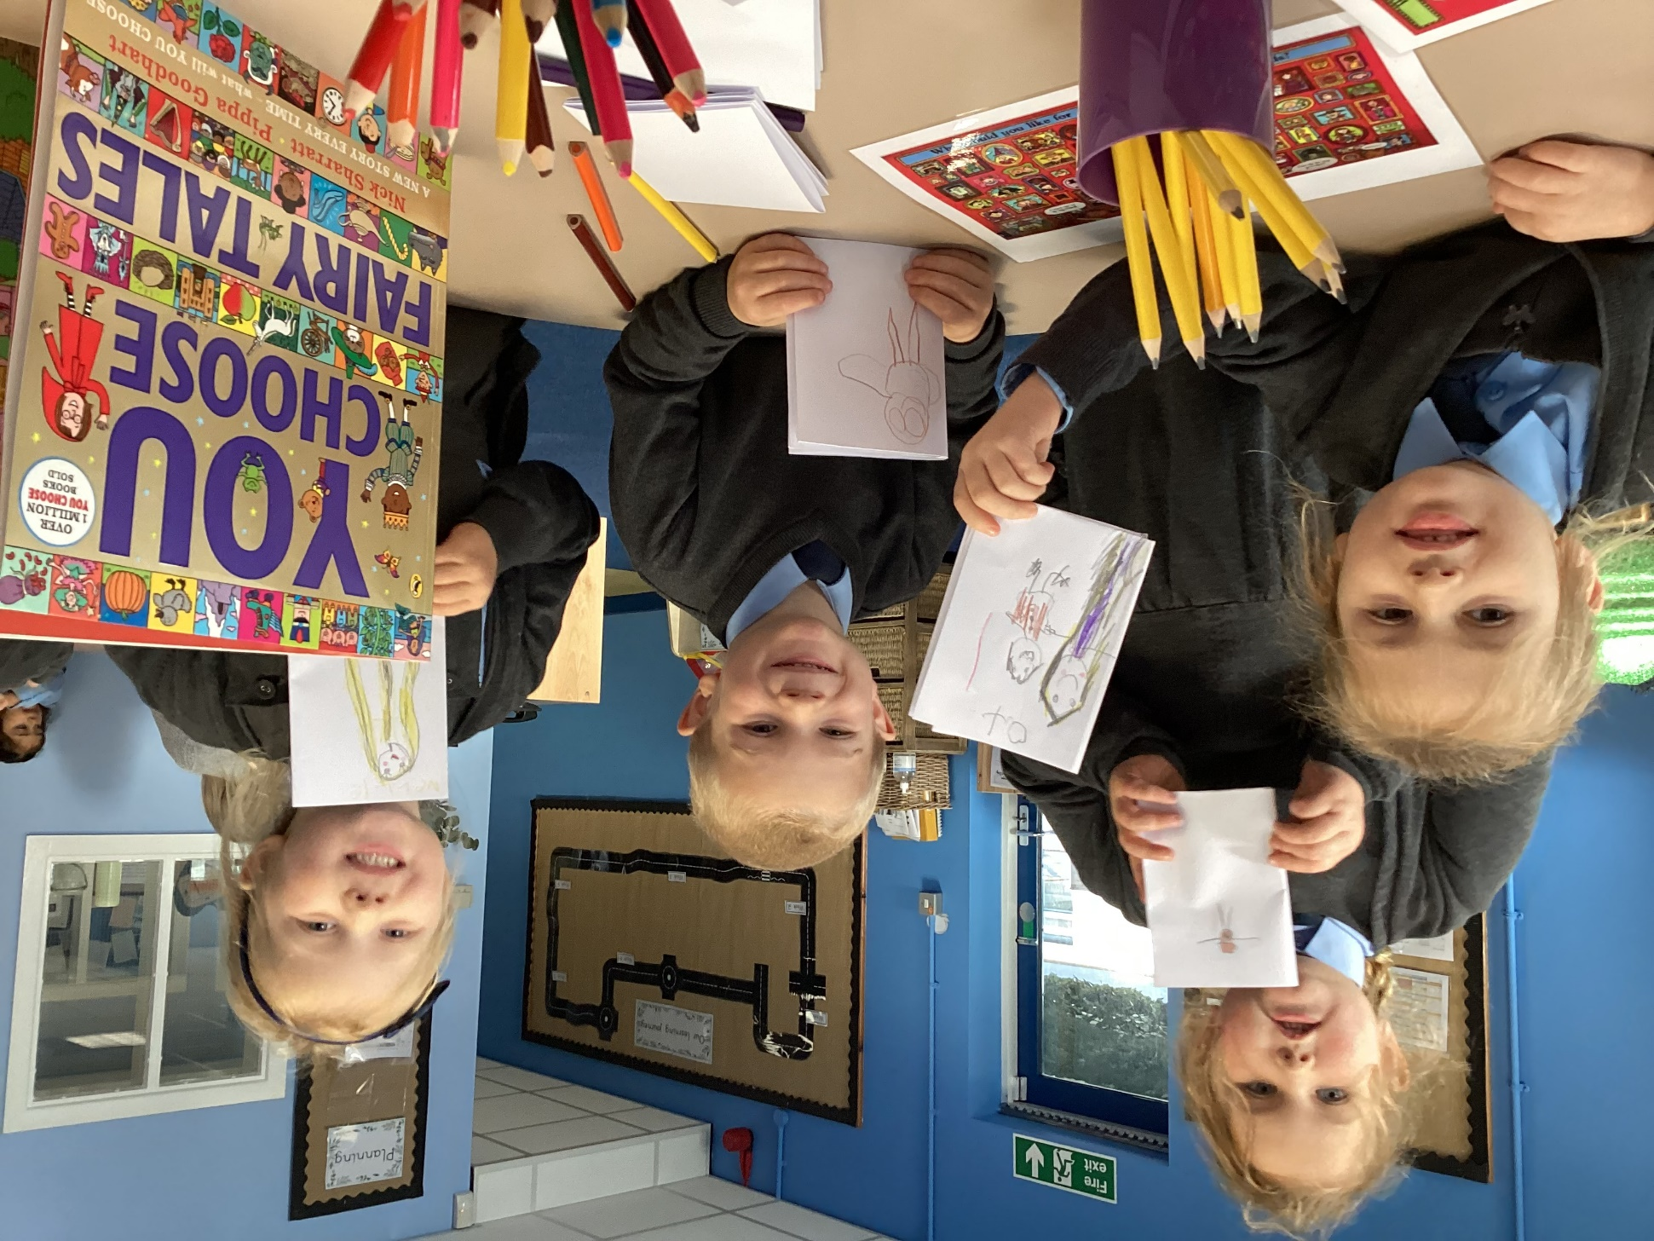
Reading
We encourage the children to read, read and read some more!
We can honestly say those that read every day do achieve better in all aspects of the EYFS. We know it’s a hard slog to do that every day –but your hard work will pay off!
Daily reading really helps the children to read fluently, read at speed and consolidate phonics teaching.
Please write a brief comment in your child’s reading record.
Notes:
In school:
*Fast paced daily phonics lessons.
*Weekly reading sessions with an adult.
*Provide books matched to your child’s phonic ability (changed 3x a week).
*Re-reading for fluency.
*Provide sharing books to be read by an adult at home (changed once a week).
*Weekly reading with year 6 buddies

Slide 9

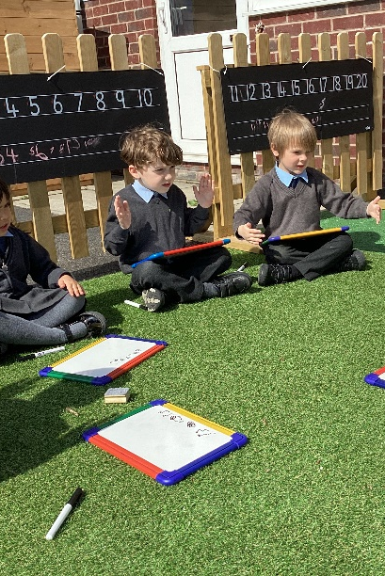
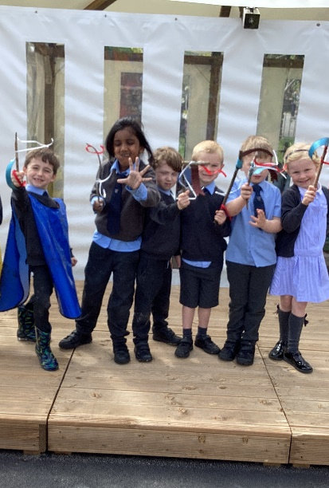
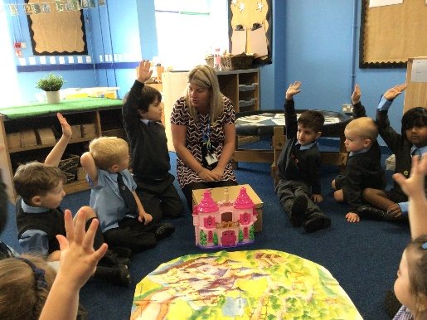
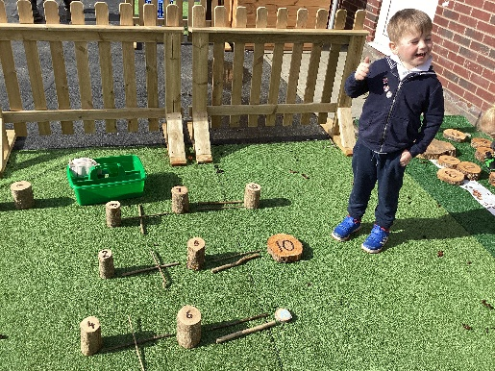
What will it be like in Reception?
Notes:
Continuous provision
Enhanced provision
Lots of play
Open ended activities to allow chn to direct their learning
1:1 and small group activities led by adult
Whole class teaching
Areas of EYFS will overlap
Learning not going as intended but great learning nonetheless!
Learning is not always concrete, therefore will not always be recorded.
Mess, chaos, noise and engagement.

Slide 10
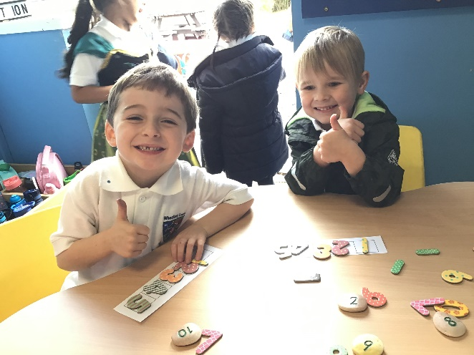
Weekly Routine
Each afternoon
*Focus on specific area of learning from the EYFS
*Continuous provision
*Story & home time
Each week-
*PE-Tues & Fri
*Welly Wednesday
*Celebration worship every Friday.
Each morning
*Worship
*Phonics
*Literacy
*Maths

Slide 11
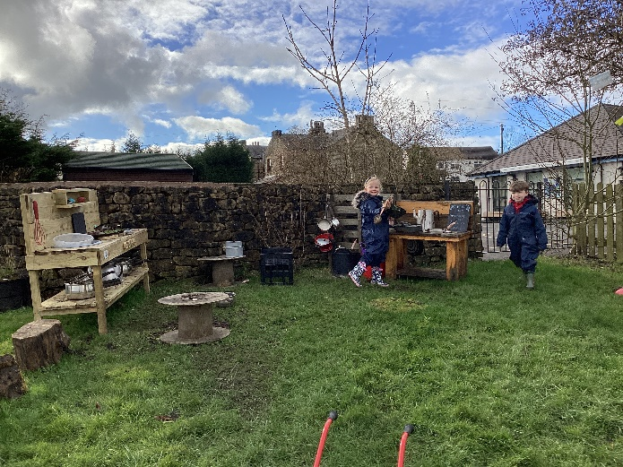
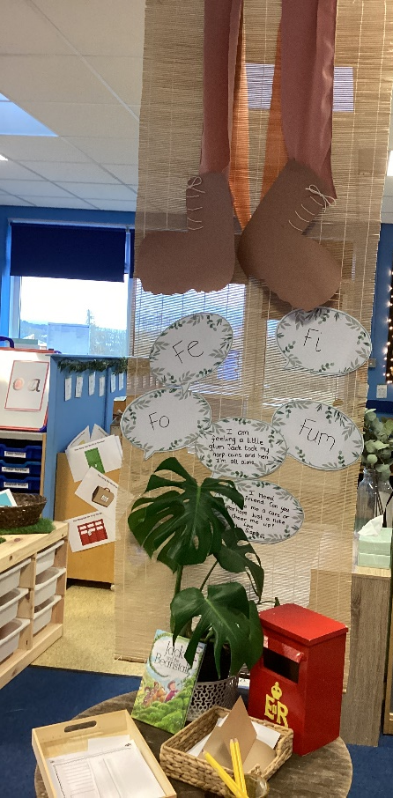
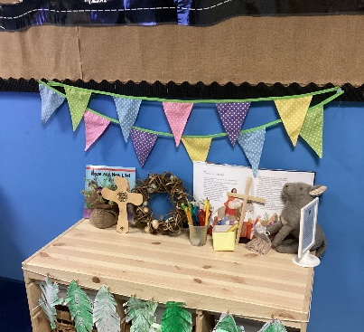
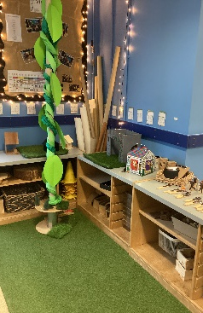
The classroom
Different areas within the indoor and outdoor area.
Lots of floor space for the children to spread out.
Quality resources accessible by the children.
Resources enhanced throughout each week according to what the children have been doing.

Slide 12
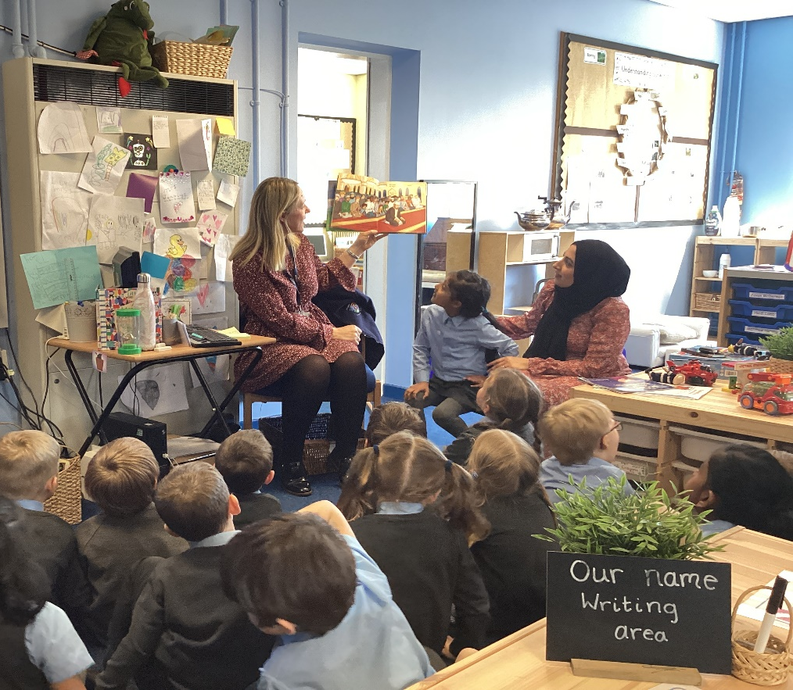
Parent partnerships
We want you to be very involved with your child’s Reception Year!
You are your child’s first educator and know them best!
Come and visit our classroom at the end of the day, we love to share what your child has been doing throughout the day.
Please share with us anything you have done at home that means something to your child and we will share and celebrate it at school on a Friday!
Reading at home with your child is so important.
At various points throughout the year you will be invited into school to stay and play/share experiences/read with the children/celebrate a special event such as mothers day or world book day.
Talk to your child about what they have done at school
Notes:
Children might say nothing – sometimes we need to tease out conversation. When they have done something out of school – what could they share with the class? If it’s something extra special we share during celebration worship on a Friday.
2 stars and a wish

Slide 13
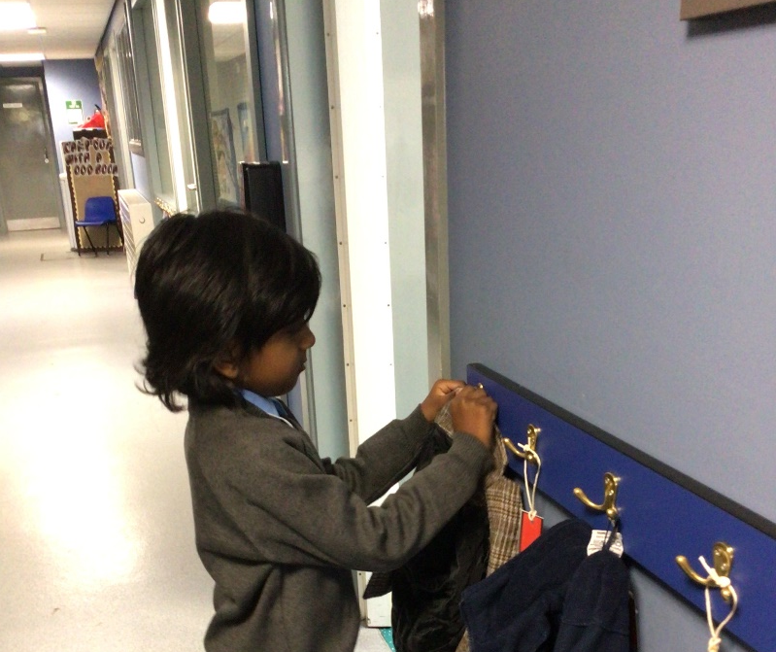
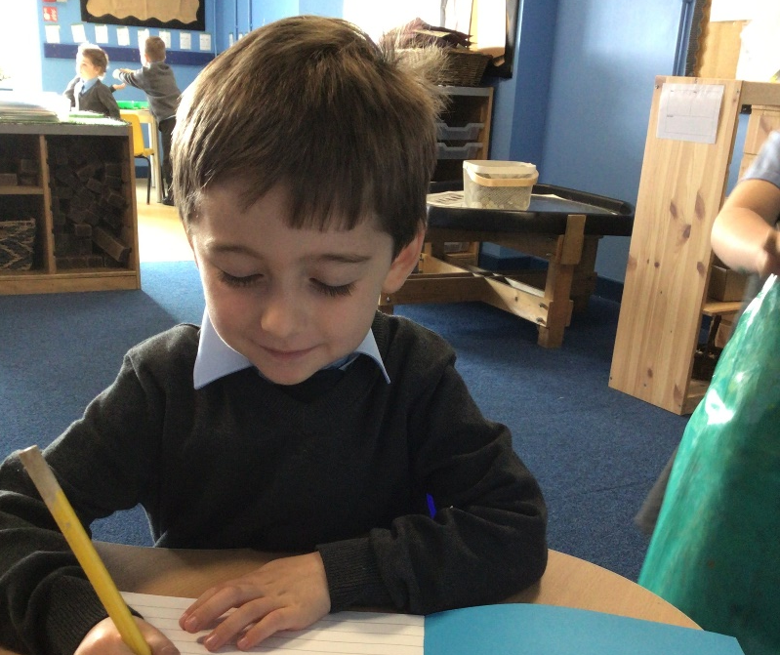
Morning routine
The children will quickly get used to a morning routine which will be as follows:
Say goodbye to parents on the main playground.
Reception class staff will welcome the children into the classroom.
Self registration – they will check in on our colour monster board to display how they are feeling.
Once we are settled and registered, we will join the rest of school for collective worship.
By doing this they have INDEPENDENTLY
entered their own classroom and started their learning.

Slide 14
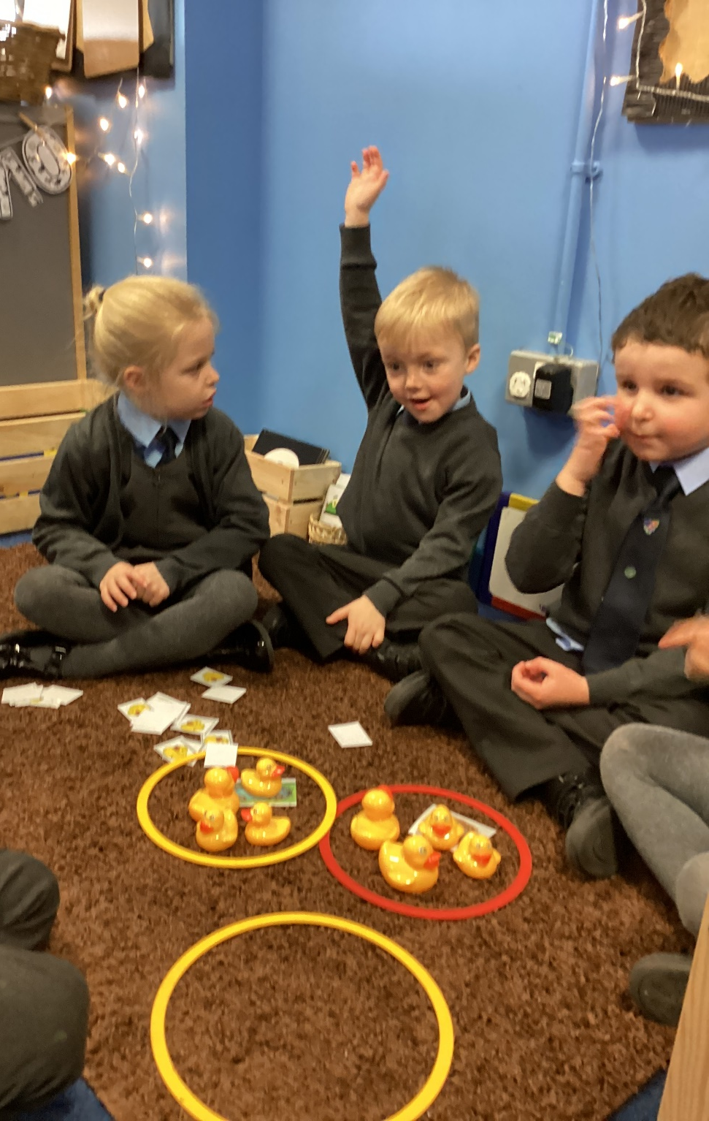
Behaviour and Expectations
The first few weeks and months will be spent settling children in, setting expectations and creating a whole class ethos and culture.
It will be incredibly nurturing and we will focus primarily on praise and reward.
We will celebrate children’s good behaviour and acts of kindness and helpfulness.
We will use our Christian values to encourage and show examples of good behaviour.

Slide 15
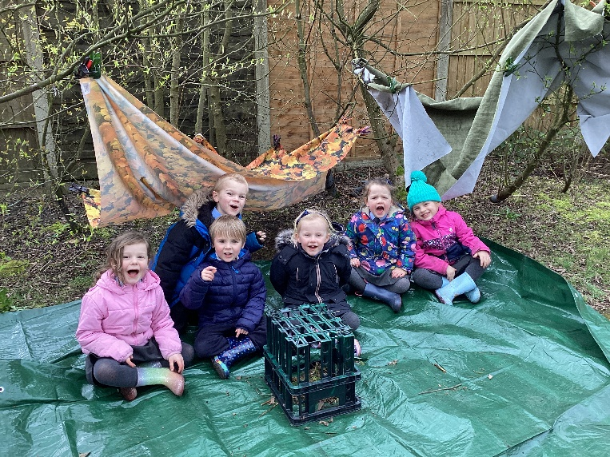
Independence
Is your child ready for school?
Independence IS KEY in Reception.
Encouraging independent individuals will build their confidence and their self esteem. They will feel really grown up and proud of themselves for doing something on their own

Slide 16
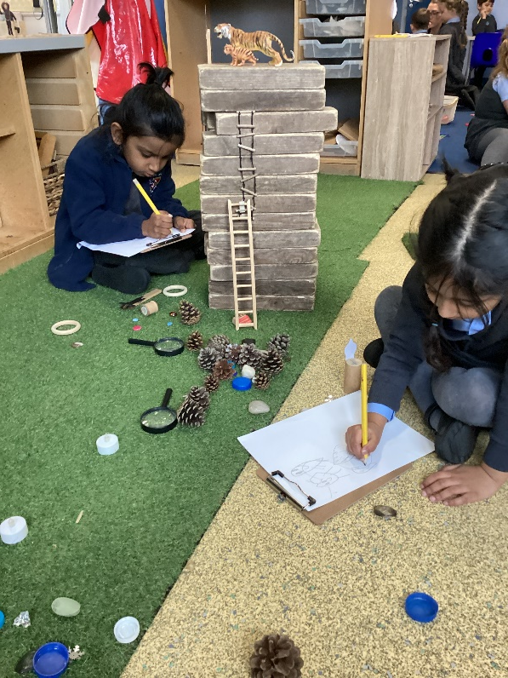
Expectations
Dress and undress
Communication
Go to the toilet independently
No longer have dummies, potties or bottles
Use cutlery and open cup at lunch time
Social skills
Have an established home routine. Including bedtime.
Notes:
Try to arrange play dates with other children starting at the same school. This gives your little one the chance to develop their social skills –
Let your child practise drawing with a range of different materials, such as pencils, crayons to help develop their fine motor skills
Encourage your little one to dress and undress themselves, and use the toilet independently.
Encourage your little one to have conversations with you – ask them questions, listen to their answers, and encourage them to talk about what they think and feel so they can express themselves with new friends and teachers.
Read with your child as often as possible. This will help language skills.
Help your child develop a basic awareness of numbers by helping out around the house – they could set the table and count the plates, match socks from the washing line, or measure the ingredients for some baking.
Play games with your little one – simple board games (like snakes and ladders) and card games (like snap and go fish) are great for practising turn-taking, sharing, waiting and learning to cope with not winning

Slide 17
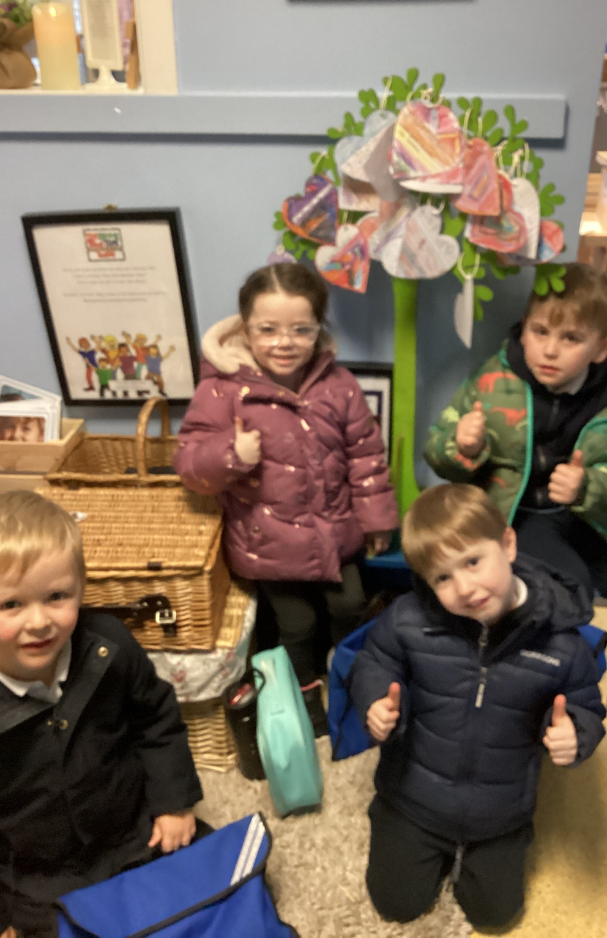
Thankyou for listening
We want to create the best possible start to your child at school. Parent partnership is incredibly important.
Email: L.Jennings@wheatleylane.epworthtrust.org.uk
Any questions?

