Slide 1
Year 4

Slide 2
Welcome
Mrs Hargreaves – Class teacher/SLT/Pastoral support
Mrs Pilkington – Teaching support
Mrs Chaffer – PPA/management time cover

Slide 3
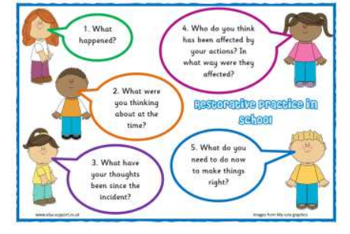
Rewards
Verbal praise and celebration of success
Class dojo
Every week, a child is chosen to receive a certificate because they have shown that they have worked well in an area of school life. These are presented to the children on Friday and their name and reason for being chosen is added to the news letter.
Behaviour
We expect and encourage good behaviour and self-discipline from all pupils in order to achieve an environment which enables emotional development, effective learning and high standards. We are restorative in our approach, using a range of methods and strategies in order to maintain positive relationships and we achieve this through visible consistency which is tightened through three simplified core rules:
Ready Respectful Safe

Slide 4
Reading
Reading is essential. Daily reading really helps your child with every part of their education. We suggest around 10/15 minutes every night, sat next to an adult who can talk things through when needed. Please write in their reading record book when your child has completed their book.
Reading bookmarks have reading prompts that we use in school so they are useful to use at home too.
A bed time story read by you is also such a key learning experience for your child as they have that quality time with you and you show them a fine example of how to read.
Changing books – We give the children an opportunity to change books when they need to.
Reading isn’t just about knowing the words, it’s also about understanding the words, so developing comprehension is a key part.

Slide 5
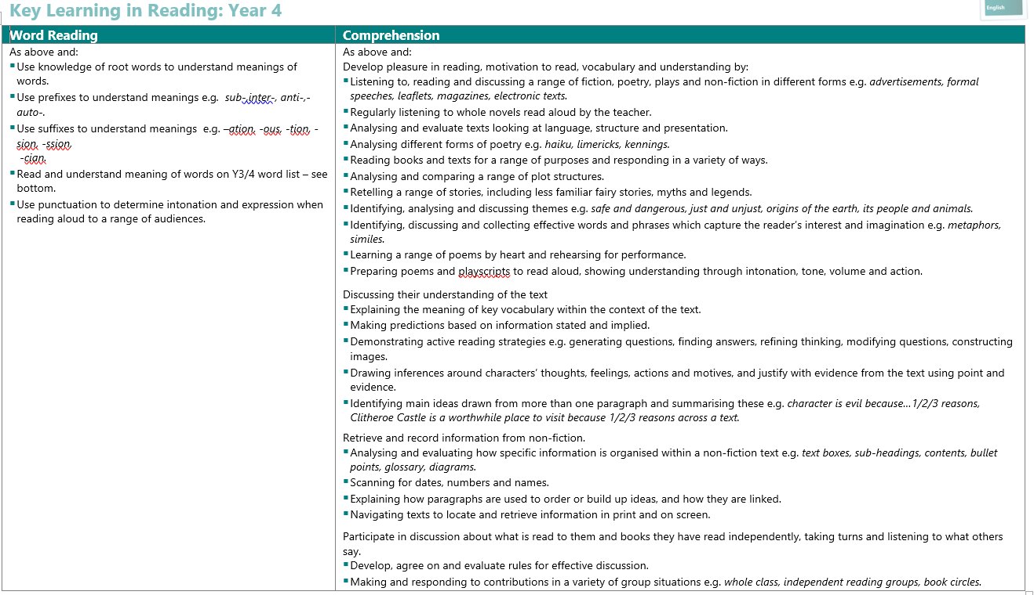

Slide 6
Writing
As with reading there are lots of skills needed to be a ‘good’ writer. Throughout the year we will be developing these skills, which we will then encourage them to use in school and as part of their homework.

Slide 7
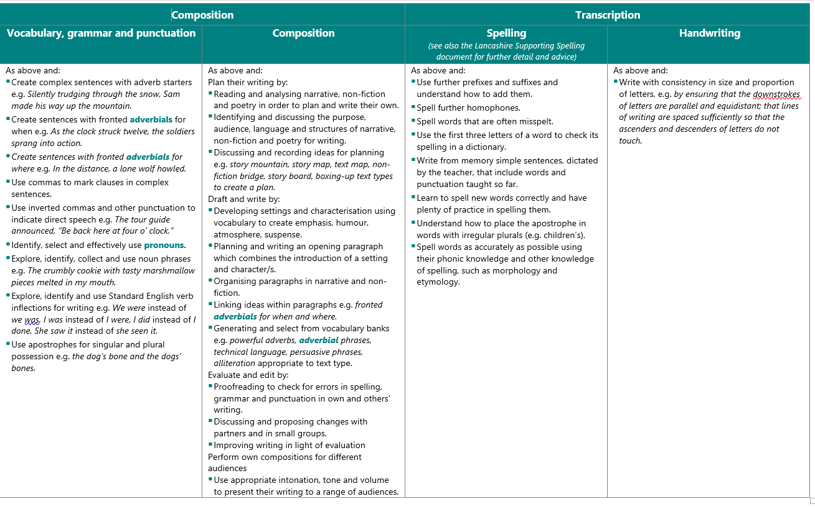
Writing

Slide 8
Maths
Your child will continue their maths journey and again your support and encouragement with activities they are asked to complete at home is key.
Times tables check
We do a timestable test in the summer term in Year 4. This tests their multiplication recall and speed of recall.
Please use the times tables Tock stars app to help as they need to be able to recall ALL times tables at SPEED and it will be a digital test so typing skills are essential too.
We have started in class – twice a day in a timed test.
There a lots of apps that can help them learn:
https://mathsframe.co.uk/en/resources/resource/477/Multiplication-Tables-Check

Slide 9
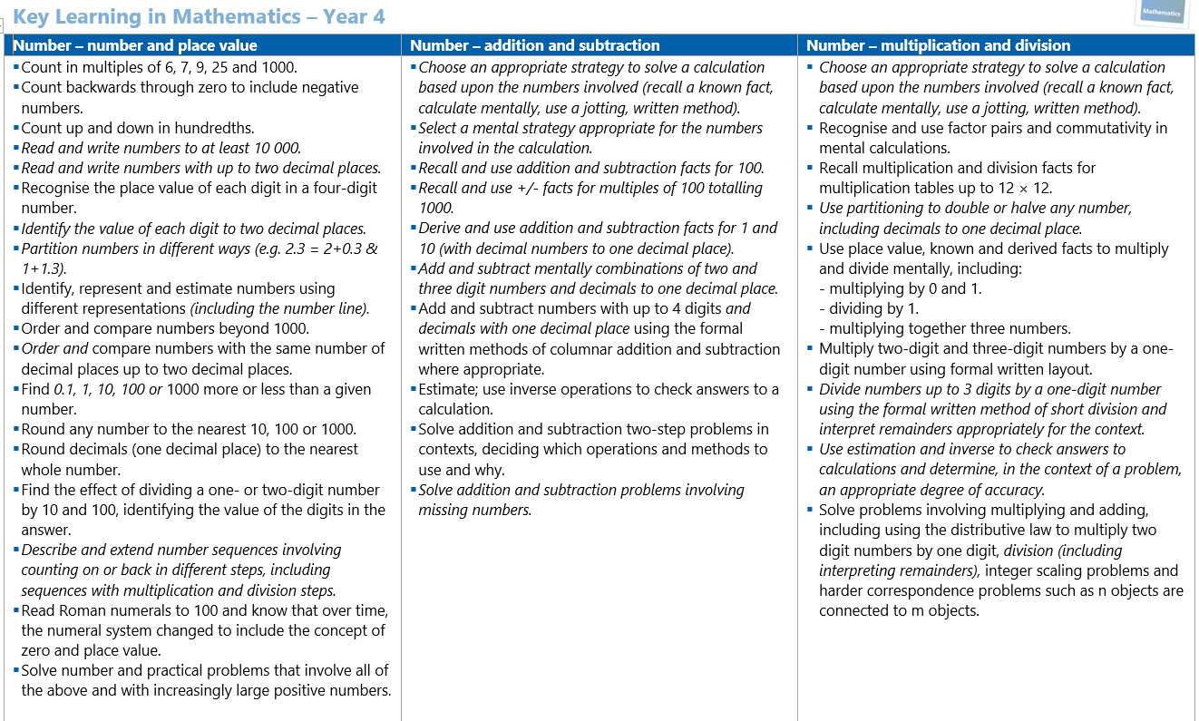
Maths

Slide 10
P.E.
We have P.E. every Monday and Thursday.
Please could your child come to school in a named P.E. kit?
Swimming after Easter (more details will follow)

Slide 11
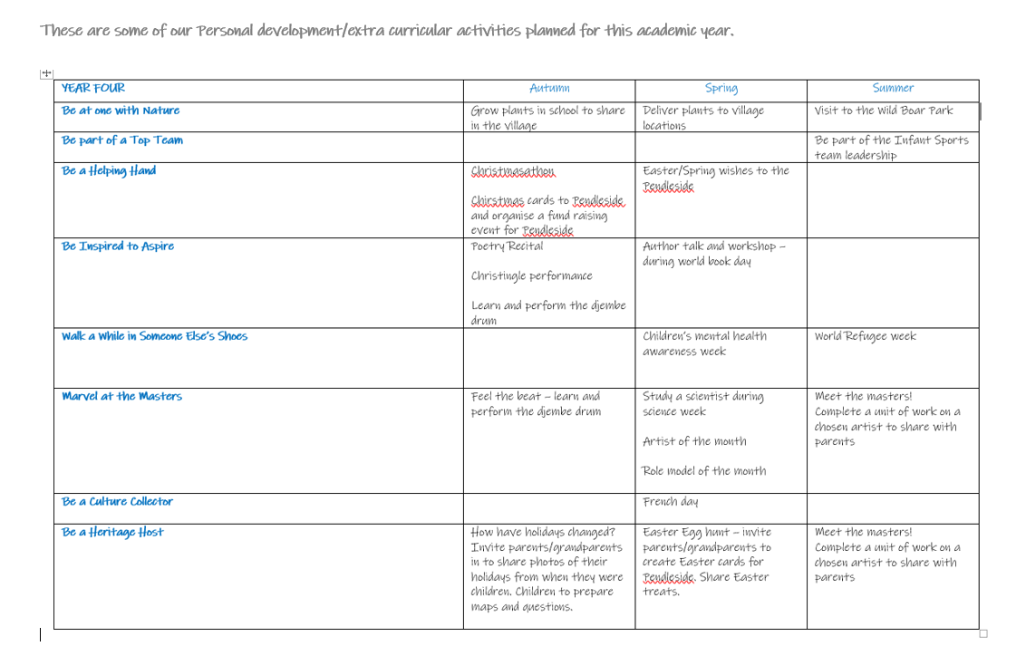
Personal development – Infinite 8

Slide 12
Homework
Homework is set on a Friday and should be completed by the following Friday or the specified date attached to the piece of work.
Try to look at the homework when it is set and then if your child has any questions they can ask and then have plenty of time to complete it.
Homework will normally include a times tables practice, spellings and Daily reading with occasional topic work.

Slide 13
Playtime
Children can bring a fruit snack for morning play.
Home time
Children will walk out on to the yard at 3.15pm. They will line up in their year group and can be collected from there. If they have younger siblings, they can be collected on the way.
If they attend after school club, they will walk down to the Rainbow Room where they will be met the AFC team.
If they are taking part in a club, they will be told where to meet and then at the end of the club, they will be brought up to the main entrance.
If you need to change any arrangements, don’t worry just inform the teacher or phone the office. (e.g. dental appointment, somebody different picking up)

Slide 14
Bags
When moving to Y4 the children have a coat hook to hang their coat, a trolley to place their packed lunch on and a drawer in the classroom to put their reading book in.
No bags please.
Water bottle
A named water bottle is important.
Children will be allowed to have their drink when they require. We encourage them to bring the bottle home each night to wash them out.
If they are on packed lunch, please can they bring a separate drink (which can include juice).

Slide 15
Uniform
Please can all uniform and P.E. kit be named? Children often take items of clothing off, like jumpers and cardigans, as the temperature in school changes and it is a lot easier to make sure each child goes home with the correct attire if items are named.

Slide 16
Thank you
Any questions?

