Slide 1
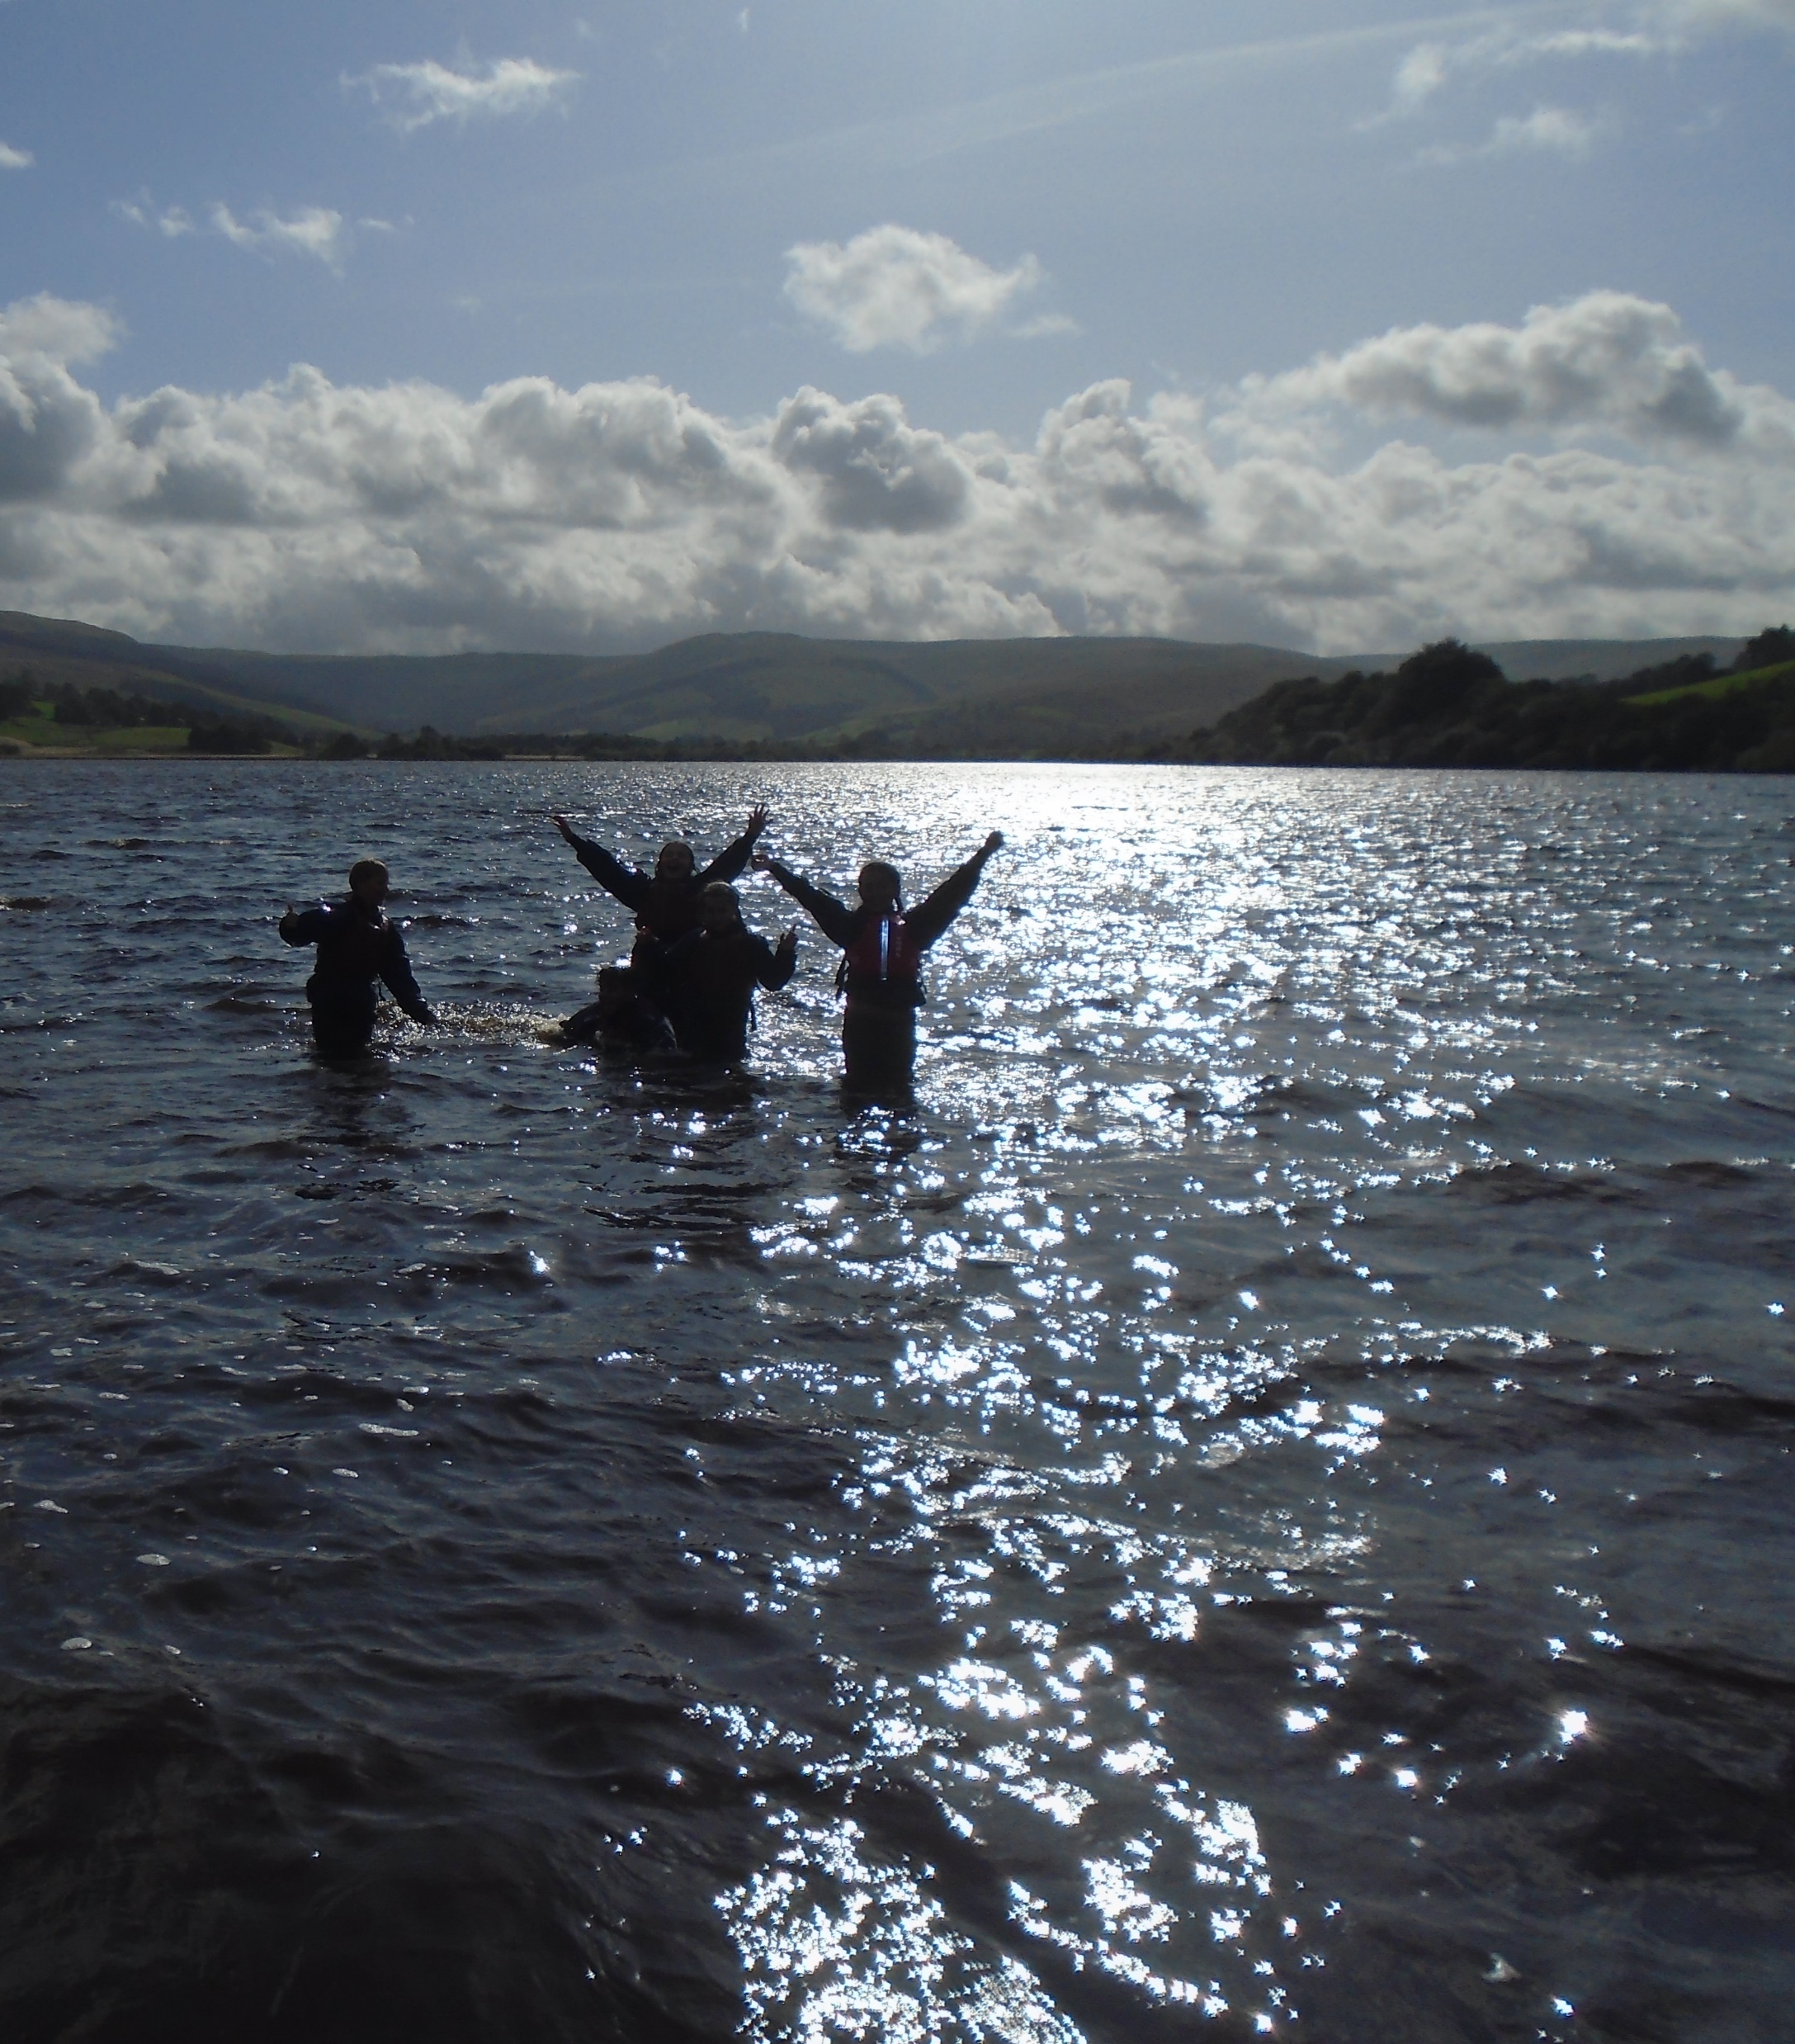
Welcome to Year 6!

Slide 2
Mr Latham
Mrs Latham (no relation!)

Slide 3
Curriculum – see Long-term plan

Slide 4
English
Reading
SPAG
Writing
S & L
1 lesson each day

Slide 5
Maths
Place Value, Calculation, Fractions, Decimals & Percentages, Ratio & Proportion,
Algebra, Measures,
Shape,
Position & Direction,
Statistics,
1 Lesson per day

Slide 6
Science
Evolution & Inheritance
Light
Animals, health & bodily systems
Classification
Electricity

Slide 7
History
The Census
WWII Impact
Significant People

Slide 8
Geography
7 Wonders
Population
Trade & Economics

Slide 9
Art
Painting
Drawing
Sculpture & Mixed Media

Slide 10
Design Technology
Electrical systems: Steady hand game
Structures - Playgrounds
Digital world: Navigating the world

Slide 11
Computing
Online safety,
Coding,
Quizzing,
Spreadsheets,
Blogs

Slide 12
R.E.
Life as a journey
Advent
Eucharist
Easter
Methodism
Ideas about God

Slide 13
Music
Develop Melodic Phrases
You’ve Got a Friend
Exploring Notation
Classroom Jazz
Music & Me
Y5/6 Performance

Slide 14
PSHE
Health & Well-being
Relationships
Living in the Wider World

Slide 15
French
At School
Regular & Irregular Verbs
Hobbies & Activities
Food & Drink
Bastille Day

Slide 16
General:
Reading – this is KEY. Children should aim to read at least five nights a week, even if just a couple of pages. Please then initial their reading record to confirm. This is part of our homework.
Other homework will usually be times tables or spellings
PE Kits – arrive in kits on PE days please.
Times Tables – important to know up to 12x12 – helps with fractions, percentages, area etc…etc…
Contact – catch me before school (around 8.40am) if it’s a quick question. Call the office otherwise and I will call you back to arrange further discussion. Don’t save your concerns for parents’ evening – that’s for updates on progress.

Slide 17

SATs

Slide 18
SATs
Myths:
“They’re really scary.”
“School piles loads of pressure on the children!”
“High Schools don’t put any value on them anyway.”
“I might FAIL!”

Slide 19
SATs
Facts:
They don’t hurt.
They ARE hard but all you need to do is try your best.
You’ll do better if you relax.
Having a sleepover the weekend before is a bad idea!

Slide 20
Parents, have a go at some SATs questions!!
Enjoy!

Slide 21
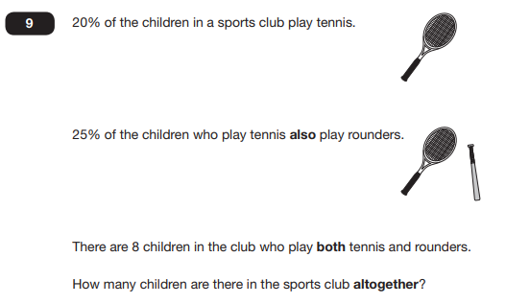

Slide 22
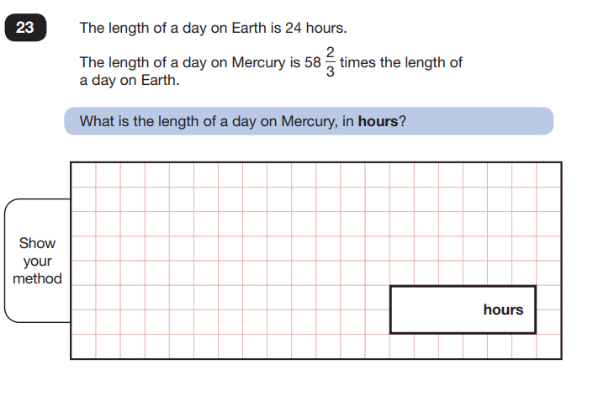

Slide 23
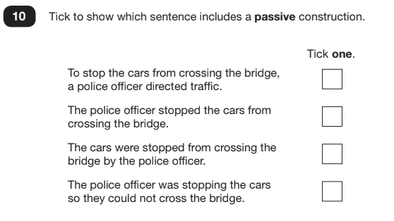

Slide 24
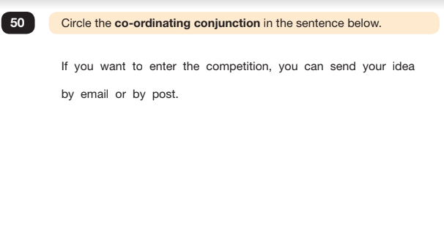

Slide 25
Thank you!
Any questions?
Please email.
c.latham@wheatleylane.lancs.sch.uk

