Slide 1
Welcome to phonics phase 5
​

Slide 2


What is phonics?
Phoneme: The smallest unit of sound in a word.
a
Grapheme: The letter or letters that represent the phoneme.
or
Digraph: two letters that make the same sound.
igh
Trigraph: three letters that make the same sound.

Slide 3
What will we be focusing on?
Segmenting
Blending
Smooth reading
Tricky words
Phonics screening test (including fake words)
Spellings

Slide 4
Further graphemes
ai
sail
rain
ow
cow
down
igh
night
fight
ee
sleep
feet
oi
foil
coin
ay
play
say
ou
sound
count
ie
died
lies
ea
sea
treat
oy
toy
enjoy

Slide 5
Further graphemes
er
flower
fern
oo
moon
fool
ue/ y(oo)
argue
rescue
oa
boat
coat
w
went
west
ir
girl
bird
ue
blue
true
aw
claw
fawn
wh
when
Which

Slide 6
Split digraphs
a-e (ai)
cake
mistake
shake
i-e (igh)
time
slime
five
u-e (oo)
flute
June
e-e (ee)
swede
theme
complete
o-e (oa)
bone
phone
stone
u-e (y(oo)
cube
mute

Slide 7
Alternative pronunciation for graphemes
i (igh)
find
mind
c (s)
cell
pencil
g (j)
ginger
danger
u (y(oo)
music
o (oa)/u
both
other
ea (e)
bread
head
ch (c)
school
chorus
a (o) (ai)
want
acorn
ow (oa)
snow
glow
ie (ee)
chief
belief

Slide 8
Alternative pronunciation for graphemes
e (ee)
remind
y (ee) (ie)
monkey
try
ou (oo) (u)
group
touch

Slide 9
Alternative spellings for phonemes
ee
ea
ie
e-e
y
e
ey
oo and y(oo)
ew
u-e
ue
ui
ai
ay
a-e
a
ey
eigh
ea
igh
I
ie
i-e
y
i
oa
ow
oe
o-e
o
ol
oul

Slide 10
Alternative spellings for phonemes
ow
ou
ough
ar
a
al
or
aw
au
oor
ore
al
our
oar
augh
ough
ur
ir
er
or
ear
u
oo
oul

Slide 11
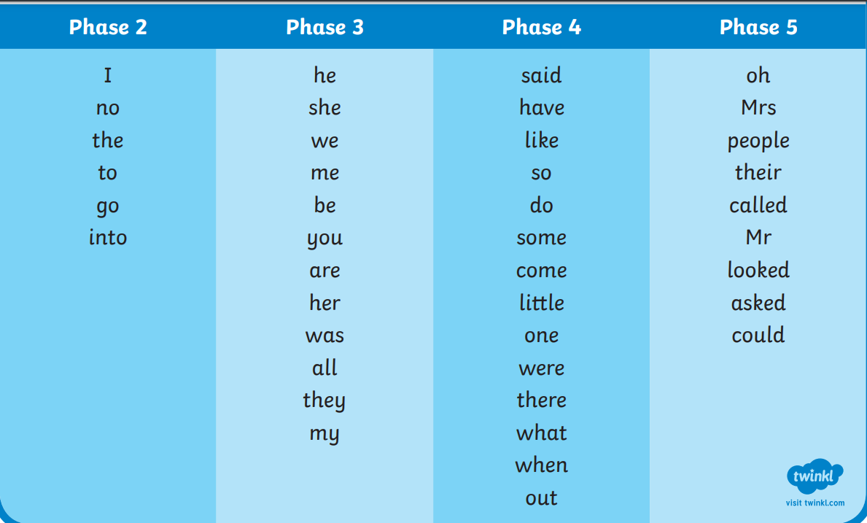
Tricky words

Slide 12
Spellings
Spell the days of the week
Adding –s and –es
Use the prefix un-
Use suffixes –ing –ed –er –est
We also have areas of grammar that we need to learn, pronoun I, capital letters, full stops, question marks, exclamation marks

Slide 13
What can you do at home?
Read little and often their phonics books (these will be changed Monday and Thursday).
We encourage you read each book 2-3 times to support fluency and accuracy with reading. (Also supports comprehension).
Practise the tricky words and graphemes/phonemes that are sent home each week.
Any questions/problems then please do get in touch.
Thank you

