Slide 1

Welcome to Year 1

Slide 2
Year 1 Team
Mrs Abbas – Teacher
Mrs Smith – Teaching Assistant/welfare/ PPA
Mrs Salmon – Teaching Assistant
Mr Dugdale – Teaching Assistant

Slide 3
Rewards
Verbal praise
Special award
Class Dojo
Pom-Poms in the jar

Slide 4

Behaviour

Slide 5
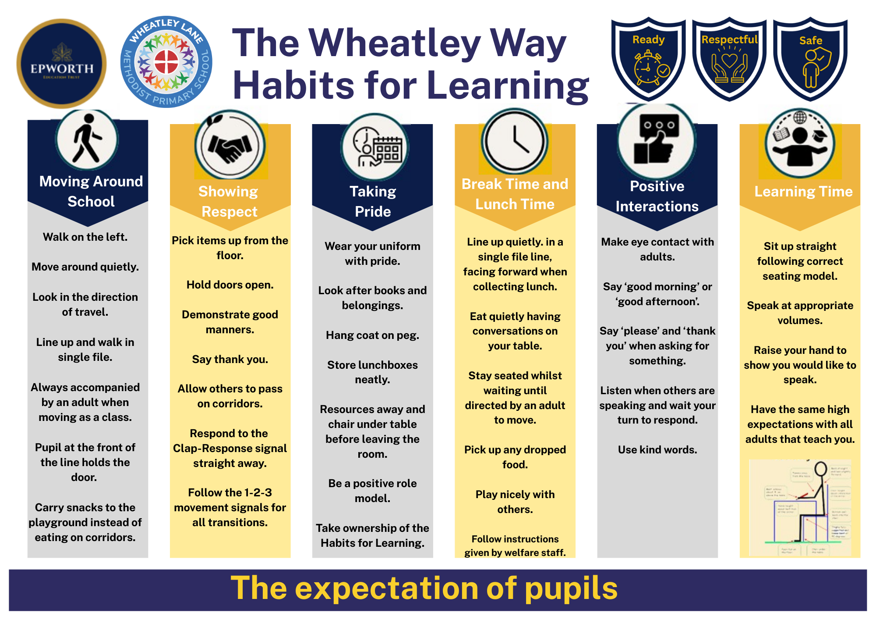
Behaviour

Slide 6
Curriculum
National Curriculum 2014
12 subjects
Assessed against ‘age related’ expectations at end of year
Assessments
Phonics screening in June

Slide 7
Curriculum
English
Maths
Science
Phonics
Design Technology
Art
Music
Computing
History
Geography
PE
RE
PSHE
Long Term Plan can be found on the website

Slide 8
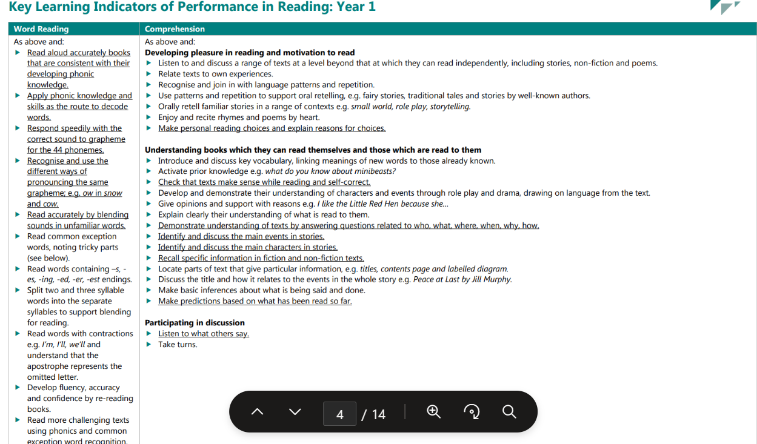

Slide 9
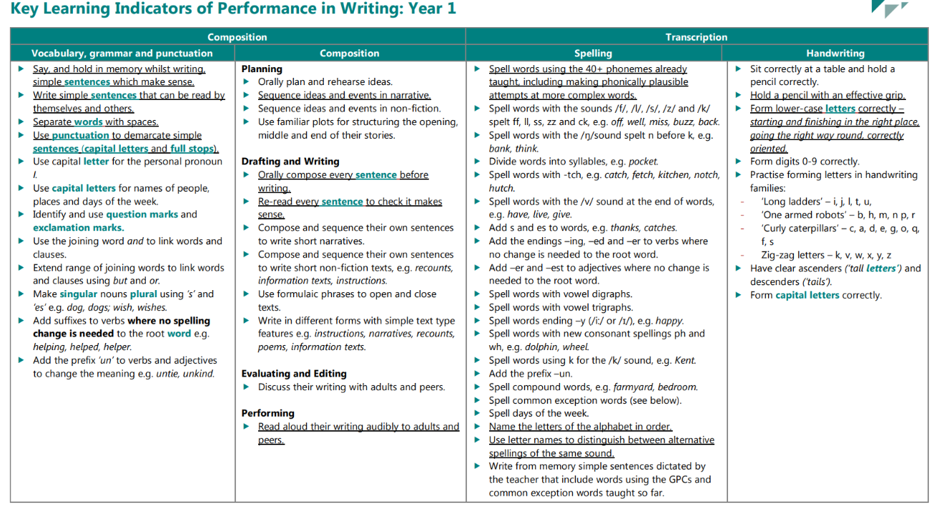

Slide 10
P.E. Days
Mondays and Wednesdays

Slide 11
Daily routine
8.40 – 8.50 Come in to school, put all items away and complete a fine motor skills activity
8.50 - Worship
9.15 - Run on the track
9:25 - English
10.30 - Playtime (milk and fruit)
10.45 - Maths
12:00 - Lunch time
1:00 - Phonics
2.00 - Playtime (afternoon snack)
2.15 - Subject (Art, History, Science etc)
3.00 - Story
3.15 - Home time

Slide 12
Reading
We expect all children to be reading everyday.
Reading books are changed on a Monday, Wednesday. Please listen to your child read everyday.
Sharing books are changed on Friday. This is to increase a pleasure of reading. Therefore, some children may bring a book home that they can’t read themselves. This is for you to read with them.
Comprehension is important. Please ask your child questions about what they have read.
Please note when you child has read inside of their reading records.
We will tick the reading robins each time your child has read

Slide 13
Spellings
The children will bring home a list of spellings to learn.
At the front of their spellings book, you will find some tips on how the children can learn their spellings at home.

Slide 14
Online Safety
We will be covering online safety every term.
Please have open conversations with your child about how to stay safe online.

Slide 15
Key reminders
Named uniform
Waterproof, thick winter coat
Book bag
Water bottle
Afternoon fruit/ veg snack
To read every night, even if only a page or two

