Slide 1
Welcome to Year 2.
New Parents meeting.
Autumn Term 2024
Mrs Hargreaves and Mrs Chaffer/Mrs Shaw

Slide 2
Meet the teachers
Class teacher – Mrs Hargreaves
Teaching Assistant – Mrs Chaffer/Mrs Shaw
Teaching support – Mrs Longmire.
Mrs Chaffer will be supporting class teaching daily and carries out reading interventions – including those that are working towards the standard and those that are exceeding the standard.
Mrs Chaffer/Mrs Shaw supports the maths and English teaching in the morning sessions and does 1-1 interventions in the afternoon sessions for those that have been recognised as needing a bit extra support to achieve the learning intention in Maths and English.
Mrs Pollard (now in EYFS) and myself are part of the Emotional and Wellbeing Support term. This means we are trained in giving children strategies to help their emotional literacy and deal with their emotions – especially when they become overwhelming.
Mrs Chaffer will be teaching every Thursday in Year 2. She will be teaching Maths, Phonics, English, Computing and P.E. in the Autumn term. Mrs Longmire will be her TA support.

Slide 3
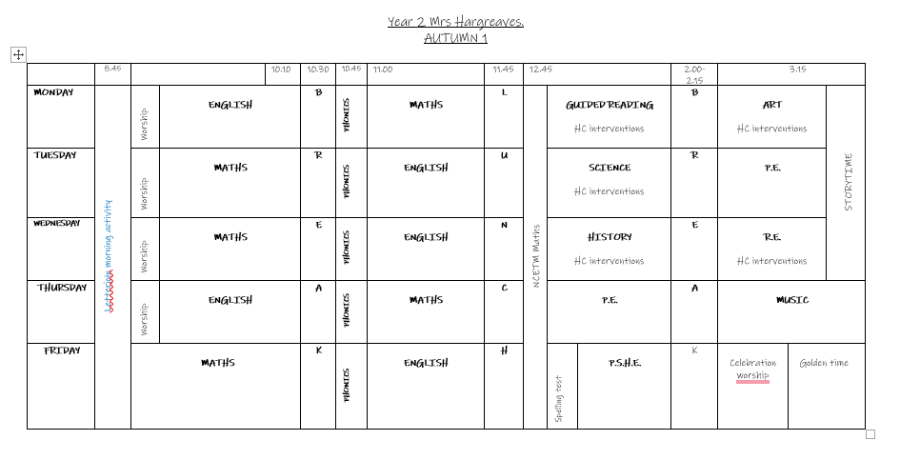
A typical day in year 2.

Slide 4
P.E days.
These may change termly.
Wednesday
Thursday

Slide 5
Independence
Independence IS KEY in year 2.
Encouraging independent individuals will build their confidence and their self esteem. They will feel really grown up and proud of themselves for doing something on their own.
The children are capable of carrying their own belongings at the start and the end of the day. Creating organised individuals helps in the long run – when they are starting to do more jobs around the house for you, making their own bed, to when they are going to high school and packing their own bags and managing their own timetables. Start with little things now that helps them to be independent and organised in their own right.
Let the children carry their own book bag, their own water bottle.

Slide 6
Check in and reading routine.
The children will quickly get used to a morning routine which will be as follows:
Self registration – they will put their named peg on the emotion card for how they are feeling that morning – it might be that they are feeling tired, or grumpy, or excited, or happy – these are all normal emotions – but we are encouraging them to recognise how they are feeling. We will check in with those that have identified that they are feeling anything that we might feel that they need support with.
We will be encouraging the children to check out at the end of the day as well so that we can monitor how their emotions change.
They will then CHANGE THEIR READING BOOK INDEPENDENTLY AND PUT THEIR OLD BOOK BACK IN THE CORRECT BOX, PUT THEIR NEW BOOK IN THEIR BOOK BAG AND PUT THEIR BOOK BAG IN THE YELLOW BOX.
They will then sit down in their morning places to complete a morning task that is on the whiteboard and is related to our days learning.
By doing this they have INDEPENDENTLY entered their own classroom and started their learning.

Slide 7
Weekly routine
Their book bag will have their reading book and reading record and with a star page which we will tick.
Homework is set on the Friday for the following Friday. We have a homework book so we can reward the children for completing their homework.

Slide 8
Daily reading
We encourage the children to read, read and read some more!
The star tick sheets that are put in their reading record is to incentivise the children – if they hand their book bag into the book box daily then we tick one star and then when they have all the stars ticked they get a big clap, we celebrate their wonderful reading with some party music and they get a prize from the prize box.
Daily reading really helps the children to read fluently, read without decoding, read at speed, read with intonation and to understand what they are reading – to infer – these are some of the KEY SKILLS in the year 2 Assessment framework which the children have to achieve to reach ‘expected’.
We can honestly say those that read every day and read a variety of texts do achieve better in their reading. We know it is a hard slog to do that every day –but your hard work will pay off.
Each week, on the homework, I will refer to the reading card and what questions to use with the reading. This will be linked to what we are doing in class - so it just helps if you use this with their reading book as they are getting consolidation of the learning.

Slide 9
Homework
The children have a homework set every FRIDAY.
The homework will usually be spellings to learn and then an additional task related to the following or previous weeks learning.
The spellings are linked with our phonics. Phonics is taught every day.
By doing 5 minutes spelling learning every day you are consolidating their class learning – an example of an easy way of doing this is to choose 2-4 words a night, get them to write the spelling words on post it notes and you ‘post’ them around the house. They hunt the word that you say, when they find it they read it, spell it, check it, use it in a sentence.
READ–COVER–SAY-WRITE-CHECK
Reading cards
Edshed

Slide 10
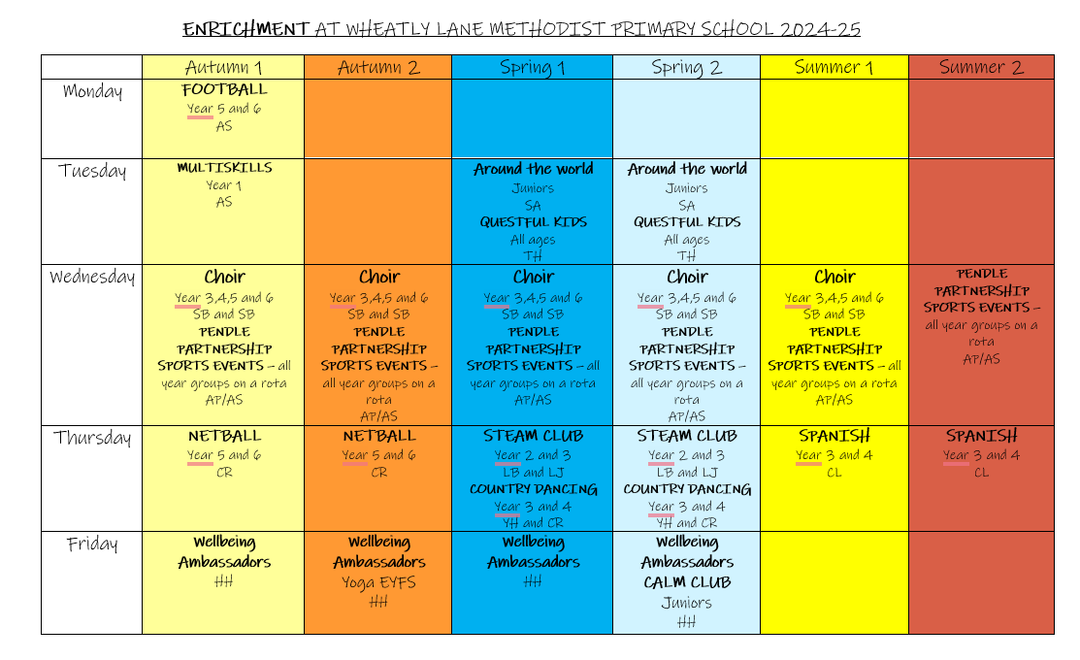
Enrichment

Slide 11
Supporting your child’s learning in MATHS
Some key skills you can work on to support your children could include:
Quick recall of number bonds to 10 and 20
Counting on and back in 2s, 5s and 10s
Place value knowledge – how many tens in 359?
Handling coins to £1.00 – making amounts using different combinations of coins
Telling the time to o clock and half past confidently
This is how we add and subtract using ‘sticks and spots’ so they have a written method to work out TU+TU or TU-TU calculations.
DEMONSTRATION.

Slide 12
Supporting your child’s learning in reading
Children have a daily reading record in which comments about reading are recorded – please read with your child and write in the reading record regularly.
Encourage reading of a range of different genres – magazines, reports, non fiction, board games questions – not just their school reading book.
Please continue to have a ‘bedtime or shared’ reading time where you model reading to your child – introduce chapter books and then you can talk about the previous chapter before that session’s reading begins – good for recall.
Encourage your child to read to younger – or older – siblings. If they think they are the expert they rise to the challenge and put on their ‘best reading voice.’

Slide 13
Supporting your child’s learning in writing
Writing includes vocabulary, spelling, punctuation, grammar and handwriting – so it is BIG!
When talking with your child, encourage and model correct pronunciation and grammar – if they hear it correctly it helps them to say it properly, if they say it correctly it helps them to write it correctly.
Check for correct letter formation.
Give opportunities for everyday writing – eg notes for you, shopping lists, birthday cards, reminders for daddy and such like.

Slide 14
Learning beyond the classroom
Talk to your child about what they have done at school and at school – they might say nothing – then encourage them by saying Mrs Hargreaves has asked you to tell me about one lesson that you have done today though so you have to tell me all about it – if they still say nothing then let me know the next day!!!!!! I will remind them what they have done for the following day! Ha Ha!!
When they have done something out of school – what could they share with the class? We don’t do ‘show and tell’ but if they have done something extra special then it is good to get them to share this with others and it gives them an audience and builds confidence..
Work towards INDEPENDENT ORGANISATION FOR SCHOOL AND HOME – put books back into their book bag, bring PE bags home on a Friday to wash, Put shoes in the ‘cleaning place’ – lay the table, clear the table, make your bed – whatever works in your house.

Slide 15
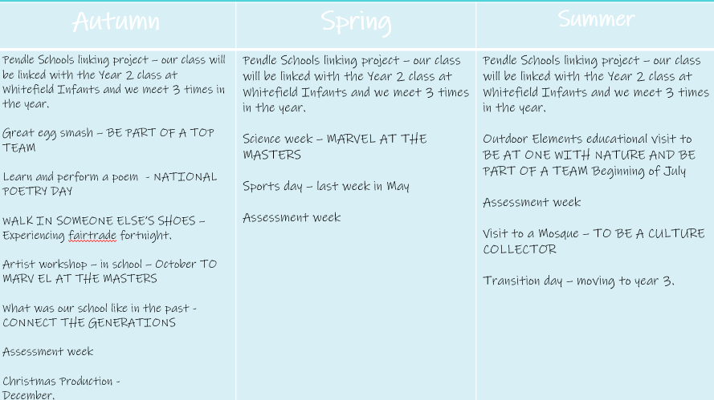
Key events in the year 2 calendar

Slide 16
SATS – Standardised Assessment Tests - changes
All children in Year 2 and Year 6 completed STANDARDISED ASSESSMENTS TESTS in May. These are now optional for year 2.
Assessment weeks in the Autumn, Spring and Summer term are being introduced across the school.
Children complete 2 maths papers – an arithmetic and reasoning paper, 2 reading papers – comprehension of the text, 2 writing papers – a spelling and a grammar punctuation and spelling test.
In addition they are assessed on their independent writing through moderated teacher assessments.
In Year 2 the children also have an assessment framework for reading, writing and maths which works alongside their tests.
The assessment framework - now used as guidance only as it is now non statutory - has a number of statements that we have to provide evidence of the children’s independent work against each statement.

Slide 17
ASSESSMENTS
Any assessments are not for you or your child to be worried about.
They are a standardised test that we work towards and we get the children prepared and confident to sit.
They help to build a full and accurate picture of which level your child is working at.
But…… they are not the be all and end all!!
Assessments are not what your child’s whole education is all about – it is a part of their education that helps them to realise what potential they have, what resilience they have in doing something that is tricky and how far they have come in their learning since they started in nursey – they feel proud of their achievements at the end of the week – brilliant for their self esteem!

Slide 18
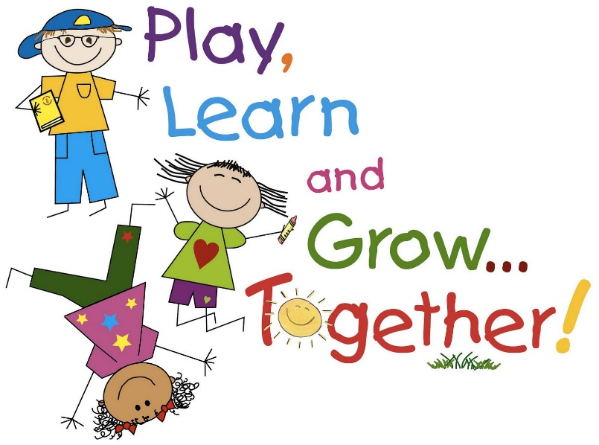
Any questions?
We are here after school to catch us if there are any issues or you can write a little note in their reading record.
Thank you and we look forward to spending a very busy, challenging but rewarding year for your children with them.
This Photo by Unknown Author is licensed under CC BY-NC-ND

