Slide 1
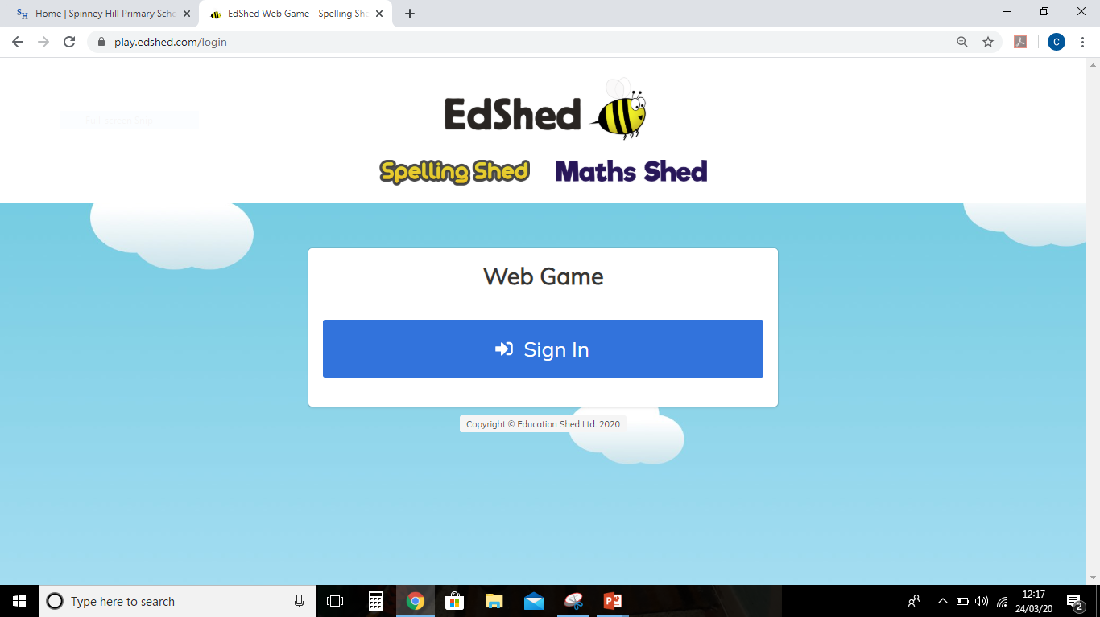
Go to https://play.edshed.com/login and click Sign in.

Slide 2
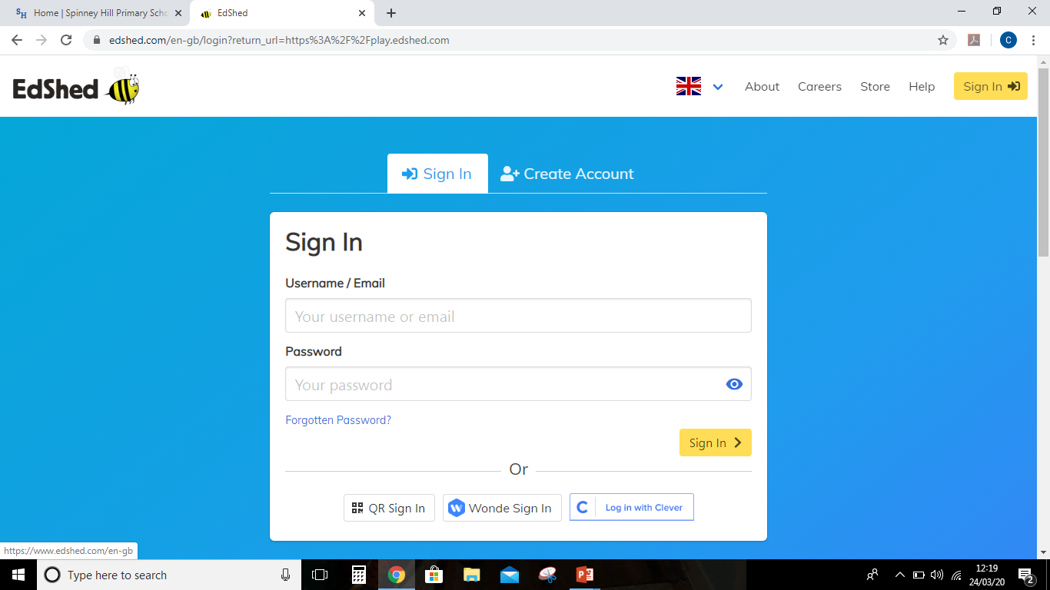
Sign in with the username and password given to you by your teacher.

Slide 3
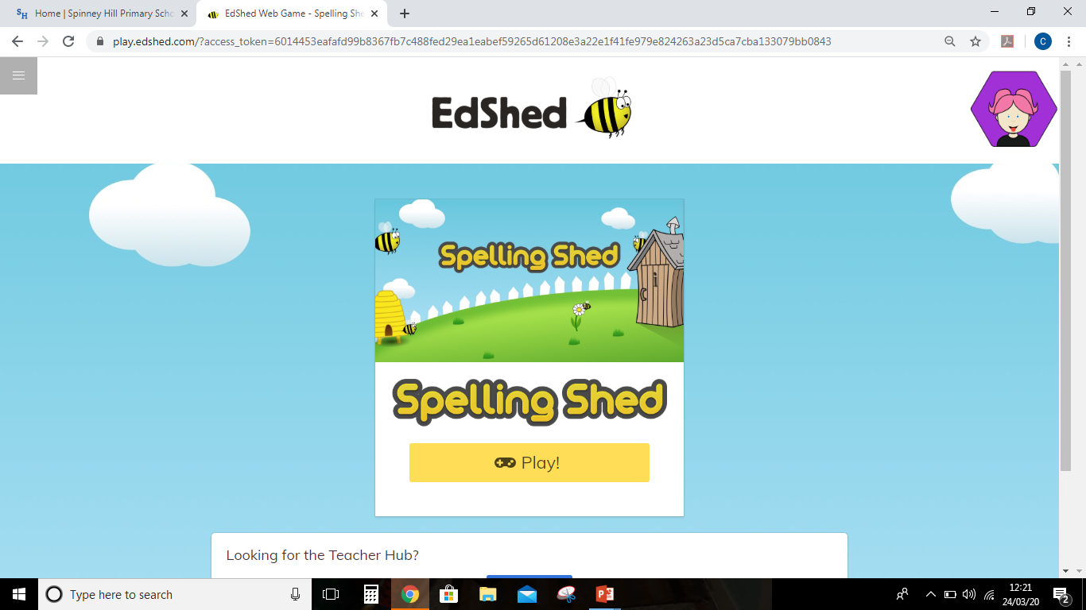
Click play to enter Spelling Shed.

Slide 4
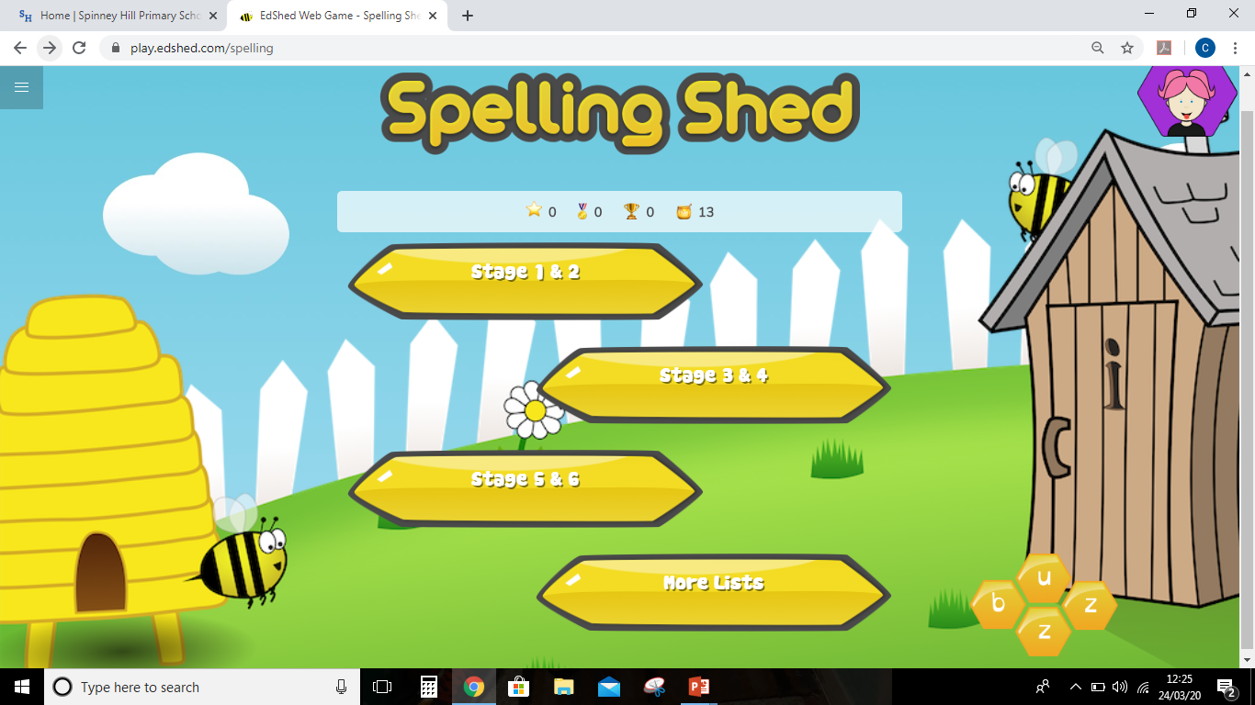
Each Stage represents a year group. So stage 1 is year 1, stage 4 is year 4 and so on.
Select your stage to practice the key word spelling list for your year group.
Select more lists to find the assignments set by your teacher.

Slide 5
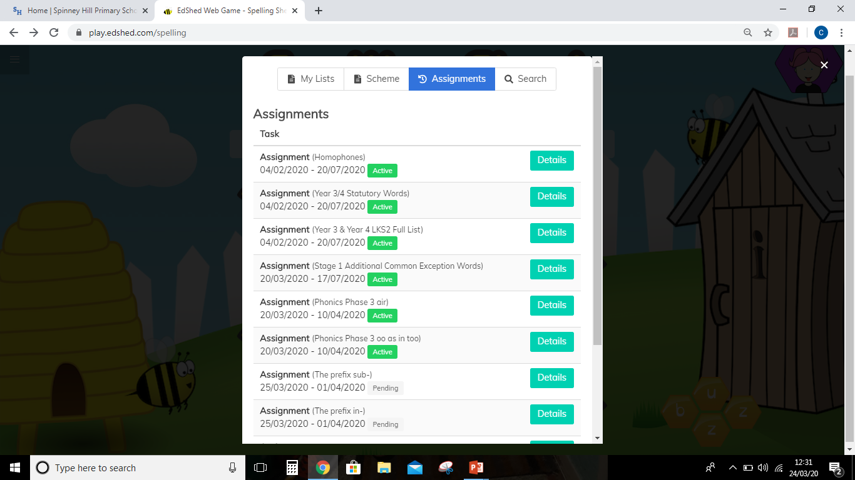
Select the assignment tab.
The assignments you can play will have a green ‘Active’ tab next to them.
Click the details button, next to the assignment, to see the words you will be learning.

Slide 6
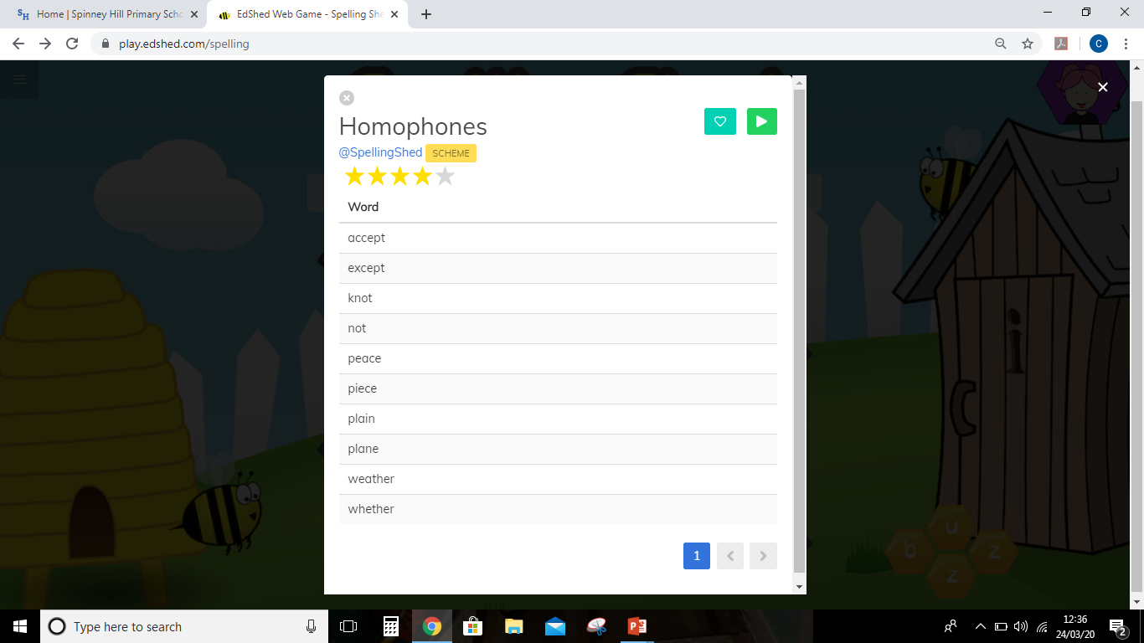
Click the green play button to access your game.

Slide 7
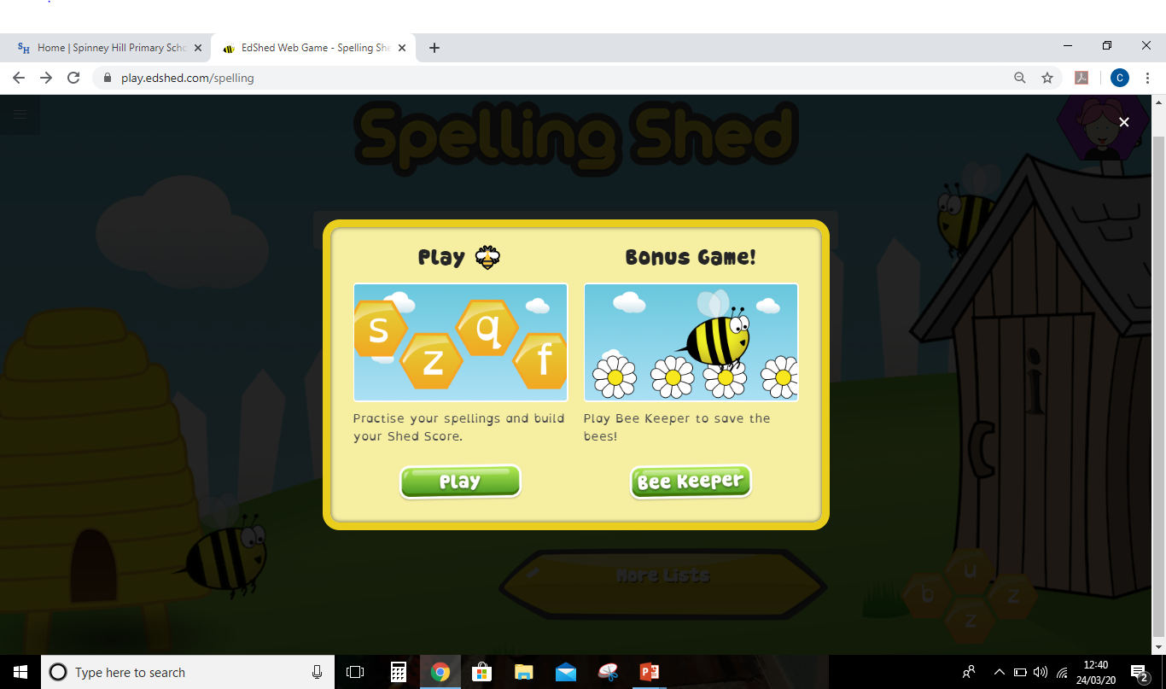
Select the type of game you want to play.

Slide 8
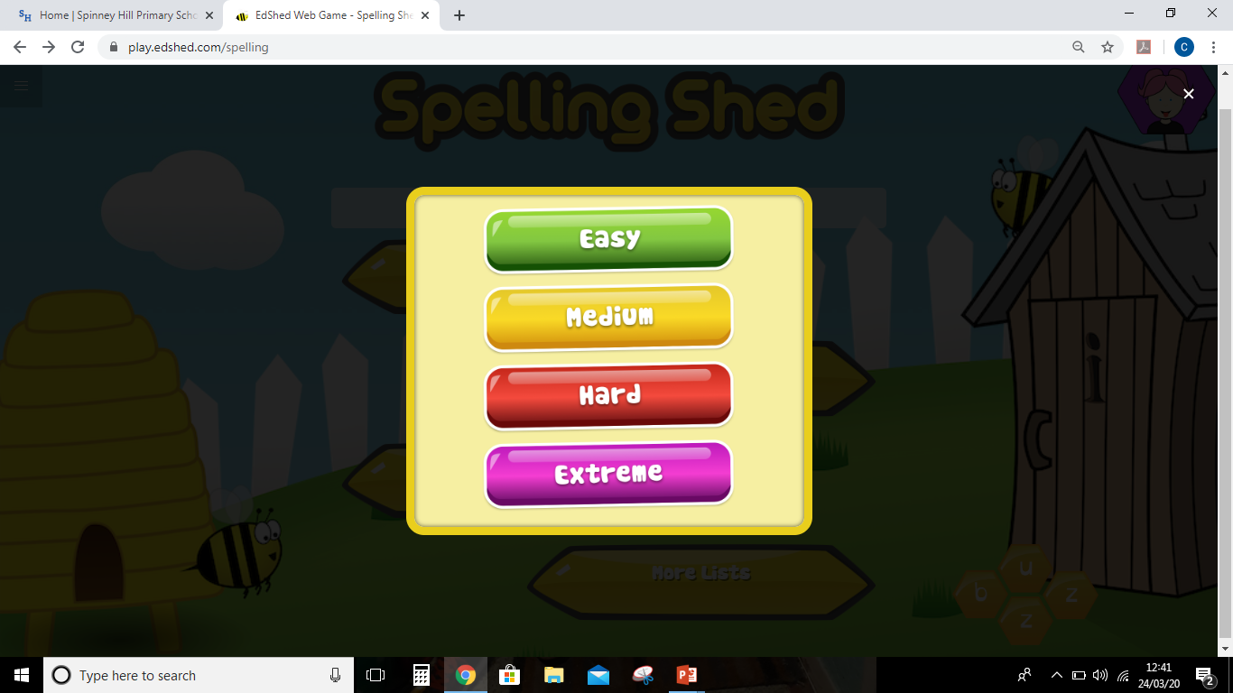
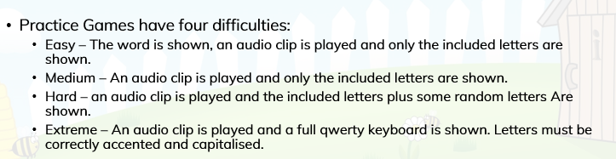
If you select the practice game select your level of challenge. Then off you go!

Slide 9
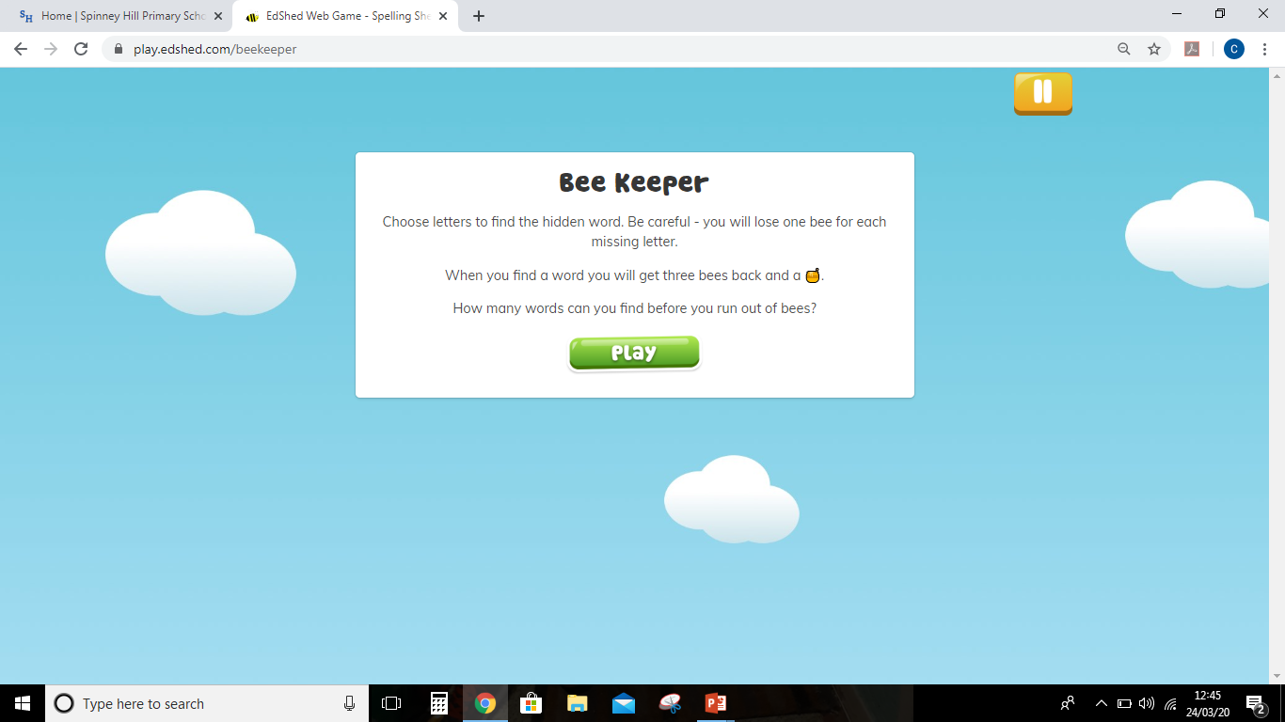
Or maybe you’d prefer Bee Keeper.
Make sure you follow the on screen instructions.

Slide 10

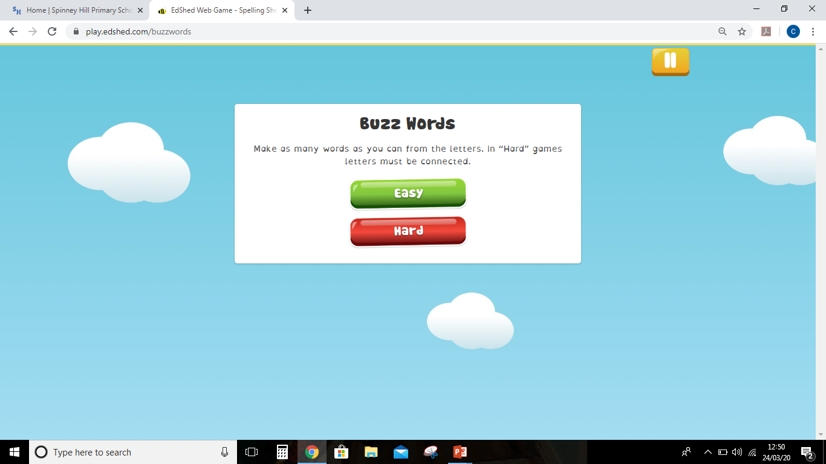
For a fun challenge, select Buzz on the main page. Spell as many words as you can using the letters you are given.

Slide 11
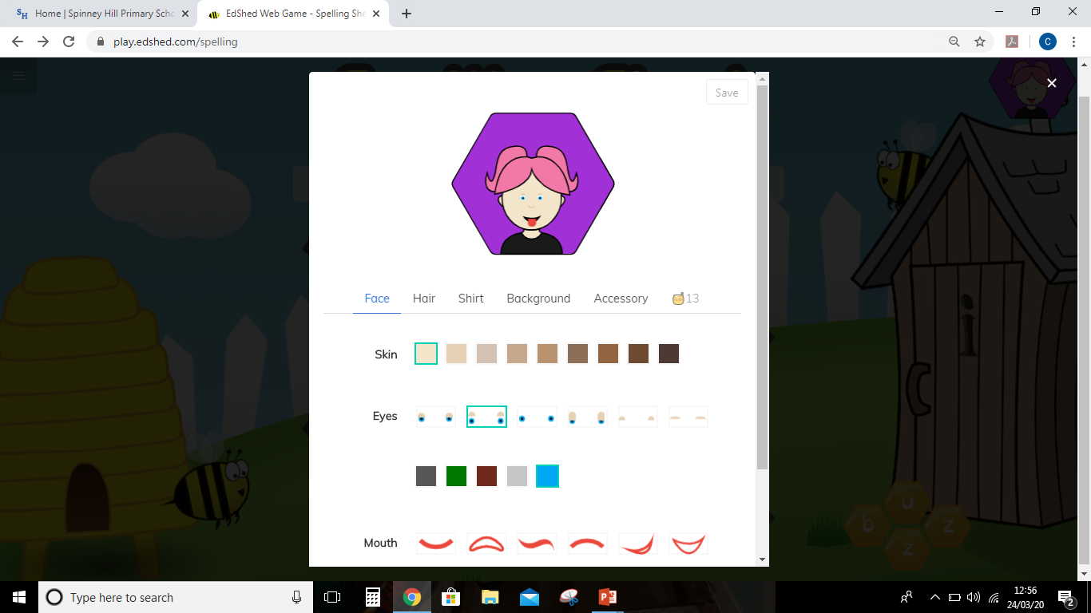
Use the Honey Pots you earn to personalise your avatar.

