Slide 1
Early Reading
EYFS Reading workshop

Slide 2

Teach your child to love books!

Slide 3
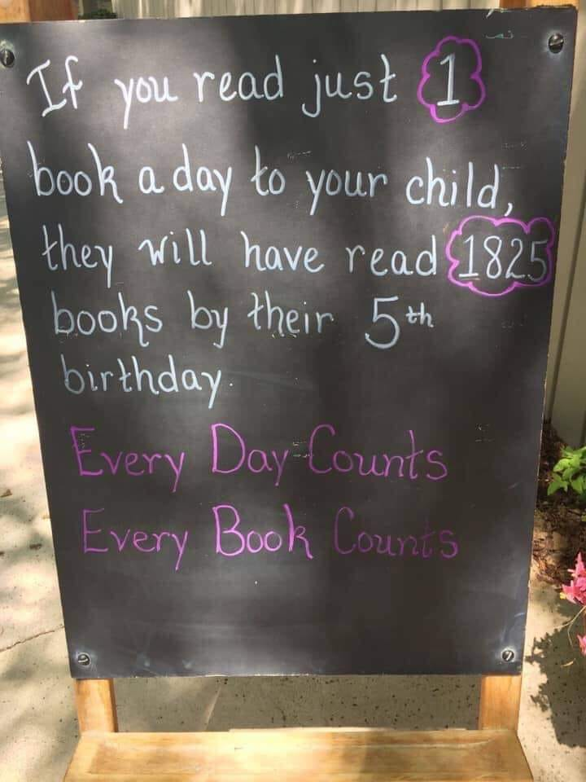

Slide 4
Three part reading!
1. Pictures, language inference and context
2. Phonics (decoding)
3. Tricky words

Slide 5
Pictures, language, context and inference….
Talk about the pictures
The language they need is often there
Develops comprehension and inference
Provides the backbone to the words they then try to decode
Gives them chance to use language richer than that they are decoding
Ask… who? what? where? when? why?

Slide 6
Phonics
Synthetic phonics each letter has a name and a corresponding sound
Specific unit of sound (no exaggeration!)
Letters and sounds phase 1 - 4 in EYFS
Teach letter name/ sound along with action along with sound in words
Blending and segmenting
Phase 5 Year 1 / Phase 6 Year 2

Slide 7
Common exception words
Words that do not follow phonetic rules and do not sound as they look!
Need to be learnt by sight
Memory, memory, memory!
Will really support fluency of early reading
Tricky word bookmarks

Slide 8
Reading routine
Daily
Short period of quality time
A time that works for you and your child
Should be fun
Not too tired
Put short comment in the reading record
Our reading routine in school changing books and guided reading
Please, still read to them

Slide 9
Reading online resources
Rising stars online books and activities
Monster phonics
Phonics play
Letters and Sounds

Slide 11


